Slide 1
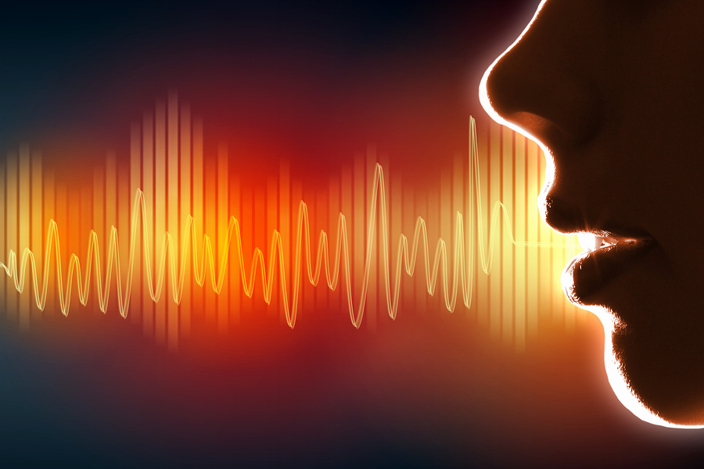
Voice Inflection

Slide 2
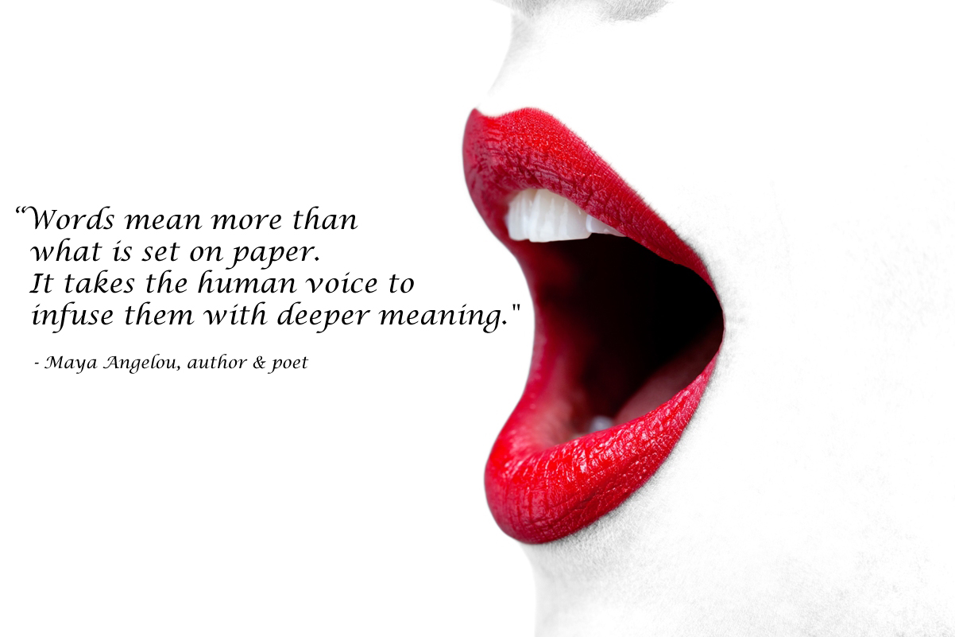

Slide 3
Voice Inflection
1. What is it?
2. How does it affect our speech?
3. Can we recognize it?
4. How can we use it successfully?

Slide 4
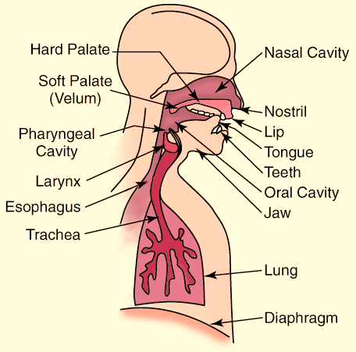
V
O
I
C
E

Slide 5
6 Warm-up Exercises
Stretch and Sigh
Baw (x6)
Bbbbbbbbbb (x3)
LALA (X6) + LA!
RRRRRRRR
Weeee---Awww (x3)

Slide 6
Voice Inflection
What is it?
“Voice Inflection means changing your voice.” (p. 28)

Slide 7
Voice Inflection
2. How does it affect our speech?
“I did not say he stole the money.”

Slide 8
 | Inflected Sentence | # | Actual Meaning
1. | I did not say he stole the money. |  | Someone else could have said it.
2. | I did not say he stole the money. |  | I just didn’t say it.
3. | I did not say he stole the money. |  | I certainly did not say it.
4. | I did not say he stole the money. |  | He could have stolen the money, but I didn’t say that he did.

Slide 9
 | Inflected Sentence | # | Actual Meaning
5. | I did not say he stole the money. |  | It could have been any other person who stole the money, but not him.
6. | I did not say he stole the money. |  | He could have borrowed, or been given the money…but he didn’t steal it.
7. | I did not say he stole the money. |  | I didn’t say he took the very specific money.
8. | I did not say he stole the money. |  | I didn’t say he stole the money, but he stole something else.

Slide 10
Voice Inflection
2. How does it affect our speech?
Now practice:

Slide 11
Voice Inflection
3. Can we recognize it? (see page 28-29)
Stressing a word or phrase
Stretching a word or phrase
……….
Pausing before or after a word or phrase

Slide 12
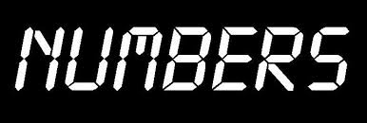
Voice Inflection
4. How can we use it successfully?
(see pages 30-31)

Slide 13
Voice Inflection
4. How can we use it successfully?
Now practice:
{pages 32-35}

Slide 14
Voice Inflection
1. What is it?
2. How does it affect our speech?
3. Can we recognize it?
4. How can we use it successfully?

Slide 15
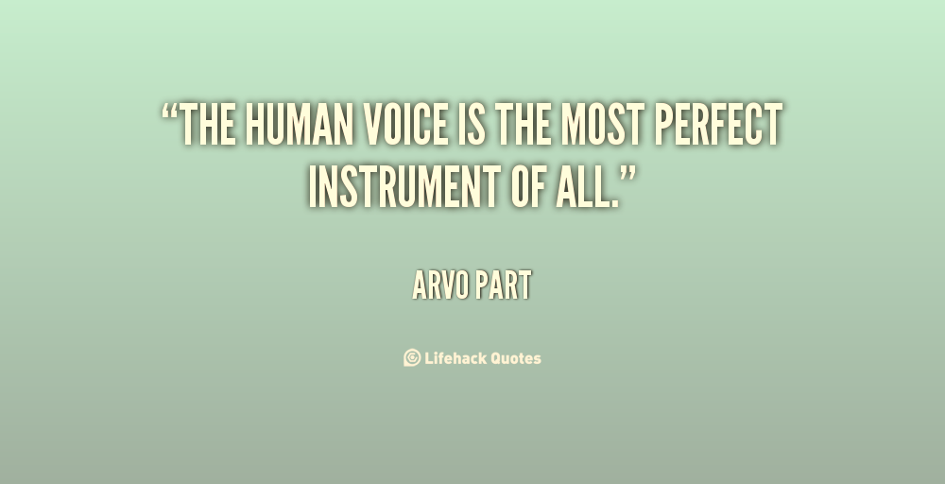
“The human voice is the most perfect instrument of all.” Arvo Part

