Slide 1
Demonstration Speech
1. Choose a simple thing to demonstrate (no food)
2. Make a PPT (no regular script) with 1 step and 1 warning for each step.
3. You MUST have a minimum of 6 steps (no more than 8)
4. You MUST add Inflection marks
{ ^, <->, (…) } to emphasize important
words on your PowerPoint script.
5. After writing the steps and warnings, make a PowerPoint with
Title Slide (Name of Demo, Your name)
Number and Picture for each step (no words)
Thank you Slide – at end

Slide 2
How to Make Kimchi Fried Rice by Julie, Sunshine Class 6.29.2017

Slide 3
1. First, cut the Kimchi
Don’t cut your finger!

Slide 4
2. Second, mix the Kimchi with 1 spoon of chili powder.
Be careful not to get chili power in your eyes.

Slide 5
3. Put one bowl of rice in a frying pan with a little oil.
The rice shouldn’t have a lot of moisture.
^

Slide 6
4. Season it with salt or soy sauce and add the kimchi.
Mix it carefully!

Slide 7
5. Fry an egg.
Be careful not to splash oil on your hand.

Slide 8
6. Serve the Kimchi fried rice with fried egg on top. Garnish with seaweed or sesame seeds
Enjoy your Kimchi Fried rice!

Slide 9
How to Make Kimchi Fried Rice by Julie, Sunshine Class 6.29.2017

Slide 10
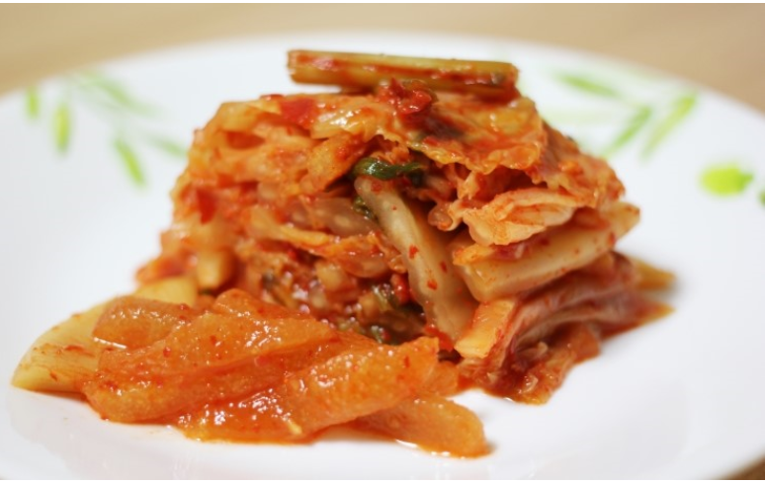
1.

Slide 11
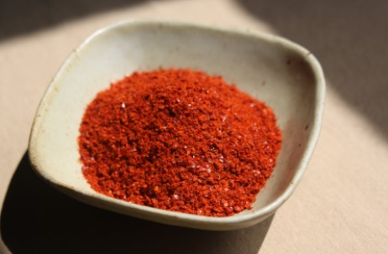
2.

Slide 12
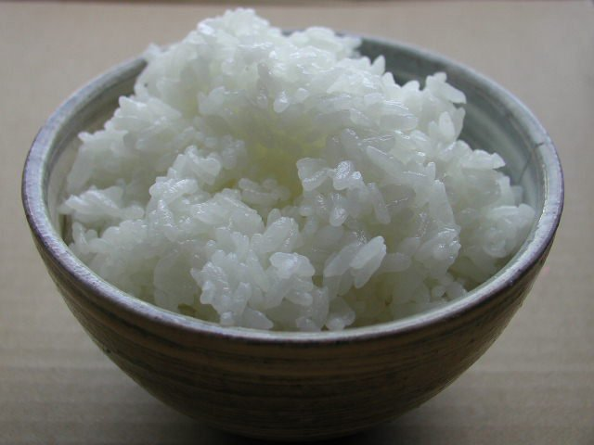
3.

Slide 13
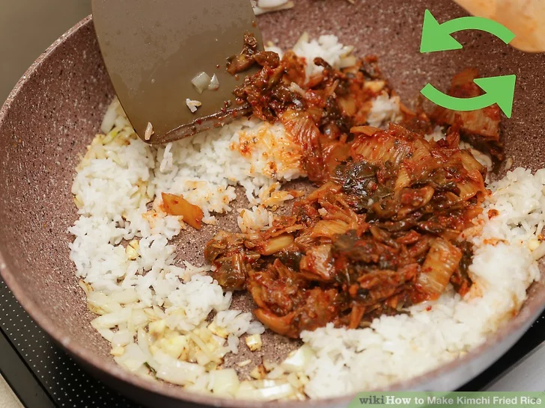
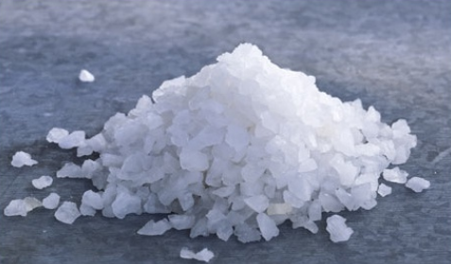
4.

Slide 14
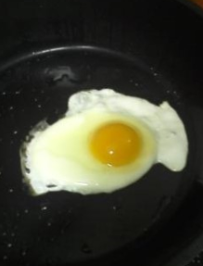
5.

Slide 15
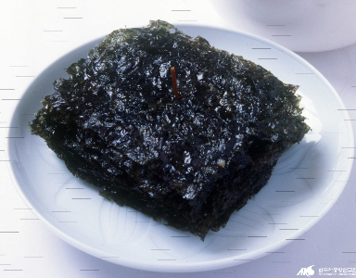
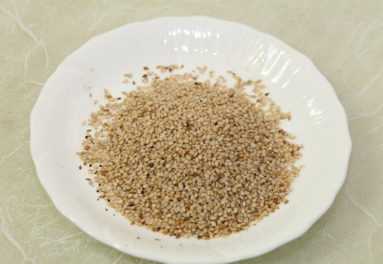
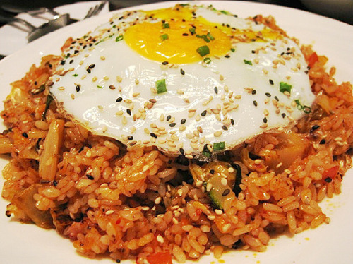
6.

Slide 16
Thank you for listening!

Slide 17
Title ________________________ by _________________ Date____________

Slide 18
1. ________________________________ ___________________________________ ___________________________________ W: ________________________________ ___________________________________

Slide 19
2. ________________________________ ___________________________________ ___________________________________ W: ________________________________ ___________________________________

Slide 20
3. ________________________________ ___________________________________ ___________________________________ W: ________________________________ ___________________________________

Slide 21
4. ________________________________ ___________________________________ ___________________________________ W: ________________________________ ___________________________________

Slide 22
5. ________________________________ ___________________________________ ___________________________________ W: ________________________________ ___________________________________

Slide 23
6. ________________________________ ___________________________________ ___________________________________ W: ________________________________ ___________________________________

Slide 24
Thank you

