Slide 1
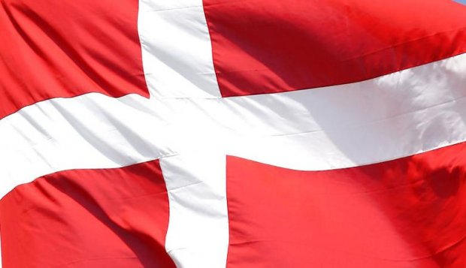
A Comparison of Denmark and Spain
By Julie & Jonathan

Slide 2
Overview
Largest Cities
Unemployment Rate
Languages

Slide 3
Largest Cities
Notes:
I: This bar graph shows the 3 largest cities in Spain and Denmark.
E:The vertical axis is the number of inhabitants. The horizontal axis is the cities in order from the biggest, then the 2nd biggest and 3rd biggest cities.
The red cities are Spanish and the blue ones are Danish.
E: The key point here is that all the cities in Spain are bigger than the biggest city in Denmark. And the biggest city is Madrid.

Slide 4
Unemployment Rate
Notes:
I: This line graph shows the unemployment rate for Denmark and Spain
E: The horizontal axis shows years, and the vertical axis shows the unemployment percentage. The red line is Spain and the blue is Denmark.
E: What you need to notice is that in the last couple of years Spain has had an increase in the unemployment rate while it has just remained the same in Denmark.

Slide 5
Languages
Notes:
I: This pie graph shows the distribution of languages in Denmark and Spain.
E: The left graph is Denmark and the right graph is Spain.
In Denmark you have Danish which is the blue piece, and Faroese which is red. In Spain the light blue represents Spanish, the green Catalan-Valencian-Balear and yellow represents Galician.
E: Please note that 99% of the Danish population speaks the native language, Danish, while only 80% of the Spanish population speaks Spanish

Slide 6
Questions
Which country has the biggest city, and what is the name?
Which country has an increasing unemployment rate?
Which country has the highest percentage of the population speaking the native language?

