Slide 1
Informative Speech
Guidelines!

Slide 2
Informative Speech
1. You will choose an animal randomly.
2. You should prepare your 1st draft of your speech by next class for our workshop.
3. Please type and print it
– double spaced
– font size 12, font
– Arial or Times New Roman
4. Include the following information in your speech.
–
–
–

Slide 3
Informative Speech
A PPT Slide with a Picture & Name of the Animal, plus your name and Class Nature Object. (Email it to me before next class).
Write about the following 4 areas!
1. What does your animal look like?
A. Size? Shape? Weight? Colors? Fur? Claws? Feathers? Fins? ETC.
B. Number of legs? Interesting / Strange features?
2. Where does your animal live?
A. Place in the world?
B. What kind of terrain?
3. What special habits does your animal have?
A. Hunting
B. Sleeping
4. What does your animal eat?
–
–
–

Slide 4
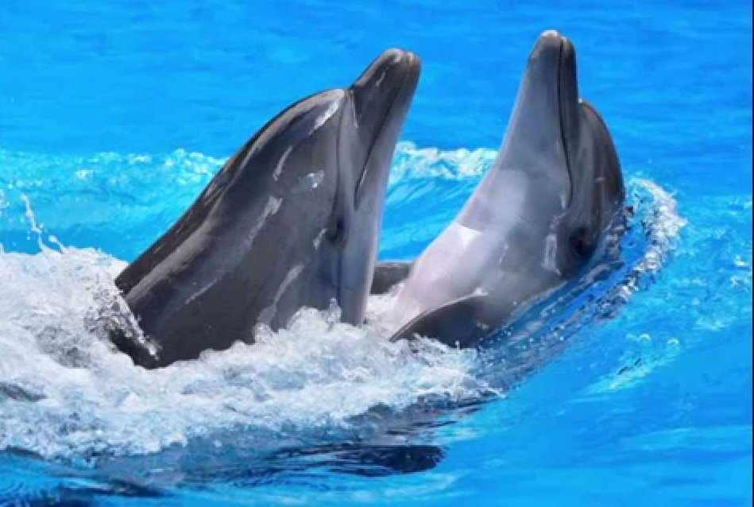
Bottlenose Dolphin
By Jennifer, Plum
September 20, 2017

