Slide 1
Smart Choice Level 1
Grammar:
the SIMPLE verb BE
+ Possessives

Slide 2
We use the simple present of ‘be’ to talk about a
The verb ‘BE’
NATIONALITY
AGE
JOB
NAME

Slide 3
The verb ‘BE’
My teacher is from England.
I am 20 years old.
He is a doctor.
Are you Sally?

Slide 4
The verb ‘BE’
(+) AFFIRMATIVE STATEMENTS
I am/’m
You/We/They are/’re from Korea.
He/She/It is/’s

Slide 5
The verb ‘BE’
NEGATIVE STATEMENTS
I am/’m not
You/We/They are not/ aren’t ...from Korea.
He/She/It is/’s not
We only contract BE in negative short answers.
No, I’M NOT. Yes, I’m.
No, WE’RE NOT. Yes, we’re.

Slide 6
The verb ‘BE’
Yes/No Questions
Are you/we/they from Korea?
Is he/she from Korea?

Slide 7
The verb ‘BE’
Yes/No Questions
Yes, I am. No, I’m not.
Yes, we are. No, we aren’t. / No, we are not.
Yes, they are. No they aren’t./ No, they’re not.
Yes, he is….
Yes, she is…
Yes, it is…

Slide 8
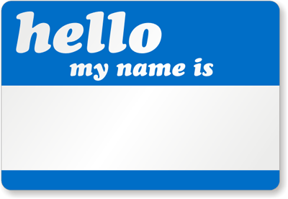
Possessive Adjectives_
I = My
You = Your
He = His
She = Her
We = Our
They = Their

