Slide 1
Smart Choice Level 1
Unit 4
Vocabulary

Slide 2
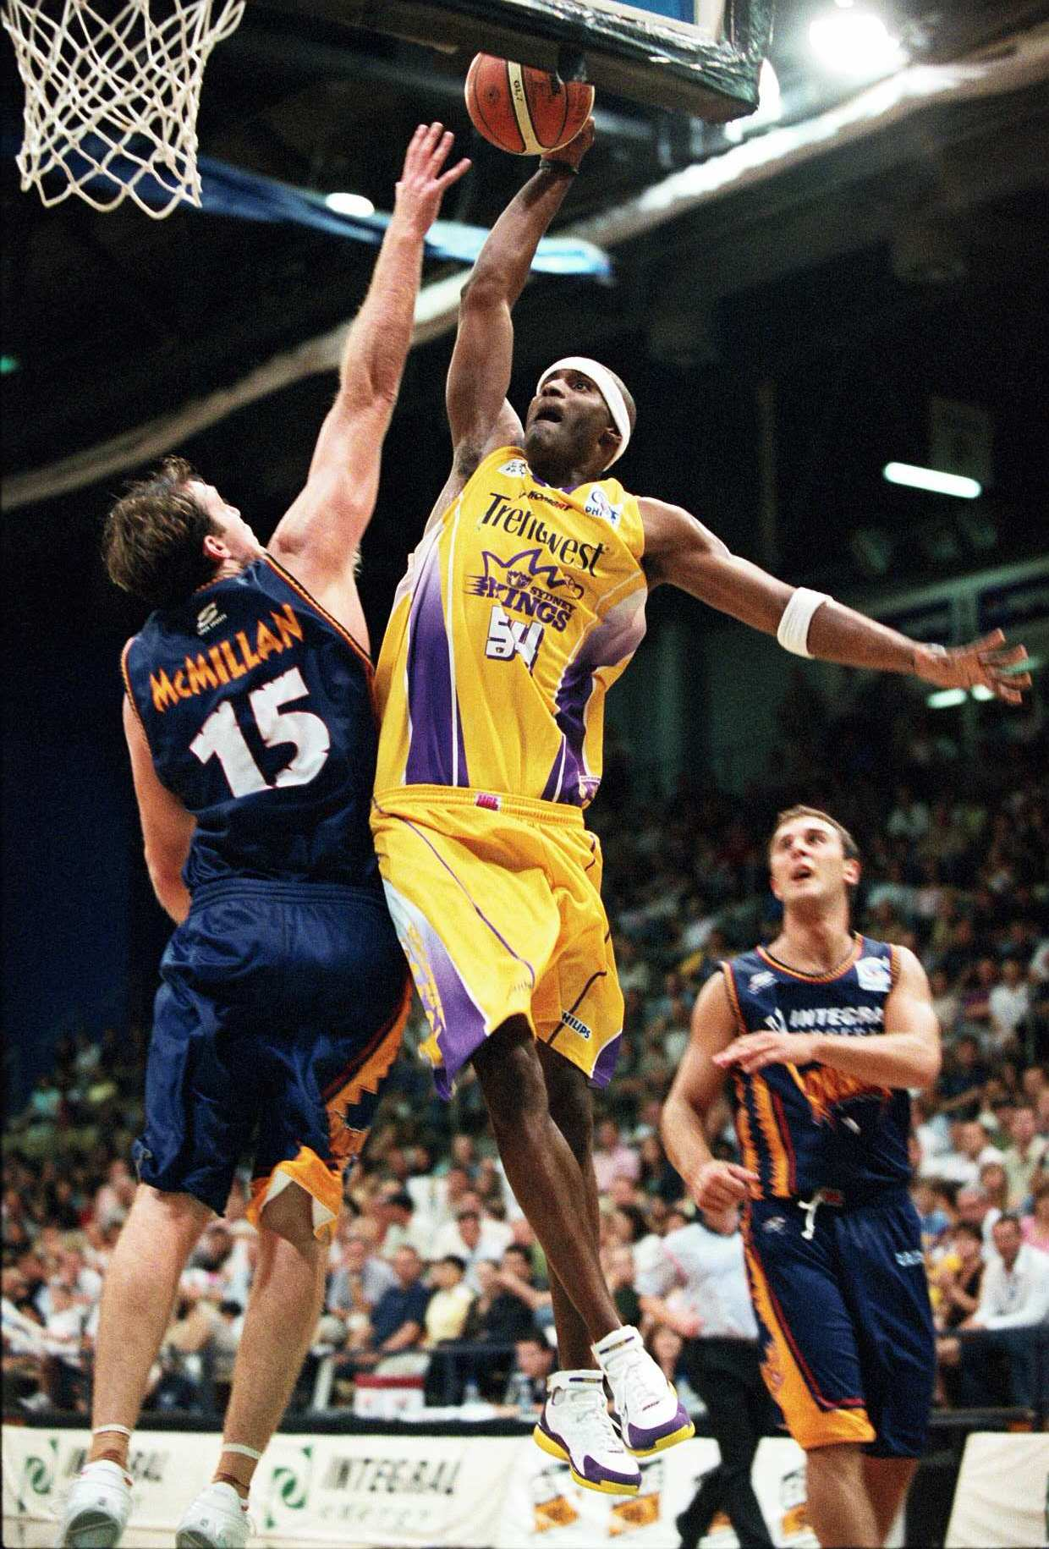
Vocabulary
basketball
They play basketball.

Slide 3
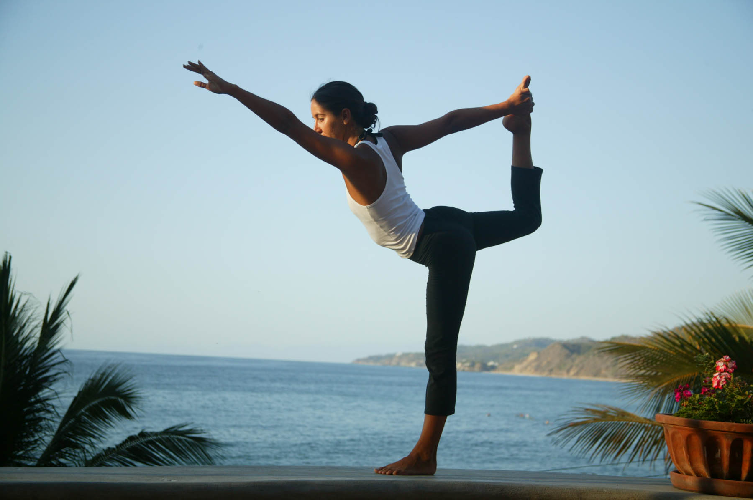
Vocabulary
yoga
She does yoga.

Slide 4
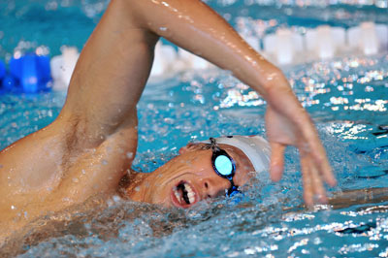
Vocabulary
swimming
He goes swimming.

Slide 5
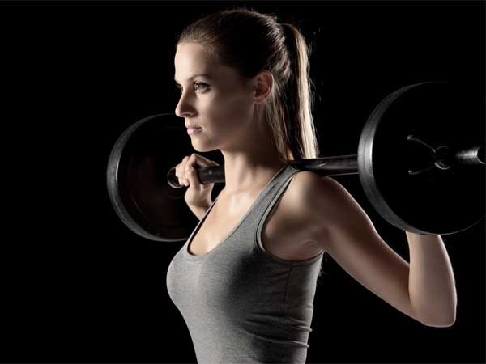
Vocabulary
weightlifting
She does weightlifting.

Slide 6
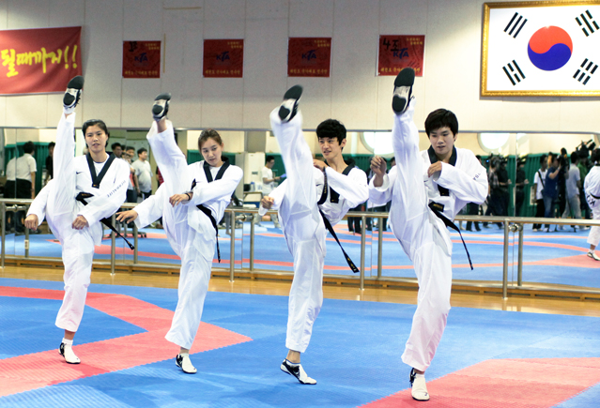
Vocabulary
Examples:
taekwondo
kumdo
karate
judo
kung fu
martial arts
They do martial arts.

Slide 7
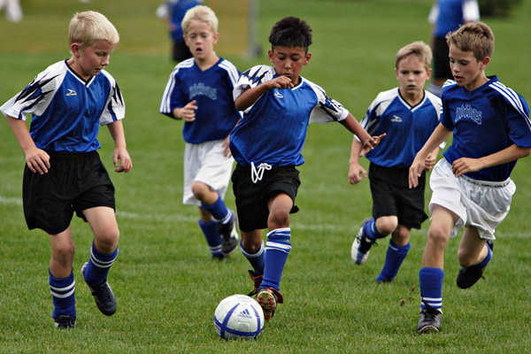
Vocabulary
soccer
They play soccer.

Slide 8
Vocabulary
helmet
bicycling
She goes bicycling.

Slide 9
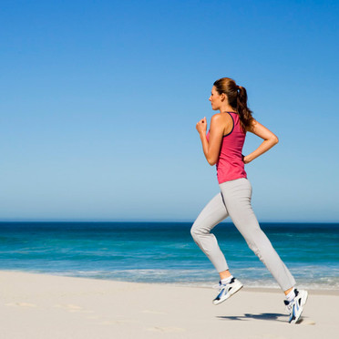
Vocabulary
jogging
She goes jogging.

Slide 10
PLAY
DO
GO
We use the verbs
play, do and go
with sports and activities.
Here is the information you need to know to use them correctly.

Slide 11
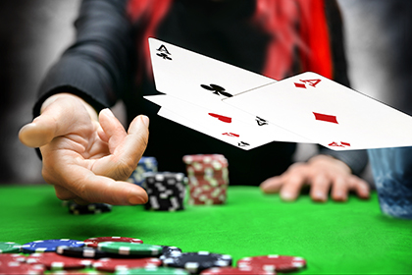
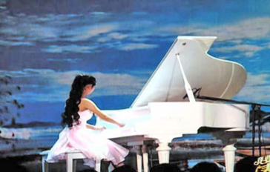
PLAY
ball sports
How often do you play tennis?
competitive games
I play poker with my friends on Friday night.
I don't like playing computer games.
instruments
She can play the piano really well.
PLAY

Slide 12
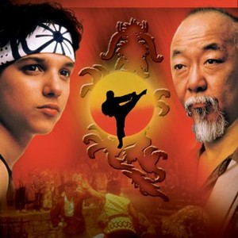
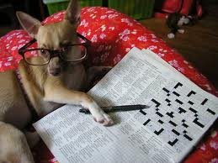
DO
non-team sport that does not use a ball
I heard that you do karate.
recreational activity
I do crossword puzzles in my free time

Slide 13
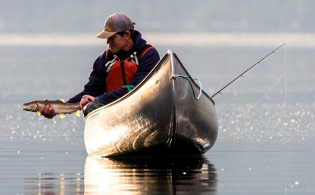
GO
activities ending in-ing.
We go somewhere to do something.
Do you want to go fishing on Sunday?
(You go to a lake to fish.)
I want to go skiing next winter.
(You go to the mountains to ski.)
She likes to go swimming on weekends.
(You go to a swimming pool to swim.)

Slide 14
Exceptions
do body building
do boxing
do weightlifting
do weight training
do some swimming (affirmative)
I do some swimming every day.
do any swimming (negative)
I don’t do any swimming on weekends.
go bowling (o)
play bowling (x)

Slide 15
Now choose the correct verb to complete each sentence:
1. Do you want to __________ hiking with me?
2. He ___________ ice-hockey for a Canadian team.
3. They like to ___________ yoga when they want to relax.
4. My parents ____________ sailing every summer.
5. He likes to ______________ chess to exercise his mind.
6. She _______________ aerobics at the gym every evening.
7. The students ________________ athletics at school twice a week.
8. She ______________ volleyball on her high school team.
9. I want to _____________ kayaking on the lake this summer.
10. He learned to _____________ taekwondo when he was in elementary school.
11. Do you want to _____________ golf with me this Sunday?
12. Let’s _____________ dancing on Saturday night.
13. They _____________ deer hunting every year.
14. When did you learn to _______________ the violin?
15. She started to _____________ gymnastics when she was four years old.
go
plays
do
go
play
does
do
plays
go
do
play
go
go
play
do

Slide 16
Name: _____________________ Class Gem: _________________ Date: _______
Now choose the correct verb to complete each sentence:
1. Do you want to __________ hiking with me?
2. He ___________ ice-hockey for a Canadian team.
3. They like to ___________ yoga when they want to relax.
4. My parents ____________ sailing every summer.
5. He likes to ______________ chess to exercise his mind.
6. She _______________ aerobics at the gym every evening.
7. The students ________________ athletics at school twice a week.
8. She ______________ volleyball on her high school team.
9. I want to _____________ kayaking on the lake this summer.
10. He learned to _____________ taekwondo when he was in elementary school.
11. Do you want to _____________ golf with me this Sunday?
12. Let’s _____________ dancing on Saturday night.
13. They _____________ deer hunting every year.
14. When did you learn to _______________ the violin?
15. She started to _____________ gymnastics when she was four years old.

Slide 17
