Slide 1
Smart Choice Level 1 – Unit 5 Grammar & Vocabulary

Slide 2
The Present Continuous
We use the Present Continuous
to talk about something
that is happening now.

Slide 3
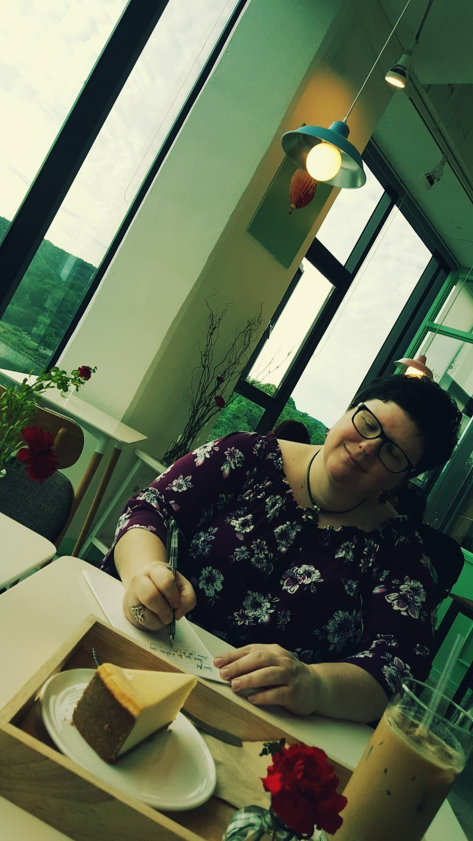
The Present Continuous
I am writing in my journal.

Slide 4
The Present Continuous
He is talking on the phone now.

Slide 5
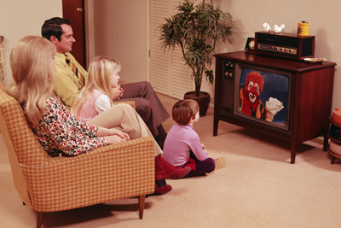
The Present Continuous
They are watching TV.

Slide 6
The Present Continuous
We form the Present Continuous with the verb BE (am, is, are) +
the “ing” form of a verb.

Slide 7
The Present Continuous
am
’m
I reading.
You
We reading.
They
are
’re
He
She reading.
It
is
’s

Slide 8
The Present Continuous
am
’m
I not reading.
You
We not reading.
They
are
’re
He
She not reading.
It
is
’s

Slide 9
The Present Continuous
Spelling Rules:
For most verbs,
just add “ing.”
work + ing = working
do + ing = doing
study + ing = studying
read + ing = reading

Slide 10
The Present Continuous
Spelling Rules:
For verbs ending in “e”,
minus “e”, and add “ing.”
care – e + ing = caring
dance – e + ing = dancing

Slide 11
The Present Continuous
Spelling Rules:
For verbs ending in a vowel (a, e, i, o, u) and a consonant (all other letters), double the consonant and add “ing.”
swim + m + ing = swimming
stop + p + ing = stopping

Slide 12
The Present Continuous
Spelling Rules:
For verbs ending
in a vowel and“y”,
just add “ing.”
pay+ ing = paying
say + ing = saying
play + ing = playing
buy + ing = buying

Slide 13
The Present Continuous
Wh- Questions:
Wh- word + BE + subject + “ing” verb
What are you reading?
Where are they going?
Who is he calling?

Slide 14
The Present Continuous
Yes/No Questions:
BE + subject + “ing” verb
Are you reading?
Are they going?
Is he calling?

Slide 15
The Present Continuous
Short Answers to
Yes/No Questions:
Are you reading? Yes, I am. / No, I’m not.
Are they going? Yes, they are. / No, they aren’t.
Is he calling? Yes, he is. / No, he isn’t.

Slide 16
Now Practice!
writing
playing
1. write ________
2. send ________
3. sit ________
4. have ________
5. play ________
6. take ________
7. run ________
8. exercise ________
sending
taking
sitting
running
having
exercising

Slide 17
Now Practice!
1. What _____ you _______ now? (do)
2. Where ___ your sister _______ now? (live)
3. What kind of music ____ your friends _______ to these days? (listen)
4. Who ____ your brother ________ to? (talk)
5. What _____ you ________ in school? (study)
6. What ____ she _______ for lunch? (make)
are
doing
is
living
are
listening
is
talking
are
studying
is
making

Slide 18
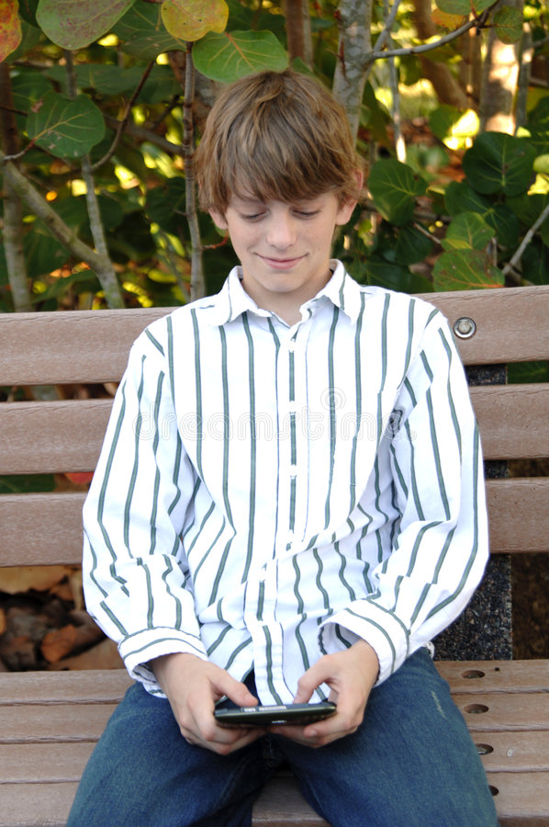
is
sending
He a text message.

Slide 19
is
checking
2. She her e-mail.

Slide 20
3. She on the phone.
is
talking

Slide 21
4. She a computer game.
is
playing

Slide 22
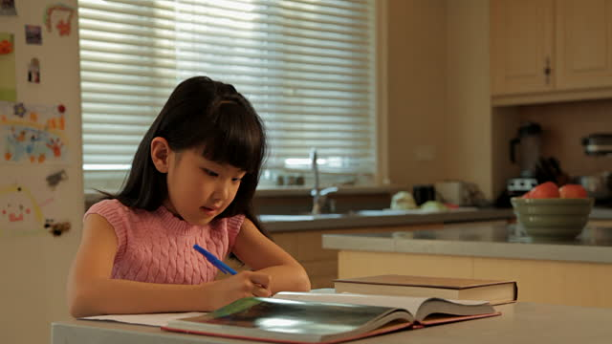
5. She her homework.
is
doing

Slide 23
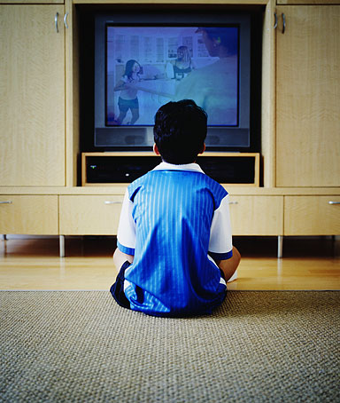
6. He TV.
is
watching

Slide 24
7. He to music.
is
listening

Slide 25
8. She a magazine.
is
reading

Slide 26
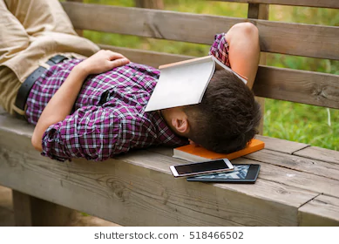
9. He a nap.
is
taking

Slide 27
He is sending a text message.
She is checking her e-mail.
She is talking on the phone.
She is playing a computer game.
She is doing her homework.
He is watching TV.
He is listening to music.
She is reading a magazine.
He is taking a nap.

