Slide 1
Level 1 Unit 5 Quiz Info
NEXT Class

Slide 2
The quiz will be in two parts.

Slide 3
Part 1
Make sentences, questions, and answer questions using the PRESENT CONTINUOUS.
It will be similar to the worksheet
done in class.
Jane / watch / TV
_________________
Jane is watching TV.

Slide 4
Part 2
Picture PowerPoint Presentation
The professor will make teams of 3 students.
Decide on a team name together.
Look at the worksheet.
4. This activity is for practicing the
Present Continuous.
5. Each team will take 10 pictures.

Slide 5
Part 2
Picture PowerPoint Presentation
6. The pictures must show an action in the
Present Continuous.
7. The first 5 verbs have been given to you. You
must choose the last 5 verbs.
8. Every subject for each sentence has been given
to you. DO NOT change it.
9. All team members must participate and be
shown in the pictures.

Slide 6
Part 2
Picture PowerPoint Presentation
Subject | Explanation
I | Must be only 1 of your team members.
He/She | Must be only 1 of your team members.
We | Must be all of your team members.
They | Must be 2 or more people who are NOT your team members.

Slide 7
Part 2
Picture PowerPoint Presentation
10. You may take only 2 pictures in 1 place.
11. For each picture, write 1 sentence using the
Present Continuous.
12. You must type your 10 sentences for next class.
13. After you finish taking pictures and writing
sentences, make a PPT.
14. Your PPT must look like the following example.
(Check the website if you forget.)

Slide 8
Unit 5 Photo Shoot

Slide 9
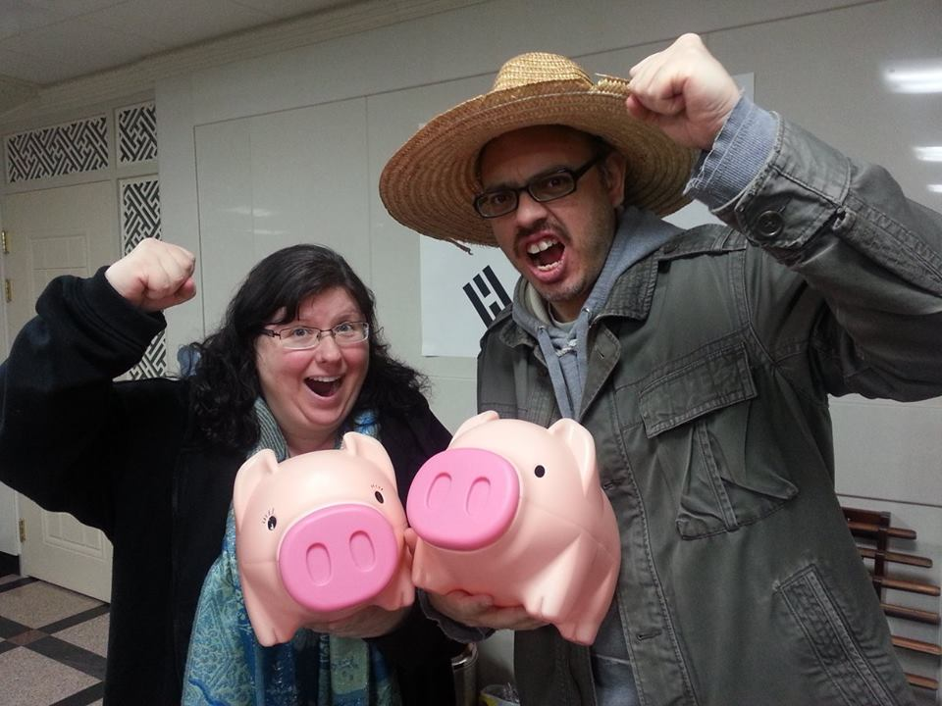
Dynamic Duo
Jose
Jennifer

Slide 10
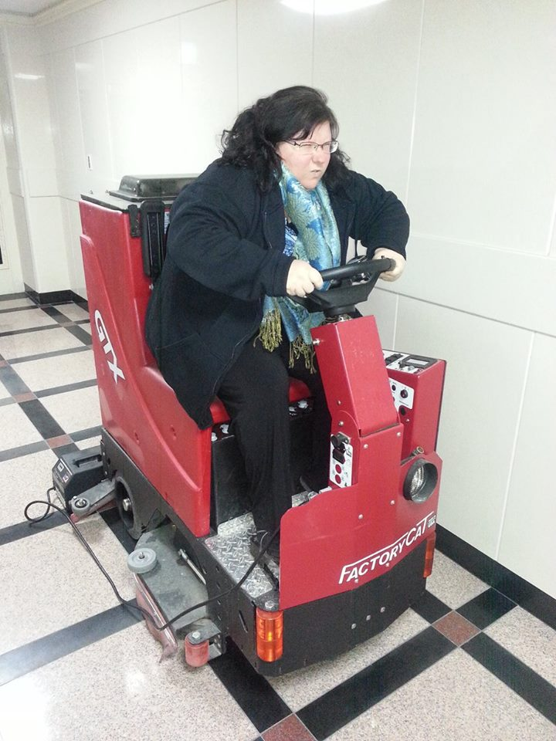
I’m driving
a floor cleaner
in the hallway.

Slide 11
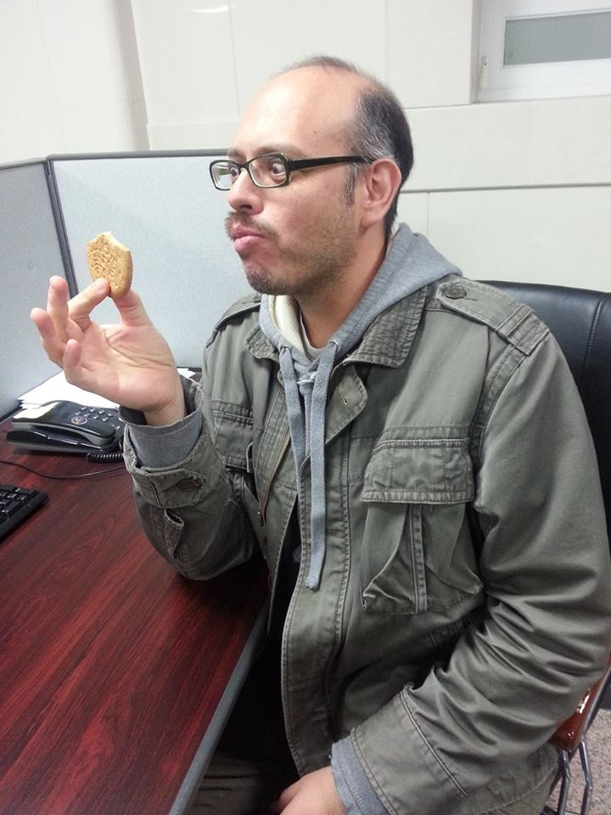
He’s eating a
cookie at his desk.

Slide 12
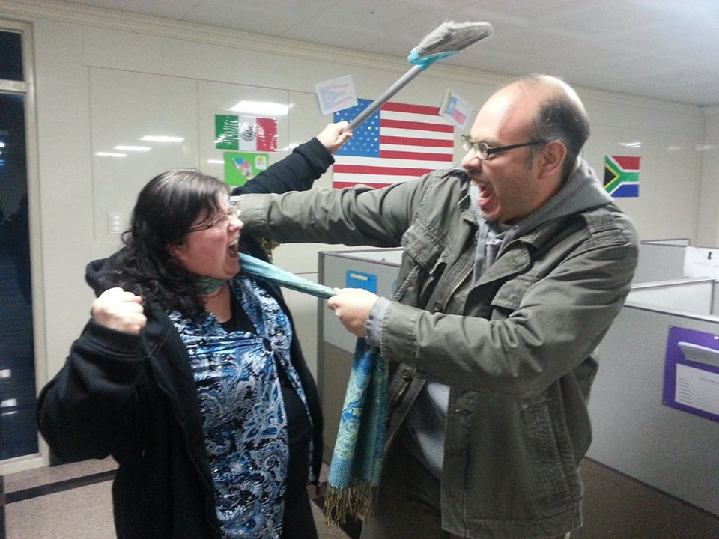
We’re
fighting with
each other
in the
office.

Slide 14
X X
X X
X X
I’m driving.
He’s eating.
We’re fighting.
I’m driving a floor cleaner in the hallway.
He’s eating a cookie at his desk.
We’re fighting with each other in the office.

