Slide 1
Quiz NEXT class
Unit 6 Quiz Review

Slide 2
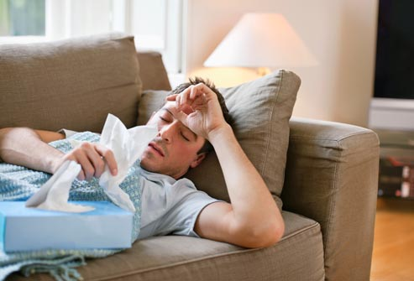
Unit 6 Quiz Review
1. Use Unit 6 vocabulary in a sentence to describe a picture:
He’s sick.

Slide 3
Unit 6 Quiz Review
1. Use the Present Continuous to describe a picture:
He is resting.

Slide 4
Unit 6 Quiz Review
3. Use BE in SIMPLE PAST to complete sentences.
was
1. I ______ looking for you. Where were you?
2. He _____ four years old when he started
playing the piano
3. My coworker and I _______ late for the meeting
this morning..
4. It _______ a nice day yesterday. It rained all day.
5. The customers ________ happy with the company’s
service. They never ordered anything from there again.
was
were
wasn’t
weren’t

