Slide 1
Smart Choice Level 1
Unit 5
Vocabulary

Slide 2
He’s late.

Slide 3
The weather is terrible.

Slide 4
He’s lost.

Slide 5
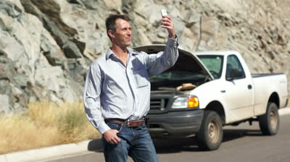
His cell phone is broken.

Slide 6
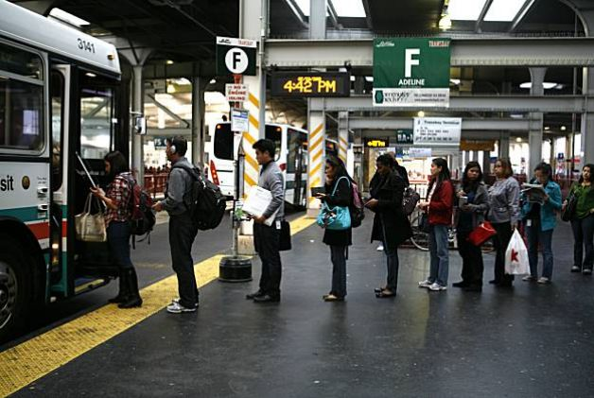
The lines are long.

Slide 7
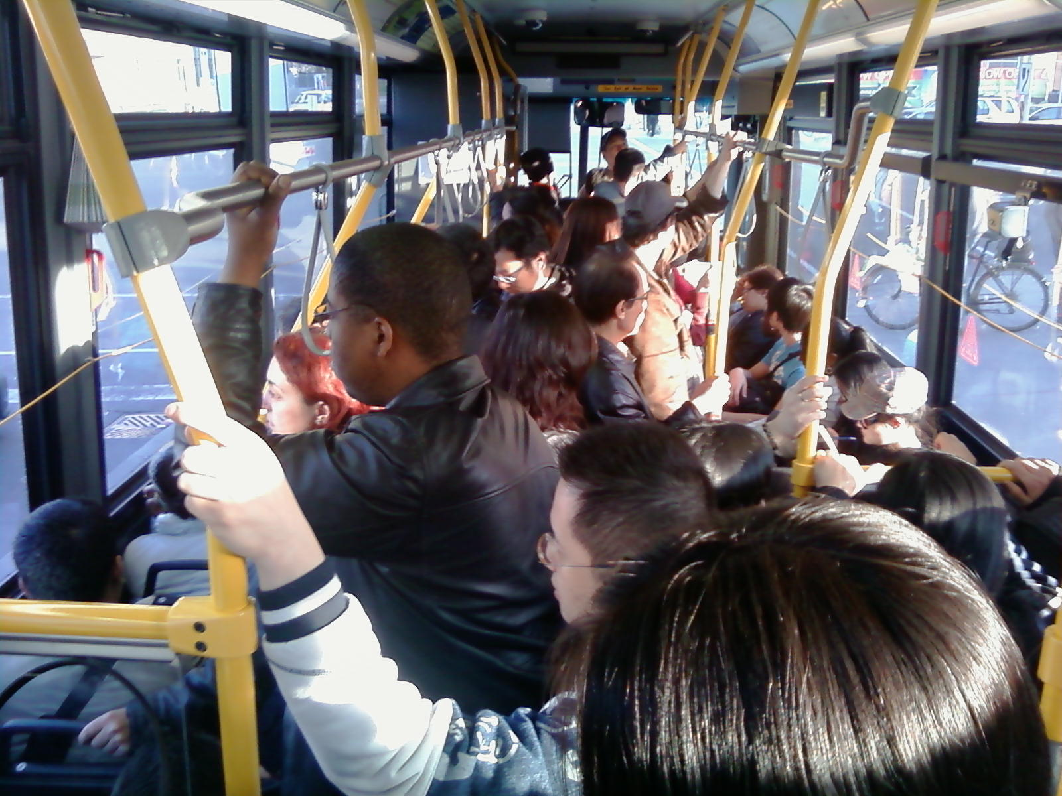
The bus is crowded.

Slide 8
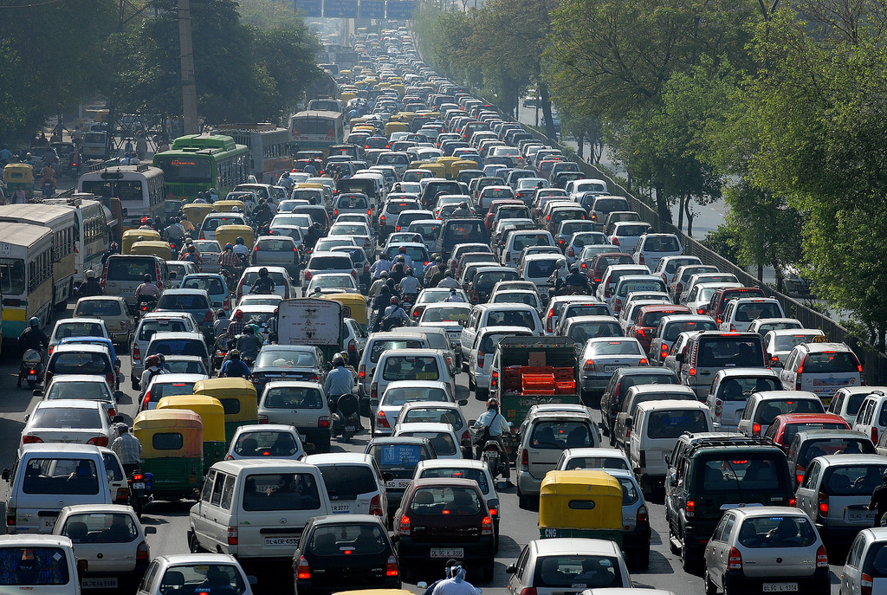
The traffic is awful.

Slide 9
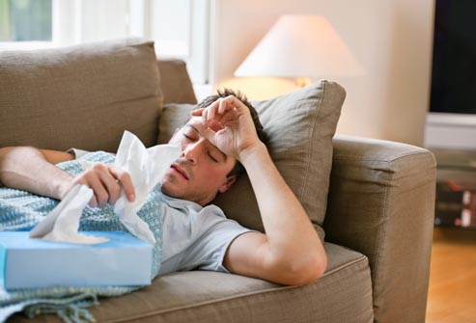
He’s sick.

Slide 10
Present Continuous Review
am
subject + is + “-ing”
are

Slide 11
1. Her dress is red and white.
2. She is talking on the phone.

Slide 12
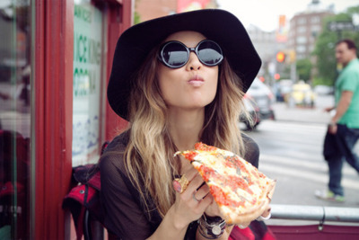
1

Slide 13
2

Slide 14
3

Slide 15
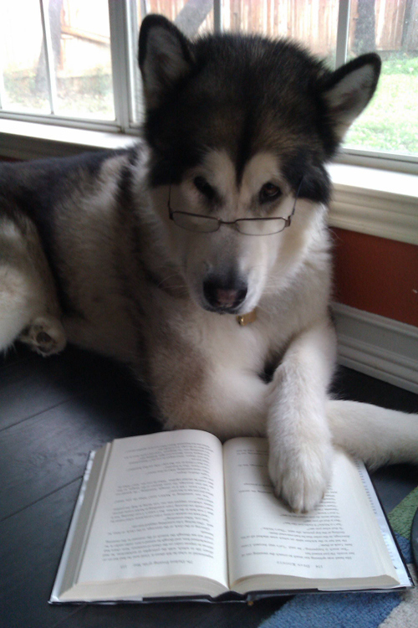
4

Slide 16
5

Slide 17
6

Slide 18
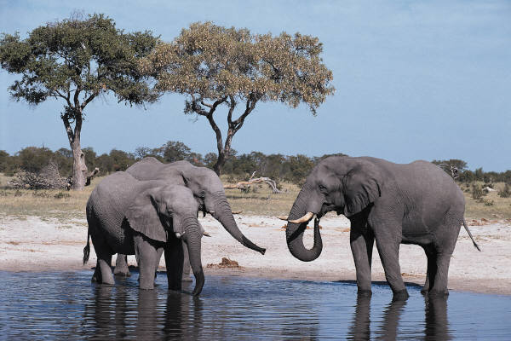
7

Slide 19
8

Slide 20
9

Slide 21
10

