Slide 1
Smart Choice
Level 1
FINAL TEST
Units 4-6

Slide 2
FINAL Speaking TEST
My name is Jennifer.
What is your name?
Where were you born?
What was your favorite color when you were a child?
What activity do you like to do?
5. How often do you do it?
6.When was the last time you did it?
I was born in Loma Linda.
My favorite color was red.
I like to paint.
I paint five times a week.
The last time I painted was yesterday.

Slide 3
FINAL Speaking TEST
Yes, I often sing.
7. Do you ever sing?
8. Do you ever (you ask the professor)?
Look at the following pictures and tell what is happening in present continuous form.
Example: She is watching T.V.
(your choice).

Slide 4
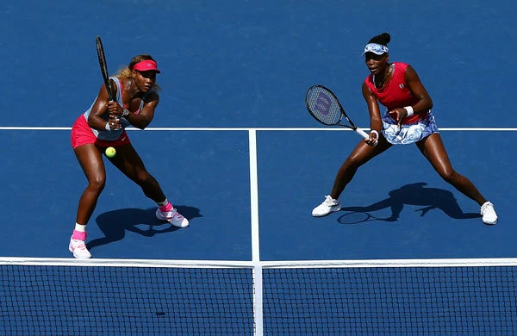
Picture 1

Slide 5
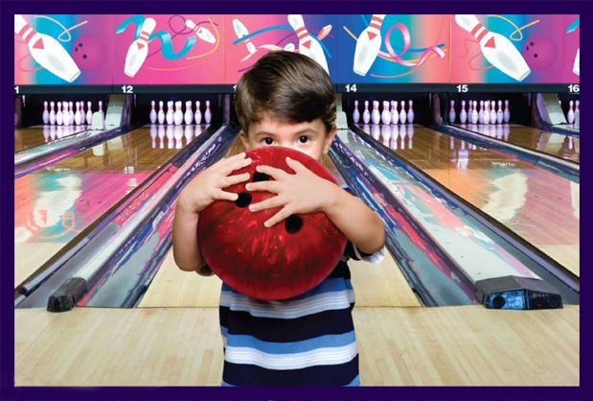
Picture 2

Slide 6
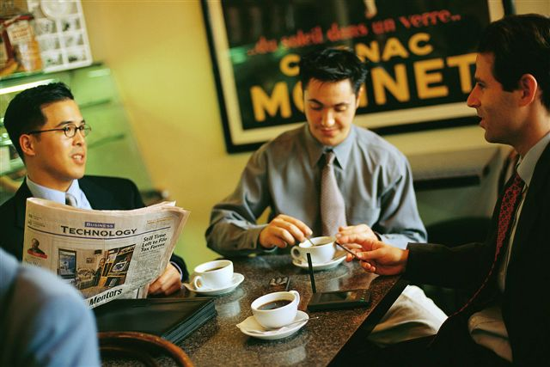
Picture 3

Slide 7
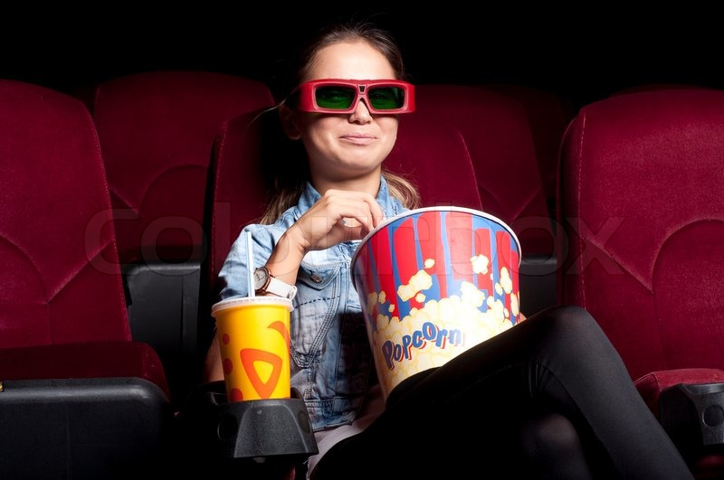
Picture 4

Slide 8
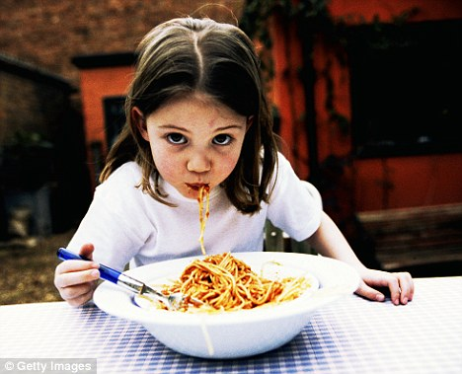
Picture 5

Slide 9
FINAL Written TEST
Unit 4 – see PPT
Unit 5 – see PPT
Unit 6 – see PPT
4. Listening - Listen to a dialogue and answer questions.
5. Reading – Read and answer questions

Slide 10
Unit 4
Know the rules for play, do, and go.
For ball sports, we use ______.
Fill in the blanks in sentences with
play, do, or go.
We often ______ dancing.
play
go

Slide 11
Unit 4
Rewrite sentences using frequency adverbs (always, usually, often, sometimes, never.)
We study hard. (100%)
_______________________
We always study hard.

Slide 12
Unit 4
Change negative sentences to
sentences using never and ever.
She doesn’t wear hats.
________________________
________________________
She never wears hats.
She doesn’t ever wear hats.

Slide 13
Unit 4
Answer YES/NO questions using frequency adverbs (always, usually, often, sometimes, never.)
Do you ever eat spaghetti?
__________________________
Yes, I do. I often eat spaghetti.

Slide 14
Unit 4
Answer HOW OFTEN questions using
time expressions.
How often do you eat spaghetti?
__________________________
I eat spaghetti twice a month.

Slide 15
Unit 5
Make words by adding – ing correctly (using the spelling rules)
smile = _______
smiling

Slide 16
Unit 5
Make sentences, questions, and answer questions using the PRESENT CONTINUOUS.
It will be similar to the worksheet
done in class.
Jane / watch / TV
_________________
Jane is watching TV.

Slide 17
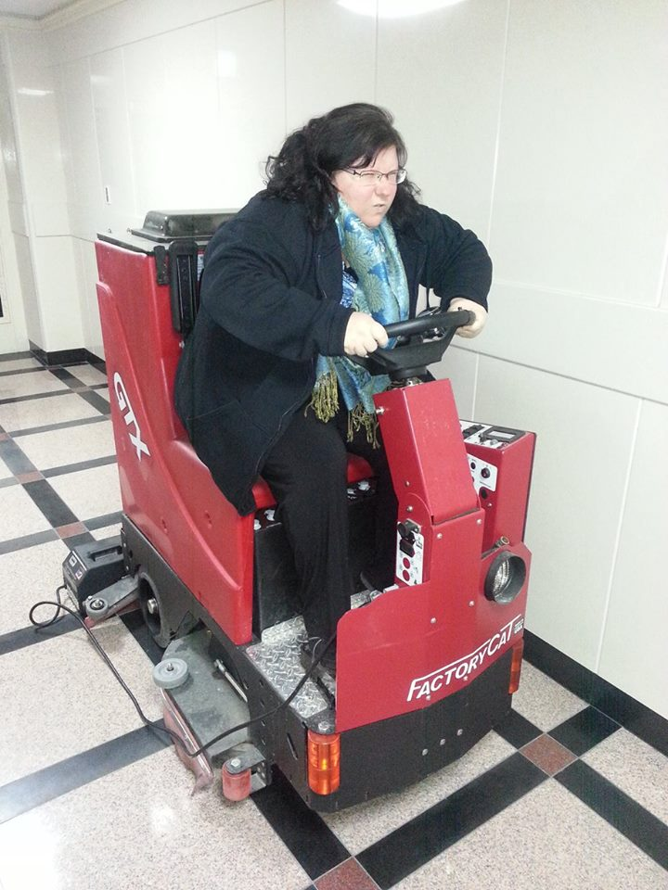
I’m driving
a floor cleaner
in the hallway.

Slide 18
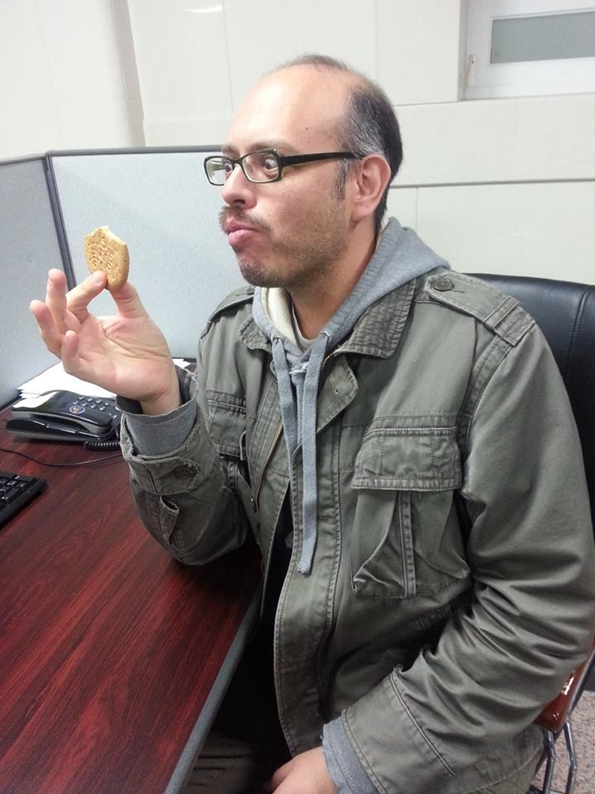
He’s eating a cookie at his desk.

Slide 19
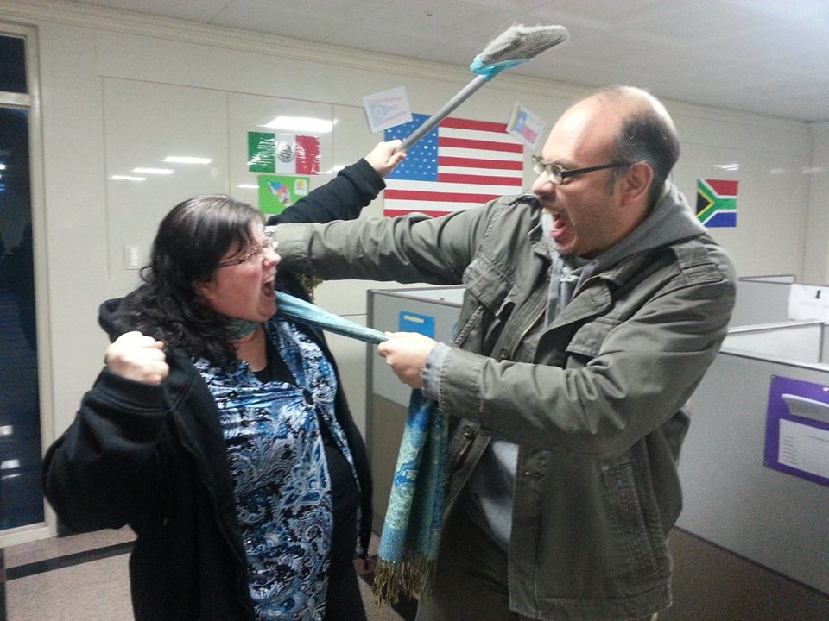
We’re
fighting with
each other
in the
office.

Slide 20
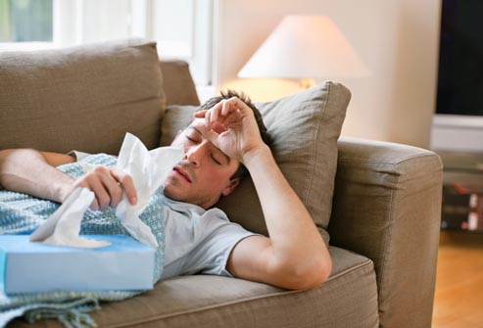
Unit 6
1. Use Unit 6 vocabulary in a sentence to describe a picture:
He’s sick.

Slide 21
Unit 6
2. Use the Present Continuous to describe a picture:
He is resting.

Slide 22
Unit 6
3. Use BE in SIMPLE PAST to complete sentences.
was
1. I ______ looking for you. Where were you?
2. He _____ four years old when he started
playing the piano
3. My coworker and I _______ late for the meeting
this morning..
4. It _______ a nice day yesterday. It rained all day.
5. The customers ________ happy with the company’s
service. They never ordered anything from there again.
was
were
wasn’t
weren’t

Slide 23
Unit 6
4. Answer questions with SIMPLE PAST.
Where was your mother born?
___________________________
She was born in Gwangju.

