Slide 1
Smart Choice Level 1
Do you like spicy food?
Unit 3 Grammar:
Simple Present
1.Questions with DO.
2.Yes/No short answers
3. WH ? with DO.

Slide 2
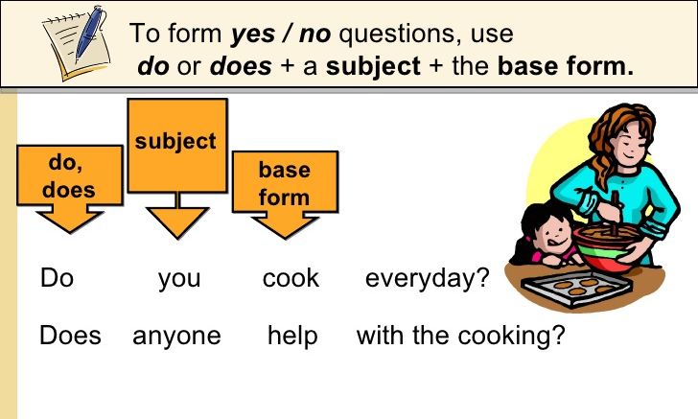
The Simple Present: Questions with “DO”

Slide 3
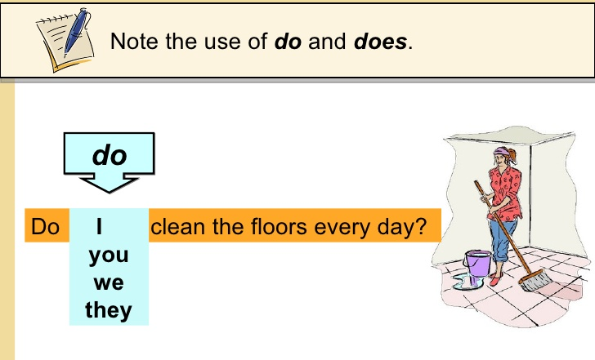
Do
clean the floors everyday?
RED TEAM

Slide 4
ORANGE TEAM

Slide 5
Do/Does | subject | Verb (base form) | ~~?
Do | you | like | pizza?
Do | we | need | pencils?
Do | they | watch | movies?
Does | he | want | water?
Does | she | have | a car?
Does | it | look | nice?

Slide 6
Answering YES/NO Questions
(Short Answers)

Slide 7
you Yes, I do. / No, I don’t.
Do we look good? Yes, we do. / No, we don’t.
they Yes, they do. / No, they don’t.
he Yes, he does. / No, he doesn’t.
Does she look good? Yes, she does. / No, she doesn’t.
it Yes, it does. / No, it doesn’t.

Slide 8
WH Questions with DO

Slide 9
Do you read every day?
Yes, I do.
What
do you read every day?
I read a novel.
WH ? 2. do, does 3. subject 4. verb (base form)
+ rest of sentence

Slide 10
Wh~ word | do/does | subject | Verb? (base form)
What | do | you | like?
When | do | we | study?
Where | do | they | live?
Why | does | he | work?
Who | does | she | like?
How | does | it | look?

Slide 11
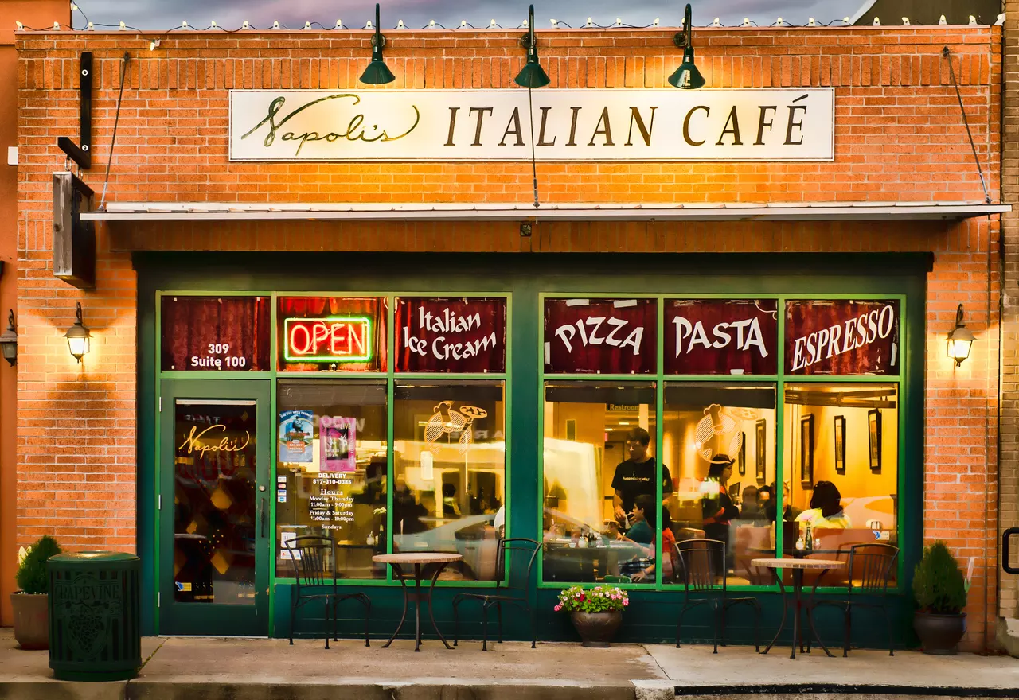
Now let’s practice:
Page 126

Slide 12
Practice 1
______ you like sushi? _________________
______ most children like spicy food? _________________
______ your school serve food? _________________
______ your friends like French fries? _________________
______ you work in a restaurant? _________________
______ your father drink coffee? _________________
Do
Yes, I do. / No, I don’t.
Do
Yes, they do. / No, they don’t.
Does
Yes, it does. / No, it doesn’t.
Do
Yes, they do. / No, they don’t.
Do
Yes, I do. / No, I don’t.
Does
Yes, he does. / No, he doesn’t.
Practice 2
Where _________ your teacher ________?
What kinds of food _______ your favorite restaurant ______?
What kinds of food _______ you _______ in the morning?
Where _______ you ________ for pizza?
does
live
does
serve
do
like
do
go

Slide 13
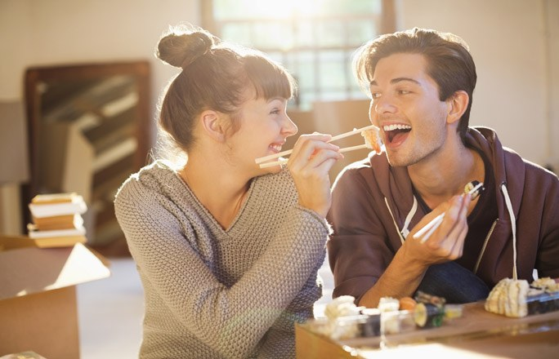
Now let’s practice:
Page 18

Slide 14
 | Loves | Likes | Doesn’t like | Hates
Chuck | beef pizza hamburgers | beans onions sushi | noodles soup | vegetables rice
Dora | vegetables rice soup | chicken beans sushi | beef noodles onions | pizza hamburgers
Chuck _______ hamburgers, but Dora ________ them.
Dora ____________ onions, but Chuck ________ them.
Chuck and Dora __________ noodles, but they _______ sushi.
A: __________ Dora _________ pizza?
B: No, she __________ it.
A: __________ Chuck _________ vegetables?
B: Yes, he __________. But Dora _________ them.
loves
hates
doesn’t like
likes
don’t like
like
Does
like
hates
Does
hate
does
loves

