Slide 2
Smart Choice Level 1
Do you like spicy food?
Unit 3
Vocabulary

Slide 3
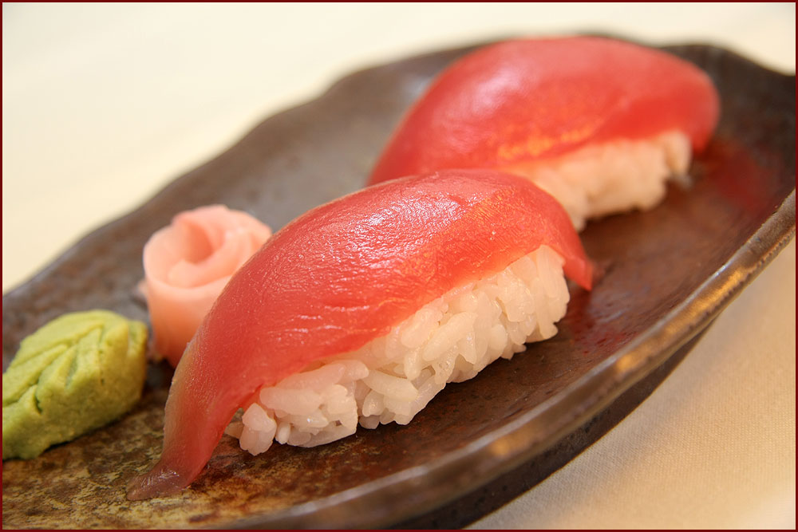
Do you like (food)?
1.____

Slide 4
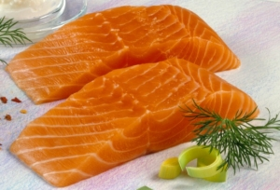
Do you like (food)?
2._____

Slide 5
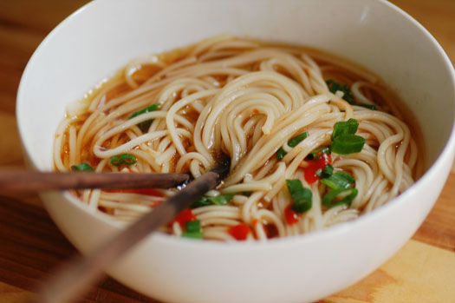
Do you like (food)?
3._____

Slide 6
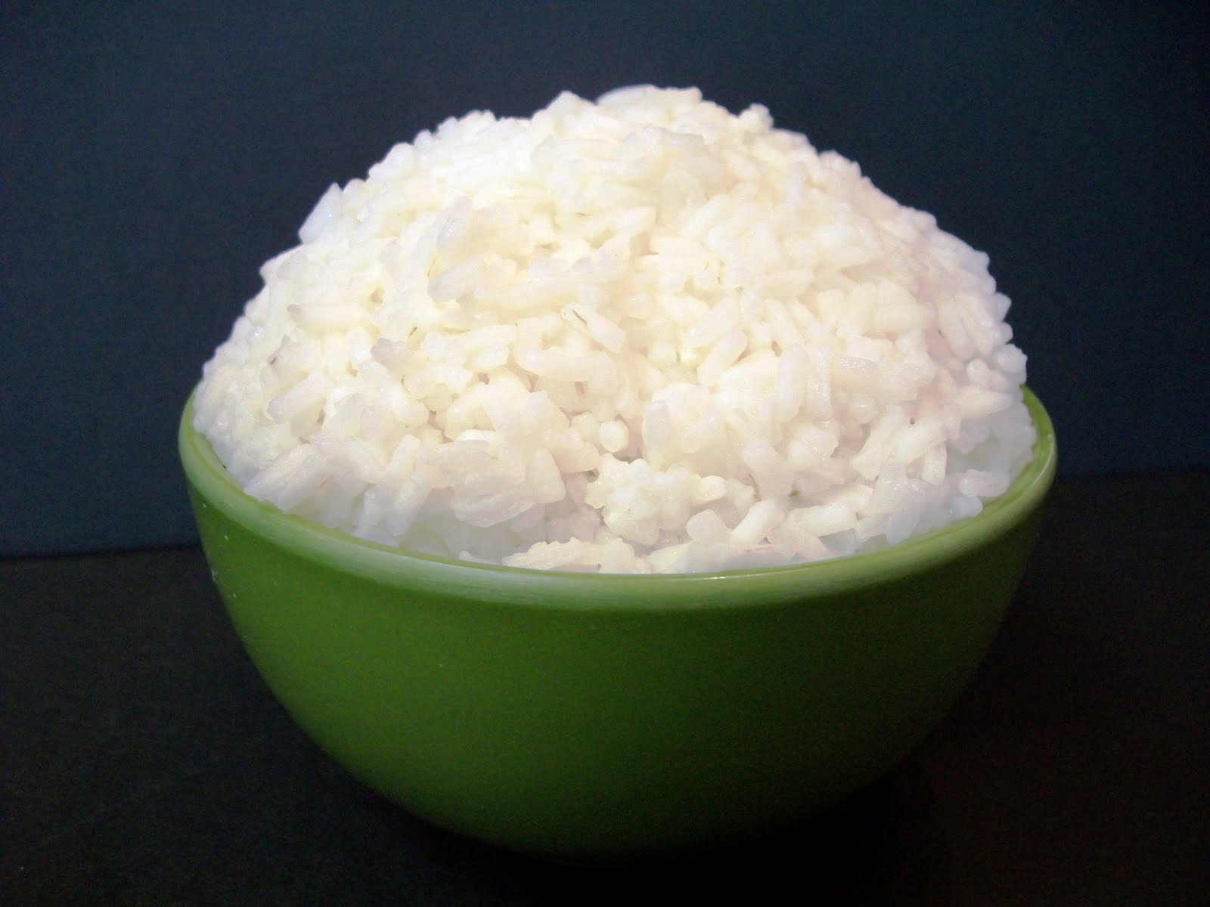
Do you like (food)?
4._____

Slide 7
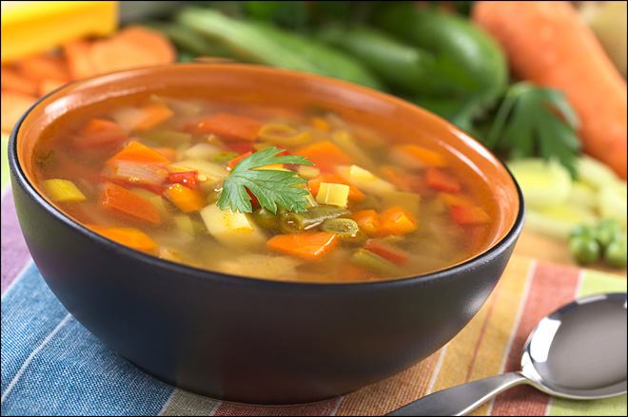
Do you like (food)?
5.____

Slide 8
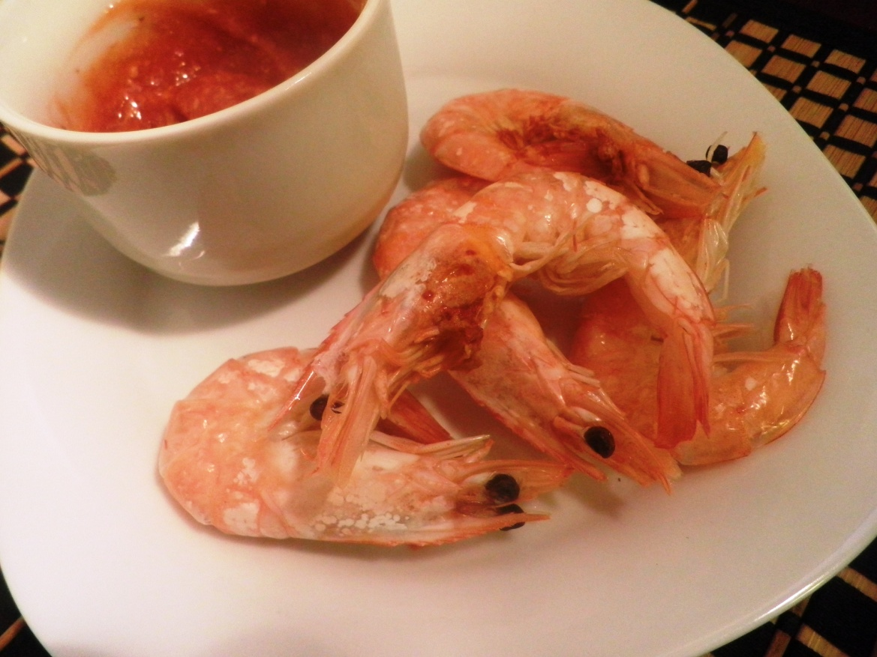
Do you like (food)?
6._____

Slide 9
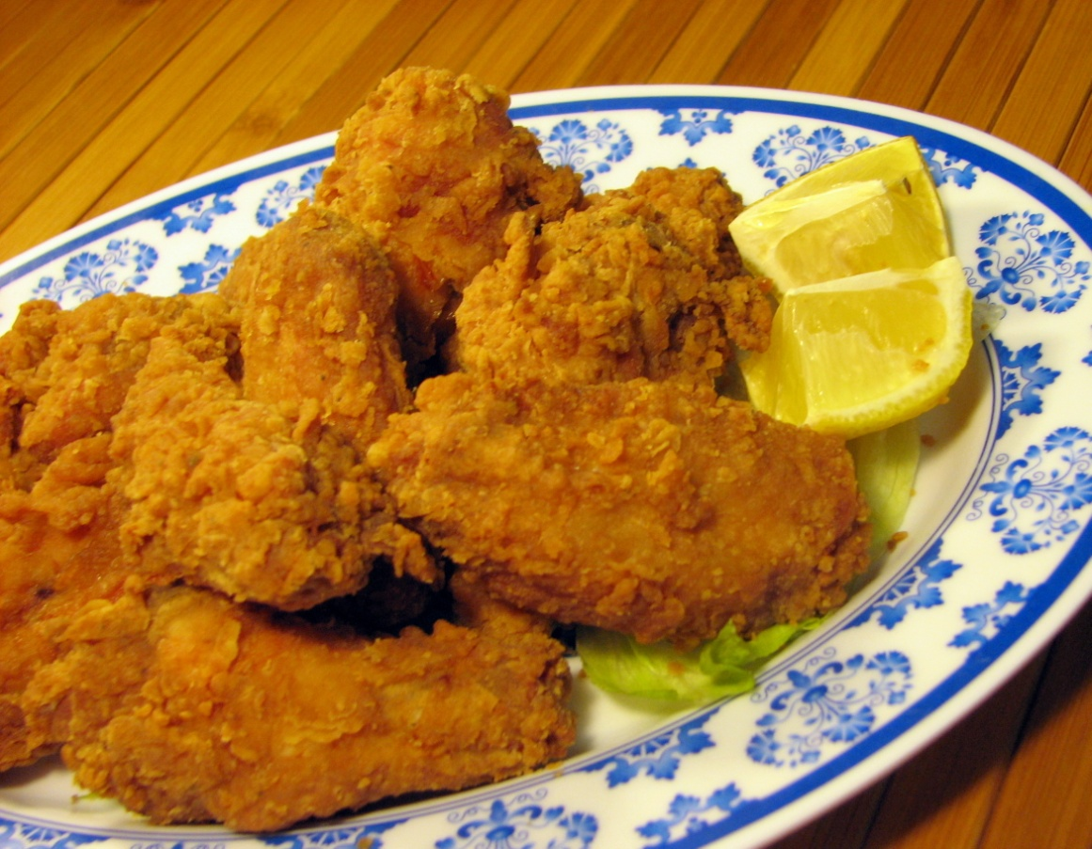
Do you like (food)?
7._____

Slide 10
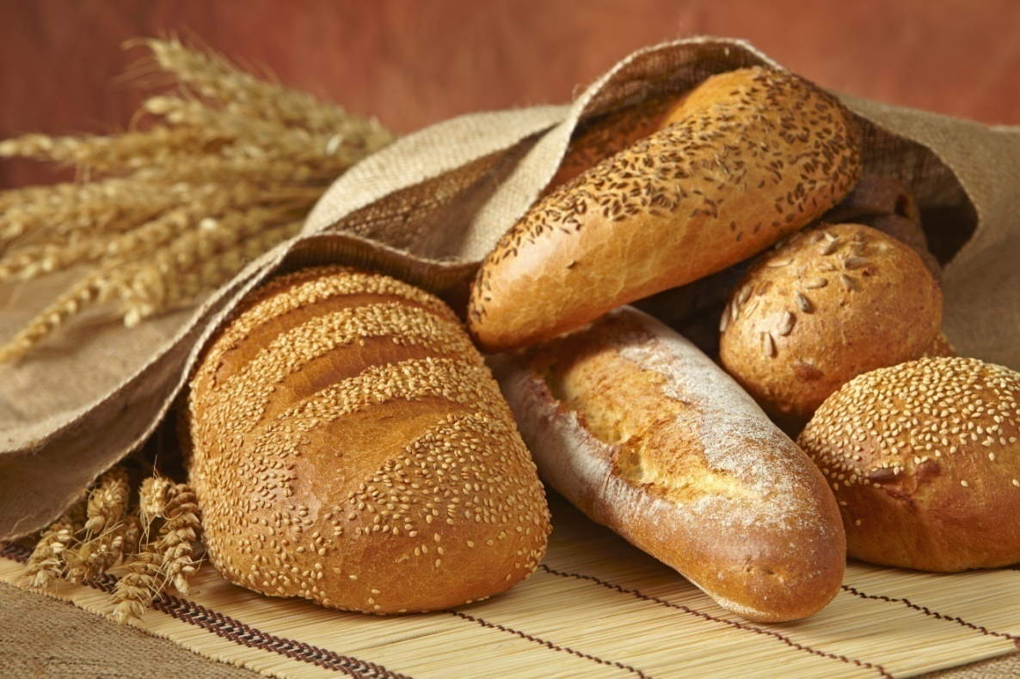
Do you like (food)?
8._____

Slide 11
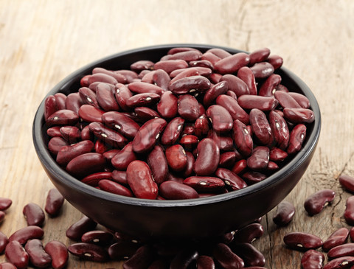
Do you like (food)?
9._____

Slide 12
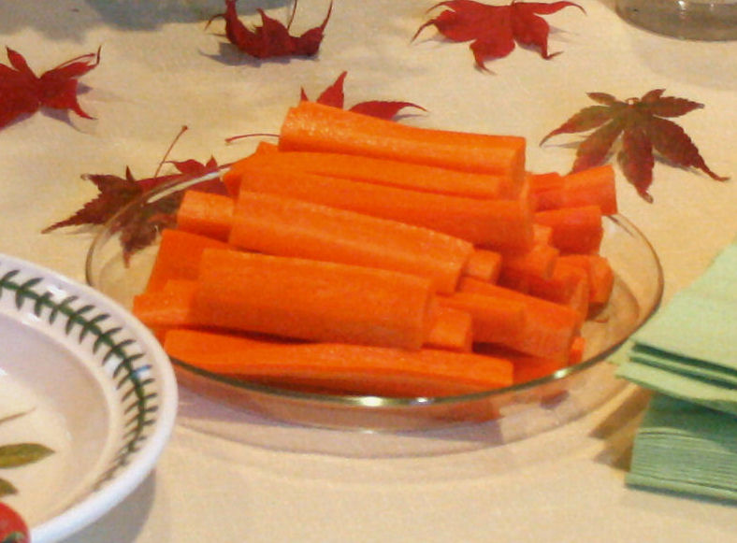
Do you like (food)?
10.____

Slide 13
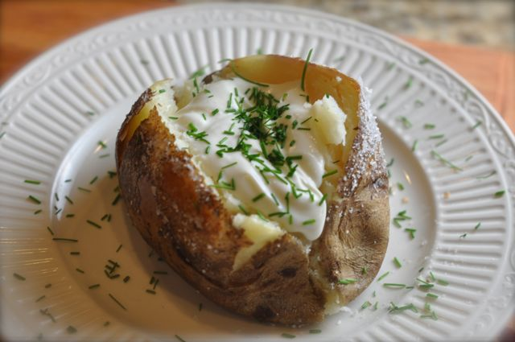
Do you like (food)?
11.____

Slide 14
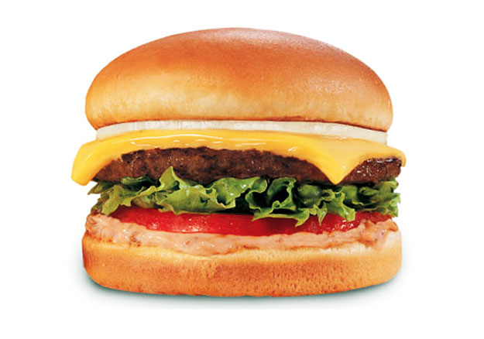
Do you like (food)?
12._____
13.____
14.____
15.____
16.____
17.____

Slide 15
Do you like (food)?
tuna

Slide 16
Do you like (food)?
salmon

Slide 17
Do you like (food)?
noodles

Slide 18
Do you like (food)?
rice

Slide 19
Do you like (food)?
soup

Slide 20
Do you like (food)?
shrimp

Slide 21
Do you like (food)?
chicken

Slide 22
Do you like (food)?
bread

Slide 23
Do you like (food)?
beans

Slide 24
Do you like (food)?
carrots
(carrot sticks)

Slide 25
Do you like (food)?
potatoes
(baked potatoes)

Slide 26
Do you like (food)?
bread (bun)
onions
cheese
beef
lettuce
tomato

