Slide 2
Level 1: Unit 2 Grammar “The Simple Present & WH ~ Questions/Answers”

Slide 3
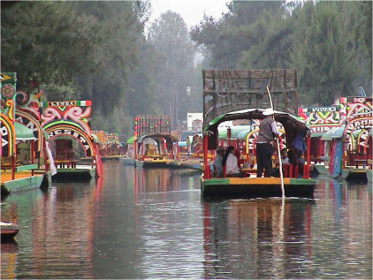
The Simple Present
We use the simple present for
FACTS
ROUTINES
&
STATES

Slide 4
The Simple Present
We use the simple present for FACTS:
I live in Mexico City.

Slide 5
The Simple Present
We use the simple present for ROUTINES:
We go to school on Monday.

Slide 6
The Simple Present
We use the simple present for STATES:
She feels tired.

Slide 7
(+)
(+)
(+)
Pronoun | Verb | Other
I | work live | in Tokyo.
You
We
They
(+)
(+)
Pronoun | Verb | Other
He | works lives | in Tokyo.
She
It
(+)
AFFIRMATIVE (+) STATEMENTS

Slide 8
He, She, It….add S
Regular verbs | + s | =
play | + s | plays
run | + s | runs
feel | + s | feels
get up | + s | gets up
SPELLING RULES: 3RD PERSON SINGULAR

Slide 9
He, She, It….add ES
Verbs ending with ch / sh / x / ss | + es | =
teach | + es | teaches
wash | + es | washes
fix | + es | fixes
miss | + es | misses
SPELLING RULES: 3RD PERSON SINGULAR

Slide 10
He, She, It…. add IES
Verbs ending with consonant + y | Change y to i + es | =
study | + ies | studies
try | + ies | tries
cry | + ies | cries
marry | + ies | misses
SPELLING RULES: 3RD PERSON SINGULAR

Slide 11
He, She, It….SPECIAL FORMS
Special Forms: | + ___ | =
do | + es | does
go | + es | goes
have | <memorize> | has
SPELLING RULES: 3RD PERSON SINGULAR

Slide 12
(-)
Use the helping verb “do” or “does” + not…
(-)
Pronoun | Verb | Other
I | do not work don’t live | in Tokyo.
You
We
They
(-)
Contractions Ok!
(-)
(-)
Pronoun | Verb | Other
He | does not works doesn’t lives | in Tokyo.
She
It
(-)
NEGATIVE (-) STATEMENTS

Slide 13
WH ~ Questions

Slide 14
What do you do? I’m an architect.
Where do you live? I live in Rio.
What does she do? She’s a college student.
Where does she go to school? She goes to NYU.
What do they do? They’re pilots.
Who do they work for? They work for Korean Air.
Where do they work? They work in an airport.
WH ~ Questions & Answers

Slide 15
What do you do? I’m an architect.
Where do you live? I live in Rio.
What does she do? She’s a college student.
Where does she go to school? She goes to NYU.
What do they do? They’re pilots.
Who do they work for? They work for Korean Air.
Where do they work? They work in an airport.
do/do=“be” + job
do/verb = present verb
do/do=“be” + job
do/verb = present verb
do/do=“be” + job
do/verb =
present verb
WH ~ Questions & Answers

