Slide 1
Smart Choice Level 4
Grammar Unit 10

Slide 2
Modals of Possibility
Must be, may be, might be,
could be, and can’t be are used to talk about degrees of certainty.
We call them modals of possibility.

Slide 3
Modals of Possibility
Modal | Possibility
must | almost 100% sure it is true
may (not) might (not) could | not sure if it is true (but it is possible)
must not couldn’t can’t | almost 100% sure it is not true

Slide 4
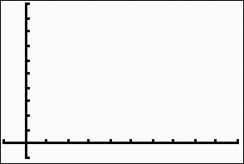
Modals of Possibility
100
80
60
40
20
may (not)
might (not)
could
must not
couldn‘t
can‘t
must

Slide 5
Modals of Possibility
I saw her going into her house.
She must be at home.
(= I’m almost 100% sure it is true.)
She speaks Portuguese.
She might be from Brazil.
(=I’m not sure if it’s true.)

Slide 6
Modals of Possibility
He looks Korean, but he doesn’t speak Korean.
He might not be Korean.
(=I’m not sure if it’s true.)
I just saw him in the park.
He can’t be in the library.
(=I’m almost 100% sure it is not true.)

Slide 7
Modals of Possibility
MAY/MIGHT NOT
&
CAN’T
Notice the DIFFERENCE
He may/might not be at home.
(=It is possible that he is not at home. I’m not sure.)
He can’t be at home. I just saw him in the park.
(=It is not possible that he is at home.)

Slide 8
Modals of Possibility
MUST and MUST NOT can be confusing.
He must be at home. (guess)
He must study for the test. (He has to study…)
She must not be hungry. (guess)
She must not go outside. (She is not allowed…)

Slide 9
Modals of Possibility
modal + be + adjective
He might not be Korean.
modal + be + description
She could be from Brazil.

Slide 10
Modals of Possibility
modal + be + verb(ing)
He must be sleeping.
modal + be + location
She can’t be at school.

