Slide 1
Level 4 Unit 11 Vocabulary

Slide 2
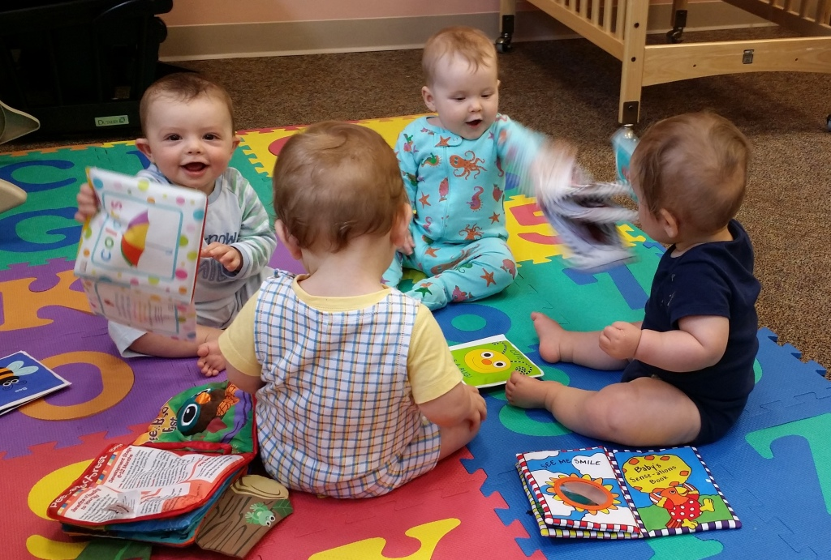
1._____________
Nursery School

Slide 3
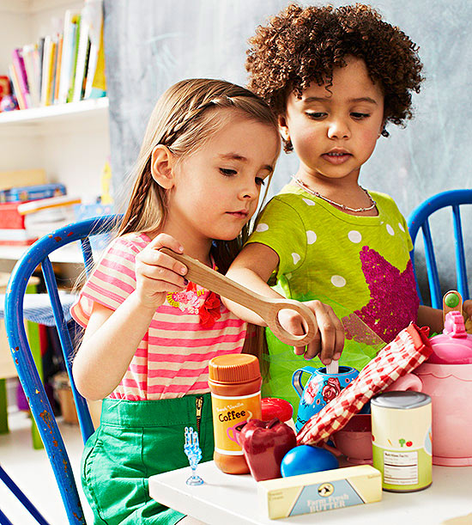
2._____________
Preschool

Slide 4
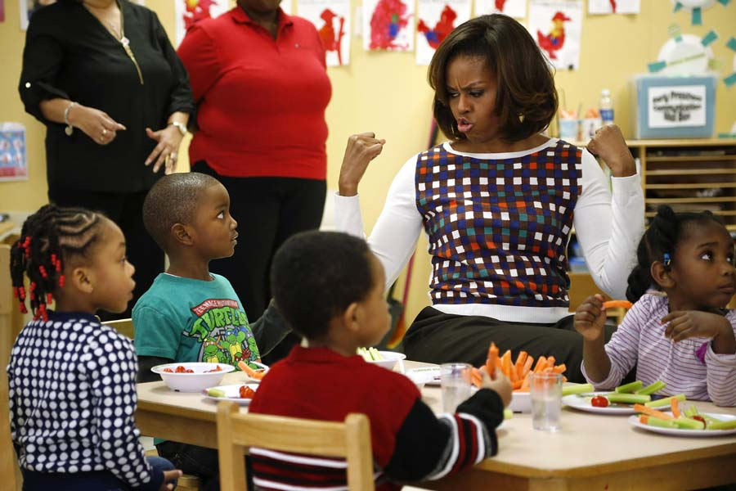
3._____________
Kindergarten (look for reading signs)

Slide 5
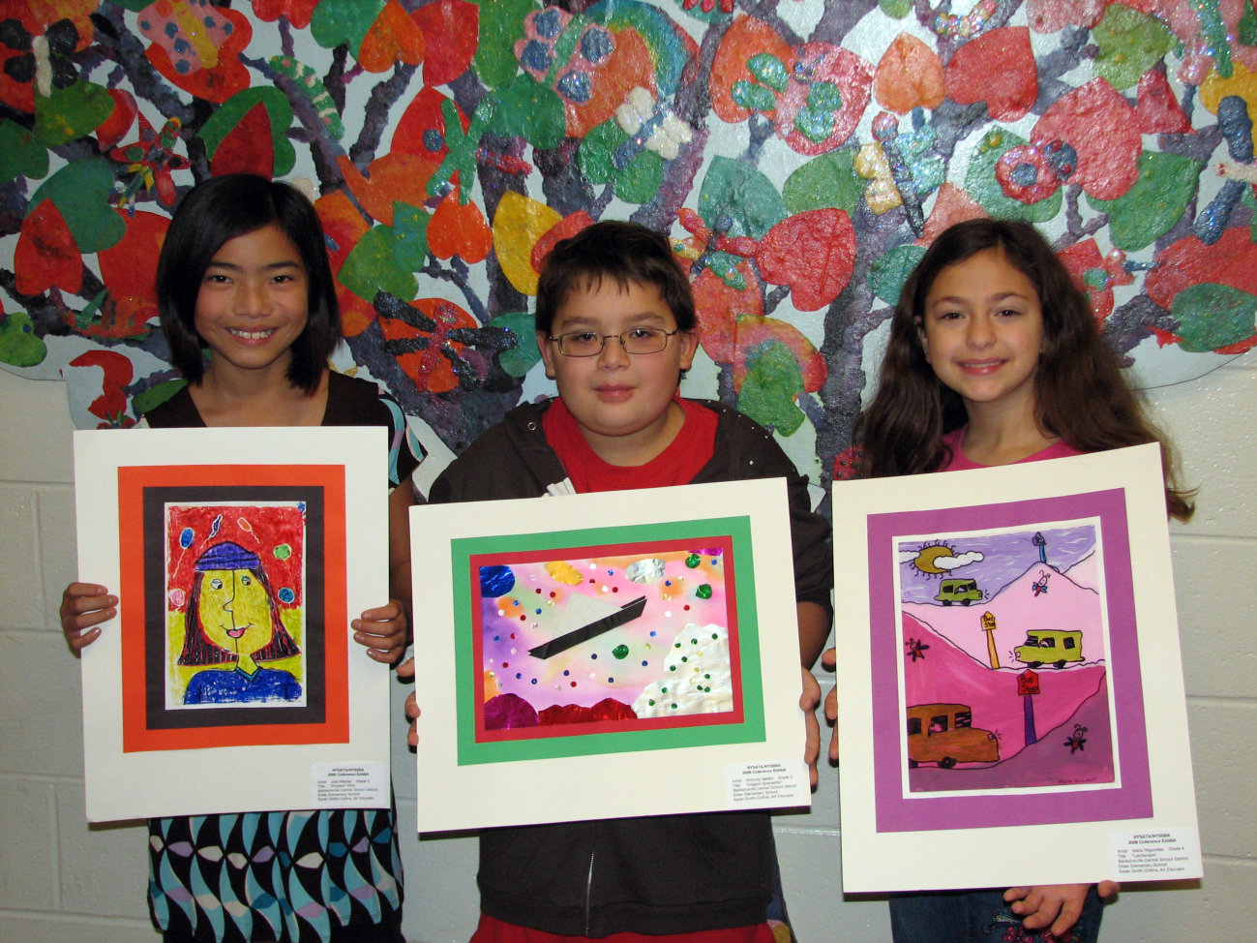
4.______________
Elementary School

Slide 6
5.__________
Middle School

Slide 7
6.__________
High School

Slide 8
7.__________
University

Slide 9
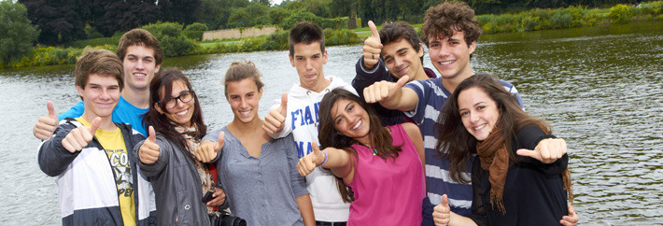
8.__________
Summer School

Slide 10
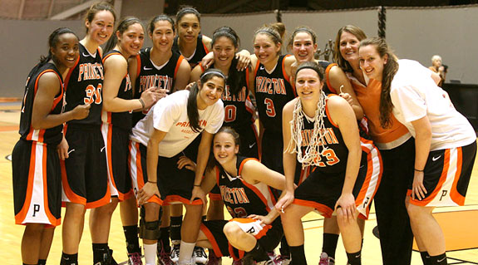
9.__________
Sports Team

Slide 11
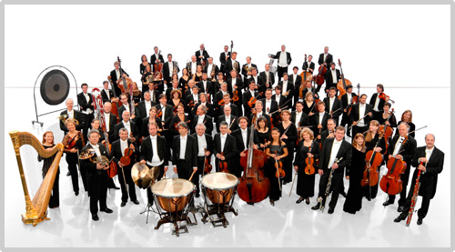
10.__________
Orchestra

Slide 12
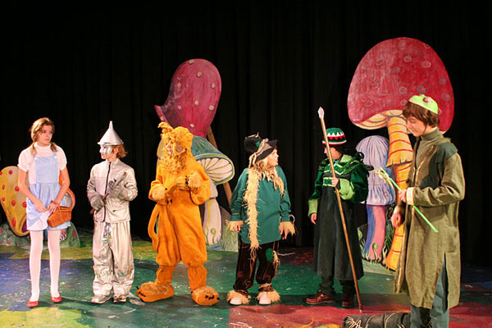
11.__________
Drama Club

Slide 13
12.__________
Choir

Slide 14
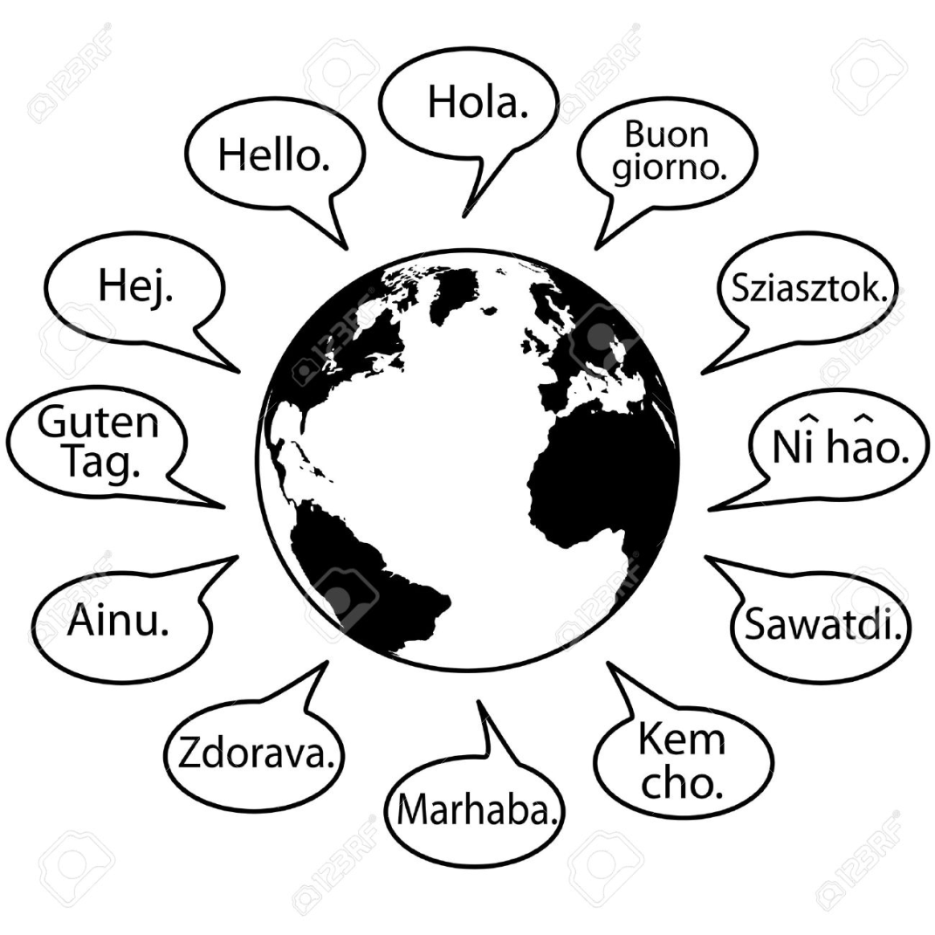
13._____________
Language School

Slide 15
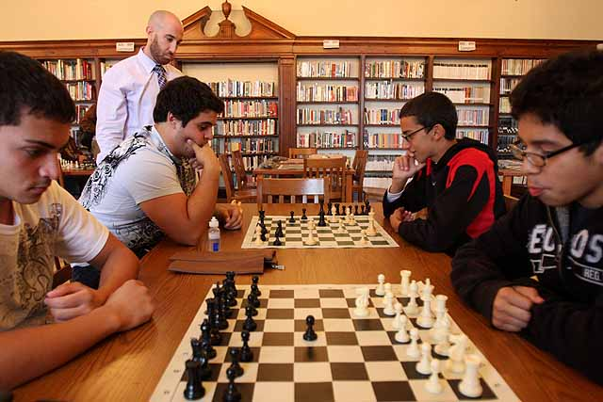
14._____________
Chess Club

Slide 16
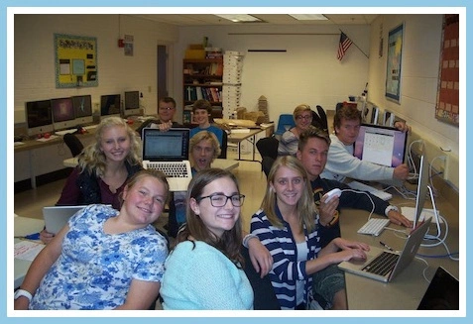
15._____________
Computer Club

