Slide 1
Level 4 Unit 12 Vocabulary

Slide 2
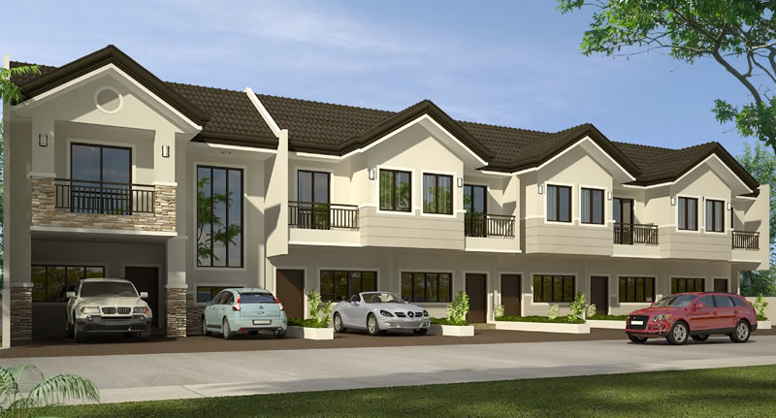
Vocabulary
Beautiful townhouse in a quiet village.

Slide 3
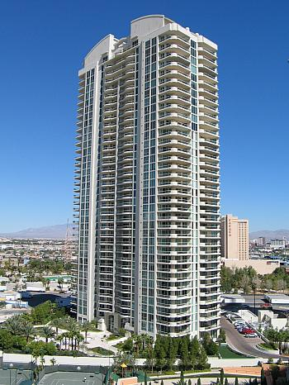
Vocabulary
Studio apartment in a high-rise downtown.

Slide 4
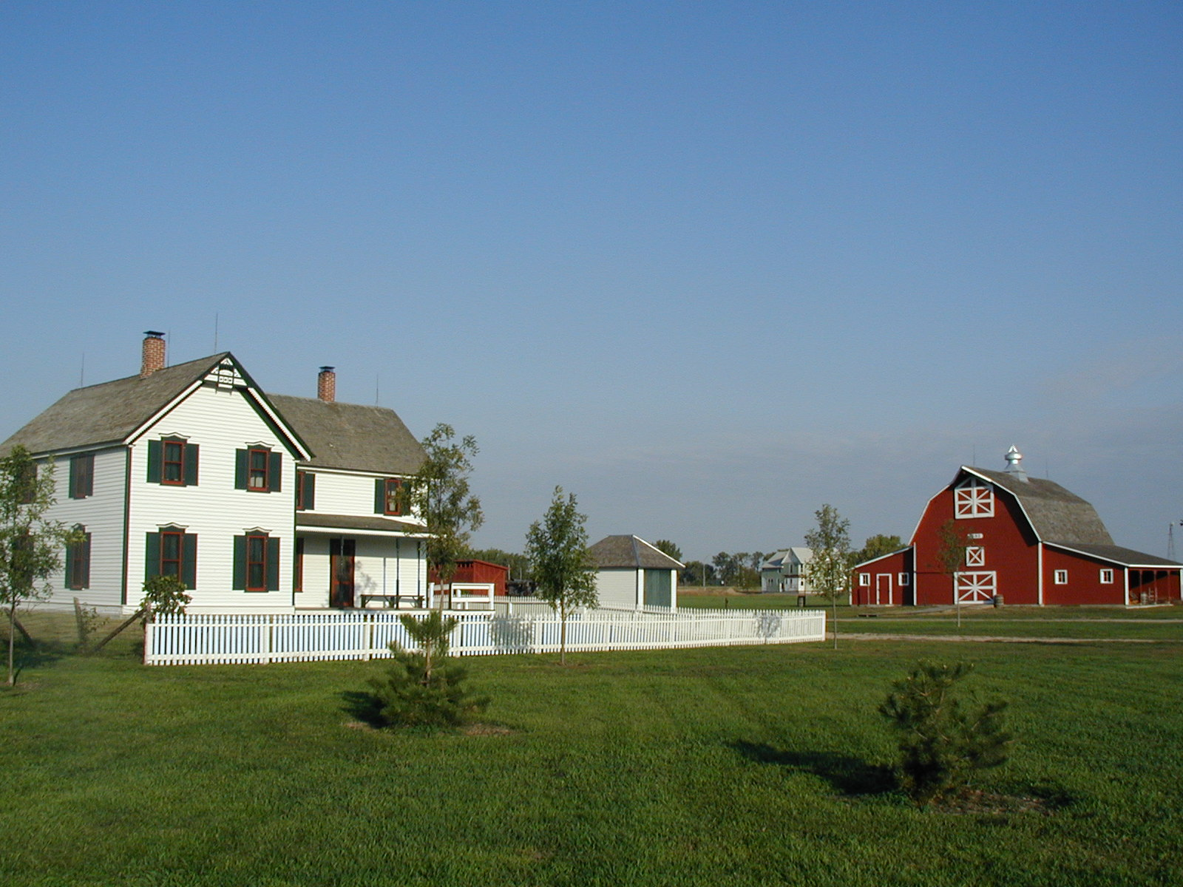
Vocabulary
Old farmhouse on a ranch. Includes barn.
farmhouse
barn

Slide 5
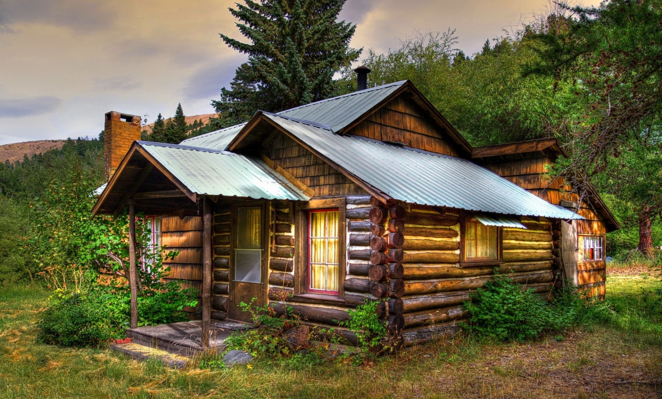
Vocabulary
Log cabin in the woods. Lots of privacy!

Slide 6
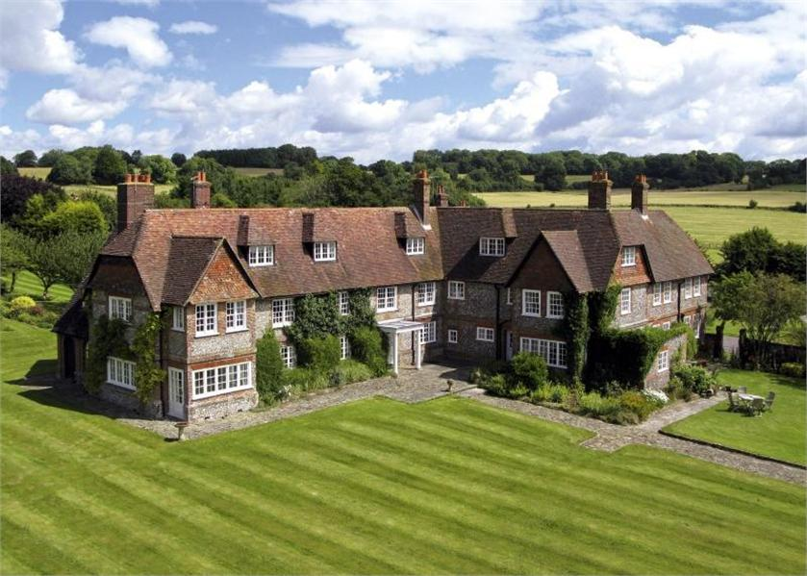
Vocabulary
Large mansion in the country.
Far from nearest neighbors.

Slide 7
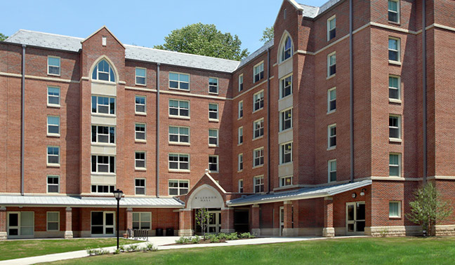
Vocabulary
Shared dorm room on a university campus.

