Slide 1
Level 4 Unit 9 Vocabulary

Slide 2
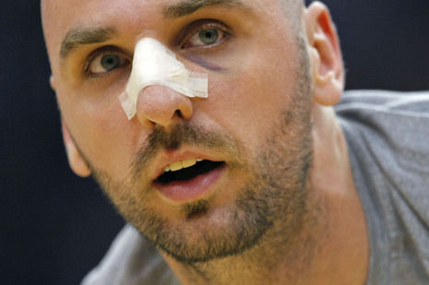
He has a broken nose.
(He broke his nose.)

Slide 3
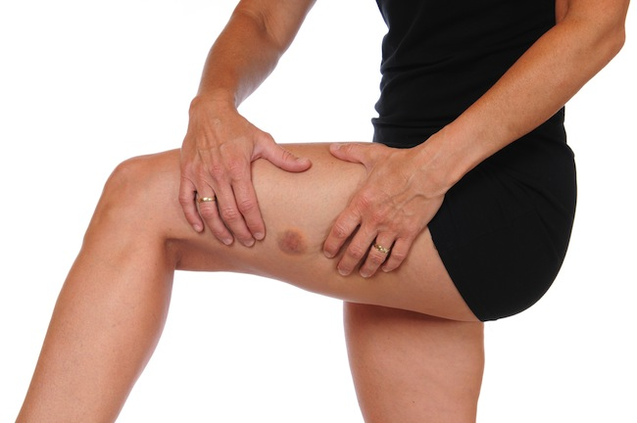
He has a bruised leg.
(He bruised his leg.)
bruise

Slide 4
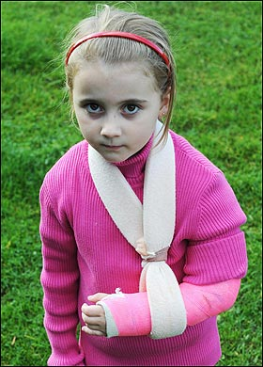
She has a broken arm.
(She broke her arm.)
sling
cast

Slide 5
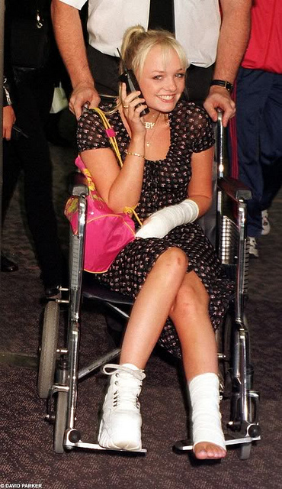
She sprained her ankle.
(She has a sprained ankle.)

Slide 6
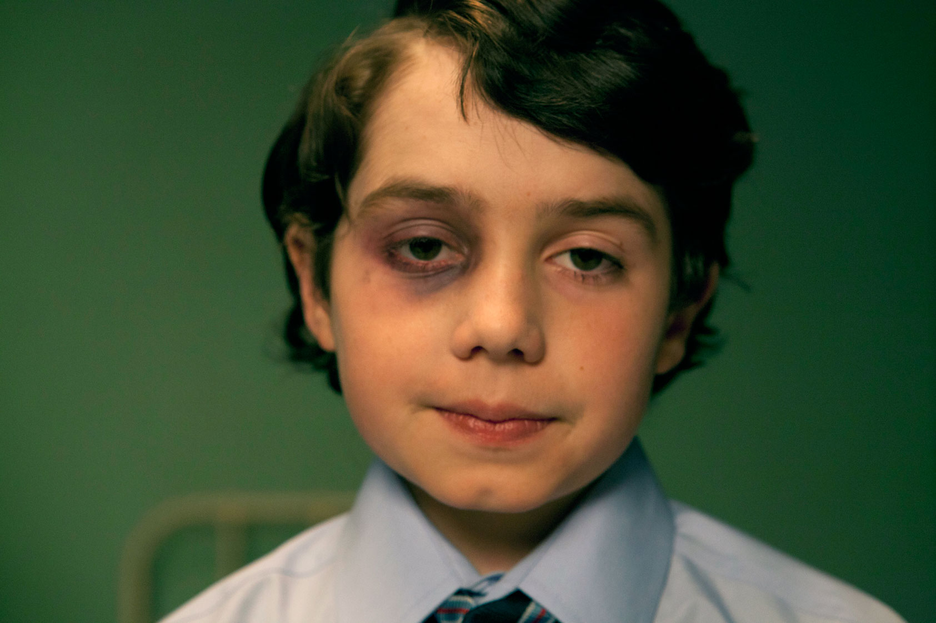
He has a black eye.

Slide 7
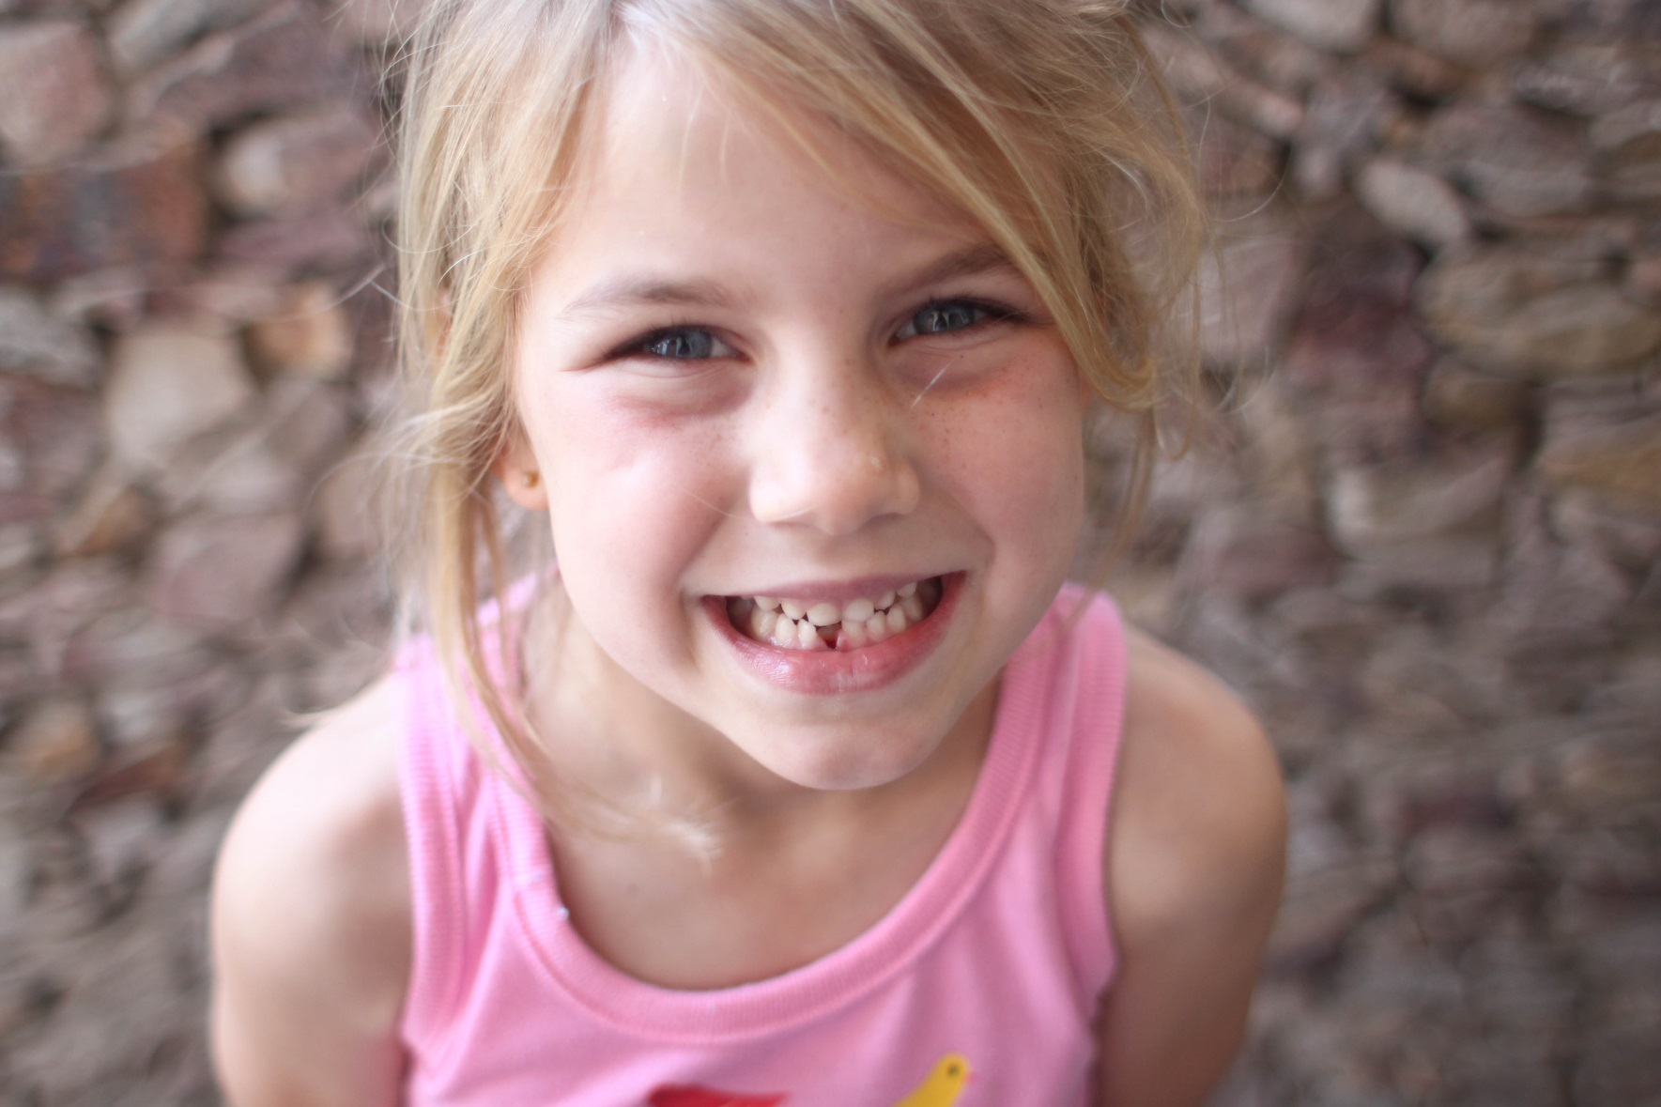
She lost a tooth.

Slide 8
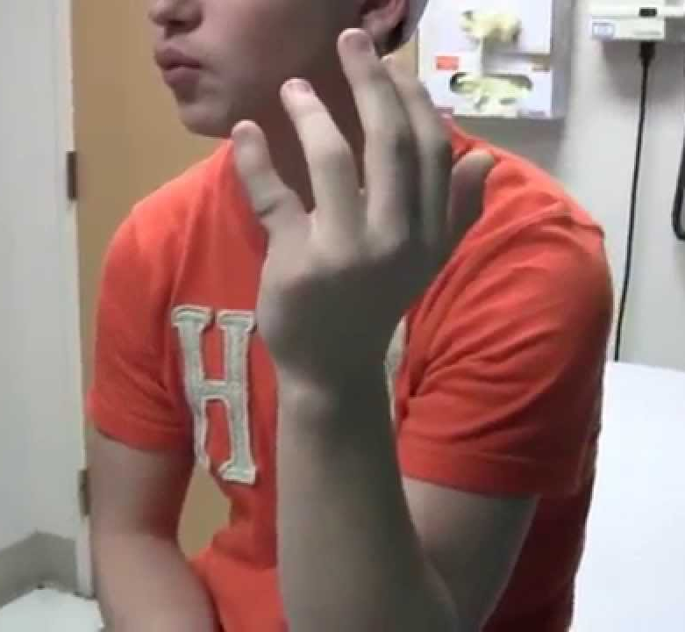
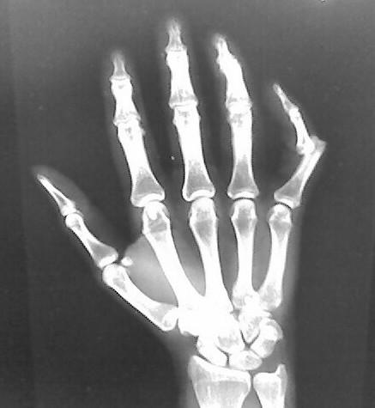
He dislocated his finger.
(He has a dislocated finger.)

Slide 9
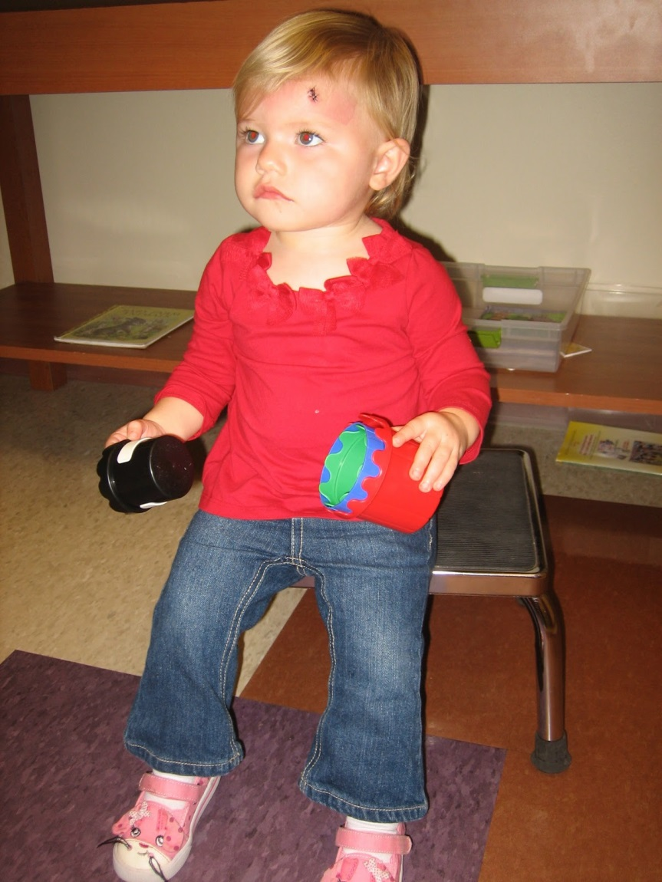
She cut her head.
(She has a cut on her head.)
stitches

Slide 11
Jungwon Medical Center
Patient Name: ________________________________________________________
Reason for visit: ________________________________________________________
How did it happen? ________________________________________________________
When did it happen? ________________________________________________________
Where did it happen? ________________________________________________________
__________________________
Patient Signature
__________________________
Doctor Signature

Slide 12
Jungwon Medical Center
Patient Name: ________________________________________________________
Reason for visit: ________________________________________________________
How did it happen? ________________________________________________________
When did it happen? ________________________________________________________
Where did it happen? ________________________________________________________
__________________________
Patient Signature
__________________________
Doctor Signature

Slide 14
Jungwon Medical Center
Jennifer McGhee
Patient Name: ________________________________________________________
Reason for visit: ________________________________________________________
How did it happen? ________________________________________________________
When did it happen? ________________________________________________________
Where did it happen? ________________________________________________________
She broke her arm.
She fell off a swing.
It happened last night at 8pm.
It happened at Yullyangdong Park.
__________________________
Patient Signature
__________________________
Doctor Signature

