Slide 1
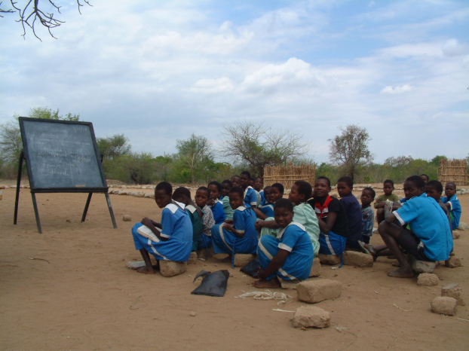
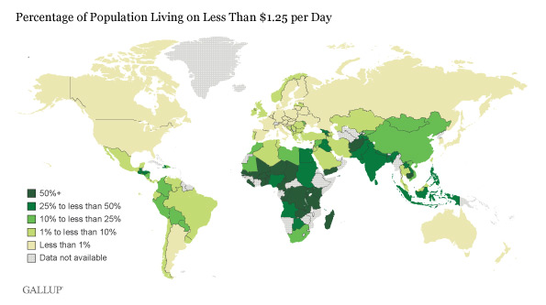
“All Children around the world deserve to go to School.”
Petition to help 89 of world’s poorest countries.
May 8, 2018
Jennifer
Elderberry
Problems
Solutions
What I can do

Slide 2
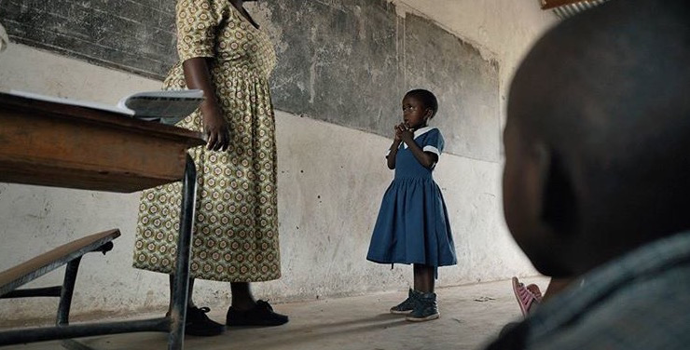
89 of the Poorest Countries
Problem 1:
89 of the world’s poorest countries need educational help.
“The world's poorest countries cannot always afford to provide a free and safe, quality primary, and secondary education for all children.”

Slide 3
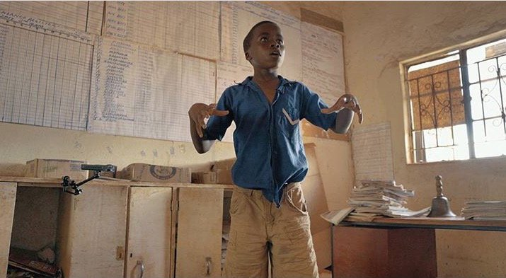
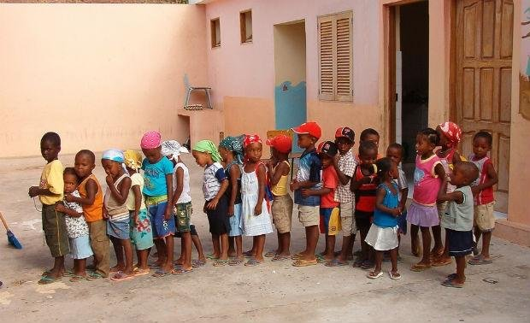
Problem 2:
264 million children around the world are missing out on an education.
By 2030, more than 800 million of the 1.6 billion young people in the world will have never gone to school or have had the basic skills needed for employment.
264,000,000
Children

Slide 4
Solution to Problem 1:
89 of the world’s poorest countries need educational help.

Slide 5
Solution to Problem 2:
264 million children around the world are missing out on an education.

Slide 6
