Slide 1
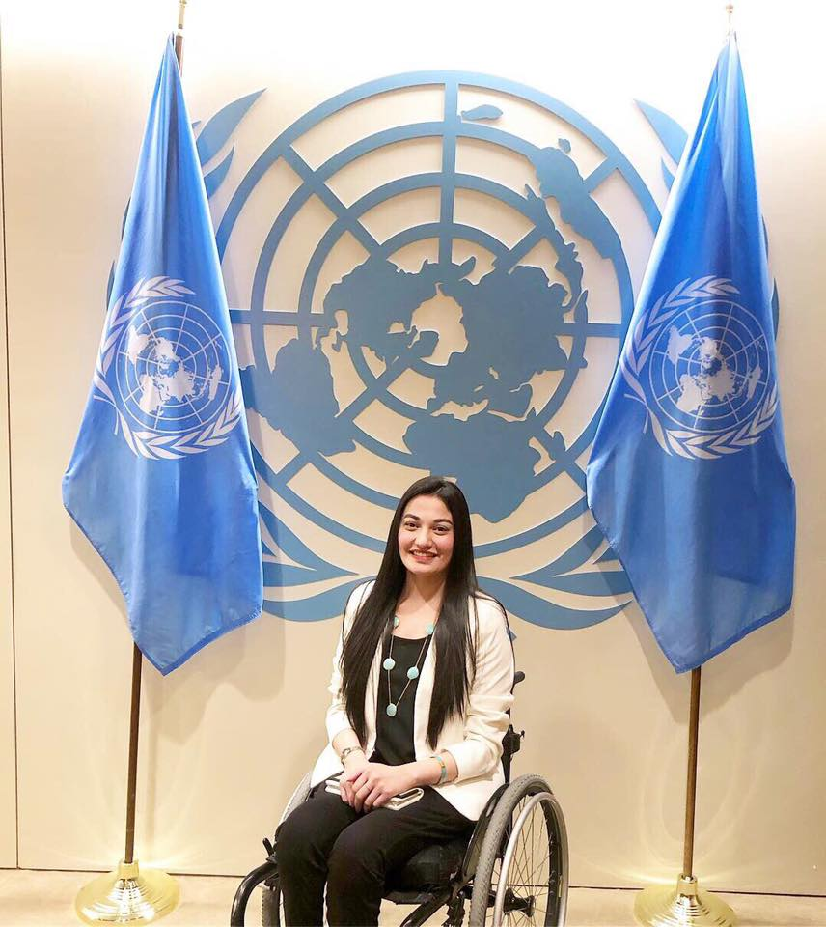
Muniba Mazari
My Hero
By Jenn, Lilac Class
March 25, 2019

Slide 2
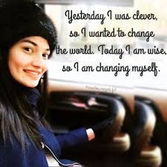
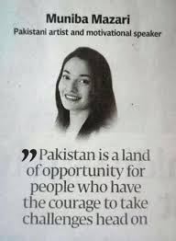
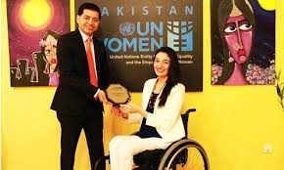
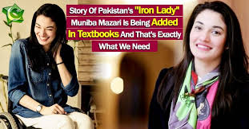
How She Changed the World

Slide 3
Why I chose her
‘Every girl is a born leader, don’t let them tell you otherwise!’- #MunibaMazari
“Limitations are just an illusion in our minds and nothing in this world can stop you from achieving your goal.”

