Slide 1
Level 1 – Unit 2 Vocabulary - jobs

Slide 2
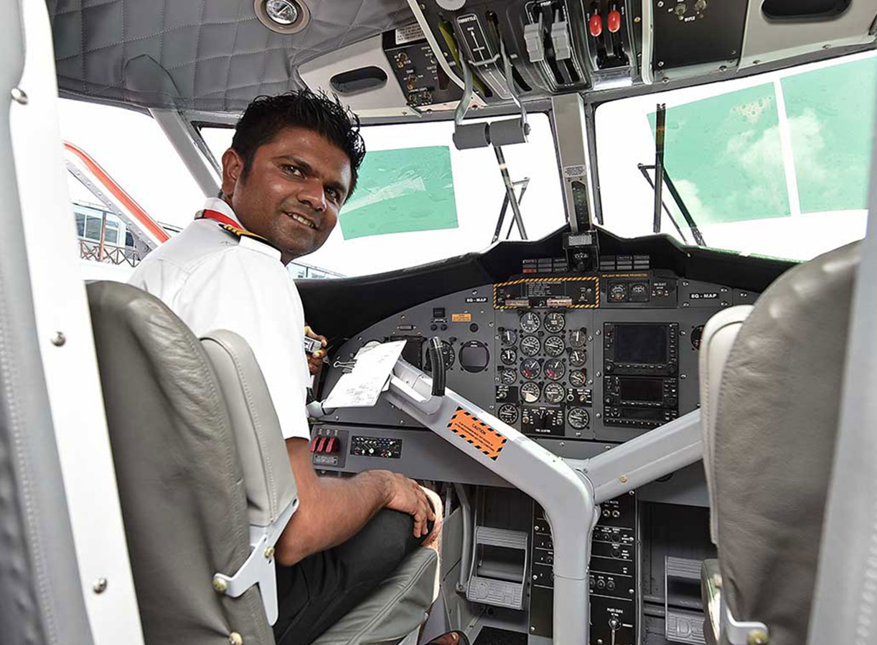
Michael
Michael is a pilot.

Slide 3
Emi
Emi is a doctor.

Slide 4
Laura
Laura is an architect.

Slide 5
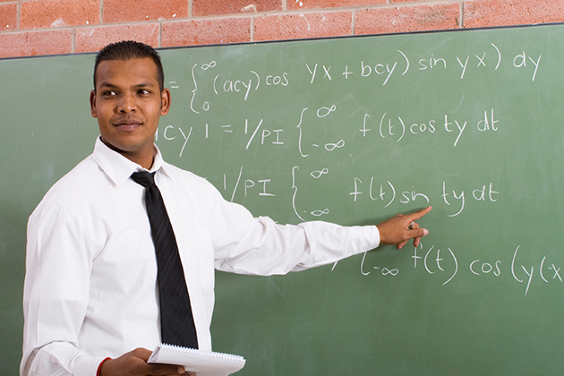
Jose
Jose is a teacher.

Slide 6
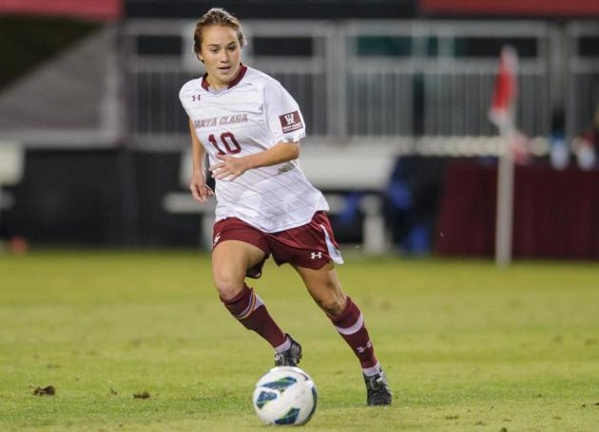
Kim
Kim is a soccer player.

Slide 7
Becky
Becky is a singer.

Slide 8
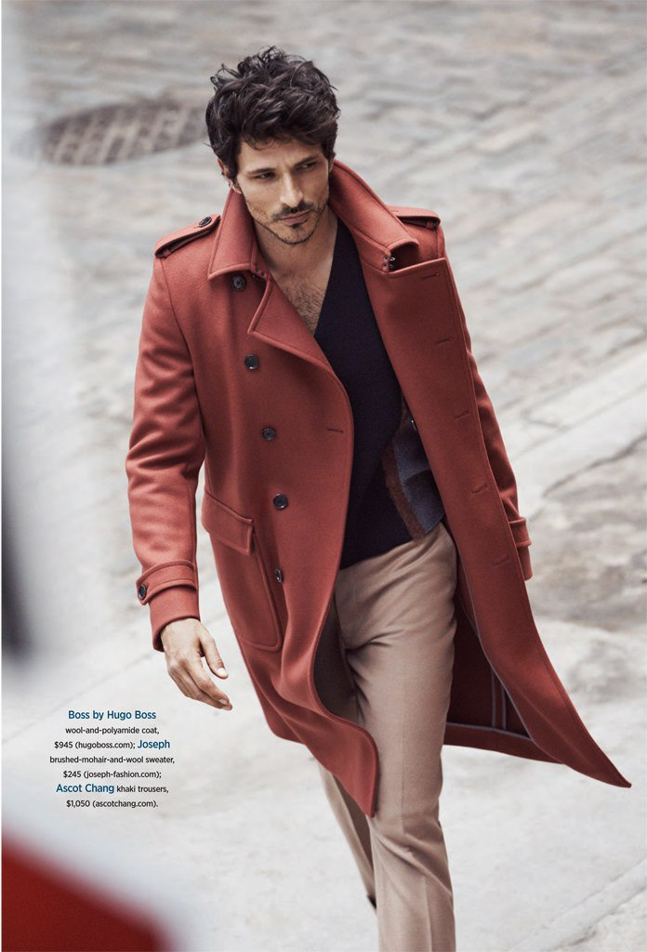
Chris
Chris is a model.

Slide 9
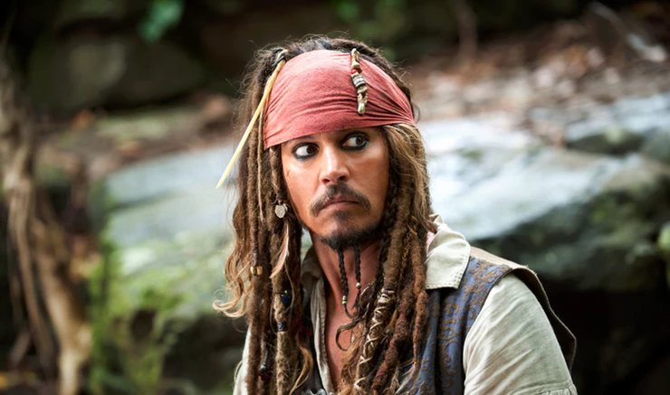
Johnny
Johnny is an actor.

Slide 10
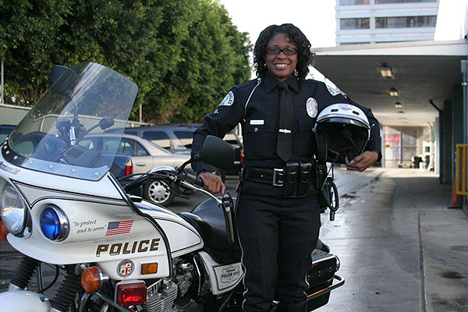
Lisa
Lisa is a police officer.

Slide 11
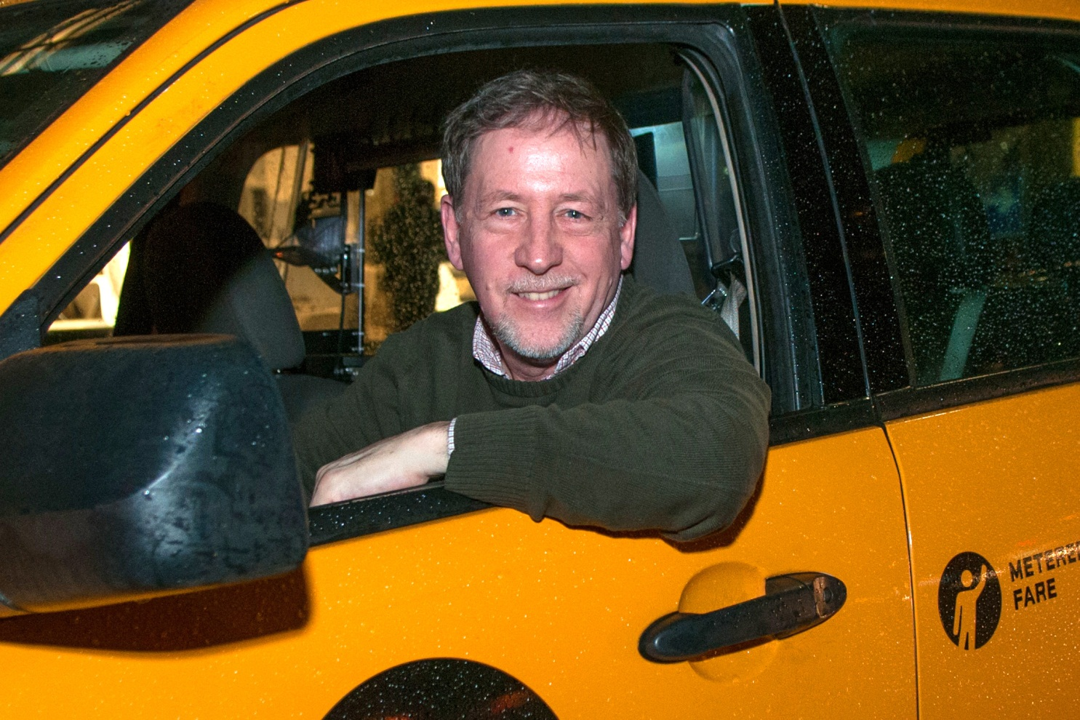
Tom
Tom is a taxi driver.

Slide 12
Jenny
Jenny is a college student.

Slide 13
Edward
Edward is an assistant.

Slide 14
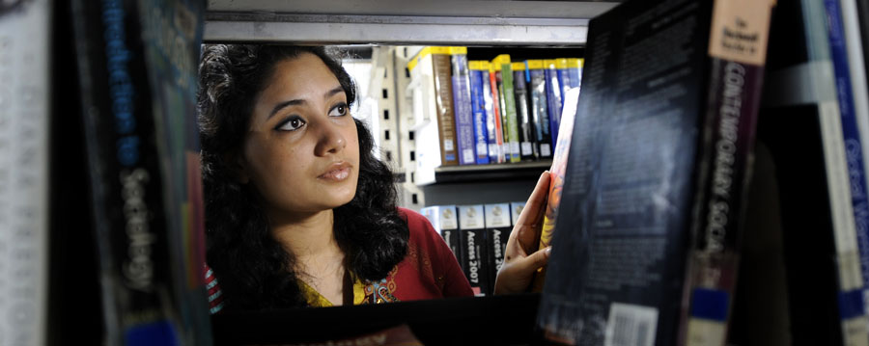
Andrea
Andrea is a library assistant.

Slide 15
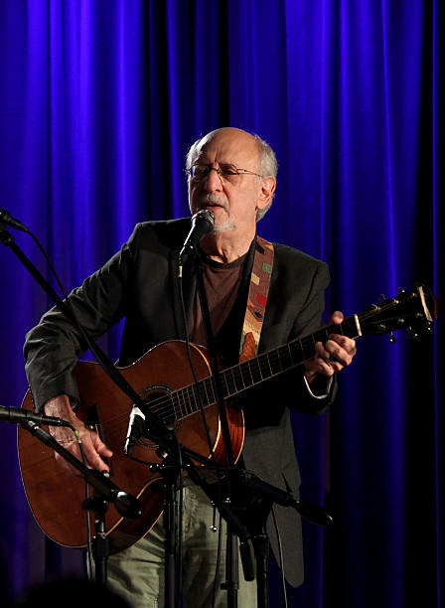
Peter
Peter is a musician.

Slide 16
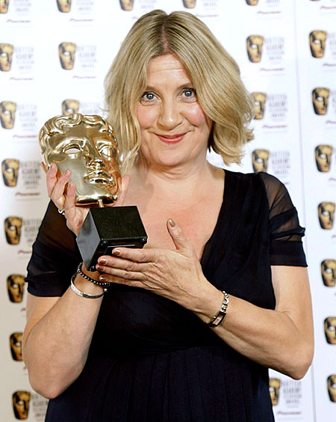
Leanne
Leanne is a movie director.

Slide 17
Josh
Josh is a nurse.

Slide 18
Victoria
Victoria is a server.

Slide 19
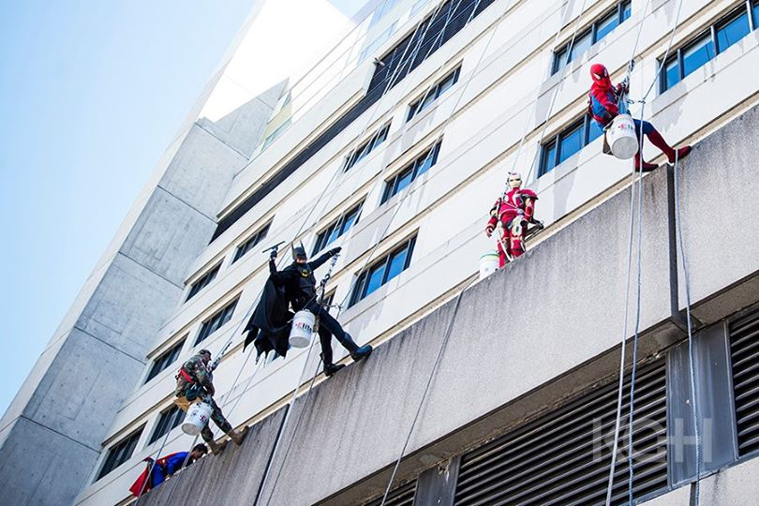
Spiderman
Iron Man
Batman
Captain America
Superman
They are superheroes.
They are window washers.

Slide 20
Samantha
Samantha is a writer.

Slide 21
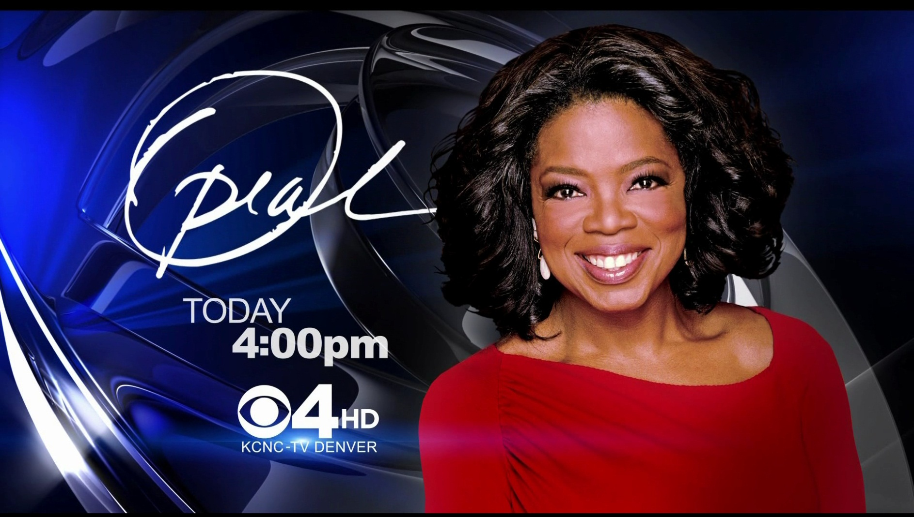
Oprah
Oprah is a TV host.

