Slide 1
Self -Discovery
Who are you?

Slide 2
Write 5 words that describe who you are.

Slide 3
Let’s Watch

Slide 4
human calculator
translator
Let’s Watch
world class shrink
one of the 5 smartest men on earth
mechanical prodigy

Slide 5
Personality Test
Use your phones now to go to
www.16personalities.com
and take the personality test.

Slide 6
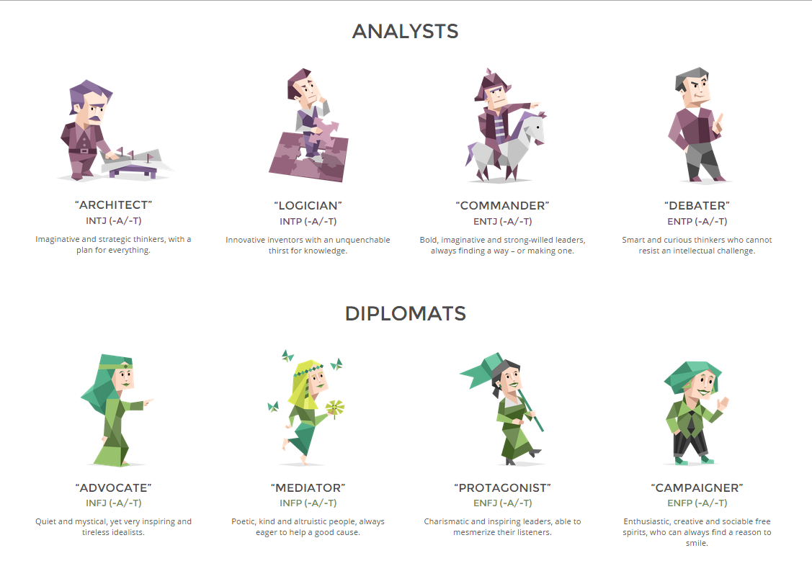

Slide 7
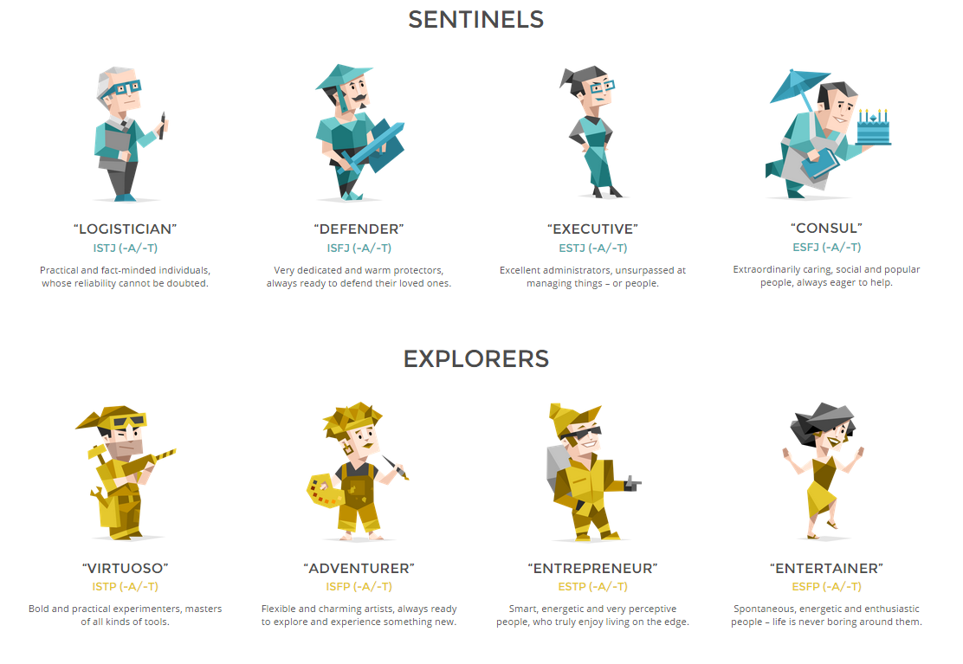

Slide 8
“Scorpion” – And Compensating for our Weaknesses:
It’s always fun when pop culture echoes some of our more serious interests in life. </Scorpion> premiered last year on American television. It’s a “spy” show that involves a group of geniuses working for the CIA. It has the intrigue, fight scenes, tech toys, close calls and explosions you expect from a spy drama. That’s all for fun, and it delivers. But there is a parallel story line about human relationships.
The geniuses (mechanical, mathematical, psychological, and technological savants), figure out how to do just about anything they need to accomplish their mission. The only thing that they don’t understand is how not to rub everybody in their path the wrong way. These four may be at the top of the IQ scale, but they have no emotional intelligence. Socially speaking, they are a band of misfits who constantly offend and insult others without flinching.
Enter Paige, a single-mom waitress with genius nine-year-old son and a heart of gold. She joins the team to translate between the geniuses and the rest of the world. Paige provides diplomacy and attends to the feelings of the others who are involved. She provides the emotional buffer that keeps the blunt group in check and behaving correctly. In return, they help her understand her son who sometimes seems like he’s on the autistic spectrum. At the very least, he knows his intelligence and the perspective it provides makes him different.
The show works as a great parable for all of us, no matter what our weaknesses. There are many ways to deal with those things that hold us back in life, but “team-building” can be one of the best. Bringing in someone who can fill in where our faults fail us is a great way to compensate and can result in a mutually worthwhile relationship.
Take for example the disorganized visionary who has his or her head in the clouds and forgets the simple things that need to be accomplished for life to go smoothly. Someone who is a stickler for detail would be a great asset by helping this person pays all of his bills or get his car registration renewed. Or take the excessively conscientious person whose life is predictable but dull. She could possibly use some of the excitement and stimulation that a more adventurous type might bring. We can imagine probably countless possible combinations of mutually helpful pairings where the outcome is growth and a better life for all the participants.
Setting up a team of complementary people is generally artificial. On a personal level, we gravitate most naturally toward people who fit our style of living. We don’t look for people who will obviously disrupt our comfort zones. Creating such teams is more the type of thing done in businesses or other organizations. We don’t typically recruit strategic talent for our private lives – even if we should.
That doesn’t mean we can’t appreciate and encourage those in our lives who already offer us balance and something different than what we’re used to. Sometimes the “different” others are present in our lives without our having to seek them out. Maybe that weird hipster cousin has more to offer than you know. Maybe a taste of that trendy quirkiness would make your life a little more interesting. You don’t have to adopt it… just appreciate it. Or that extravert who sits across from you at work and keeps inviting you to lunch – maybe she can help you balance your introverted ways. Look around you. What’s your example?
So, like the geniuses on <Scorpion>, perhaps we need to keep our eyes open for the Paige’s in our lives. Growing is about stretching and finding balance while remaining true to ourselves. Sometimes it helps to have someone on our team who can help us make that happen.

Slide 9
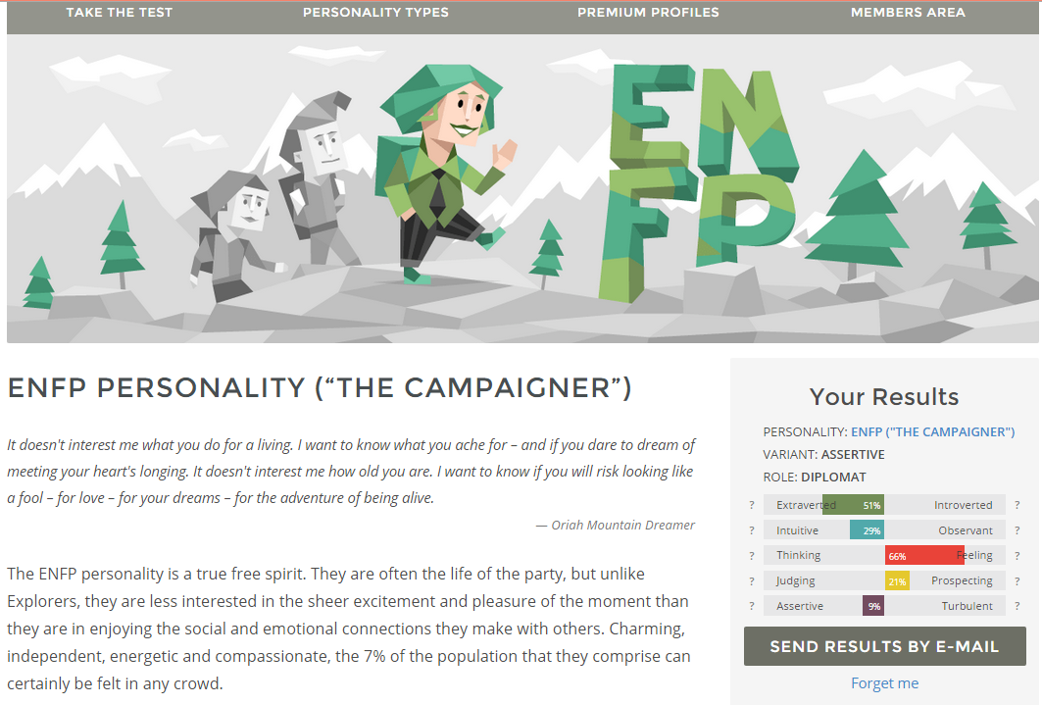
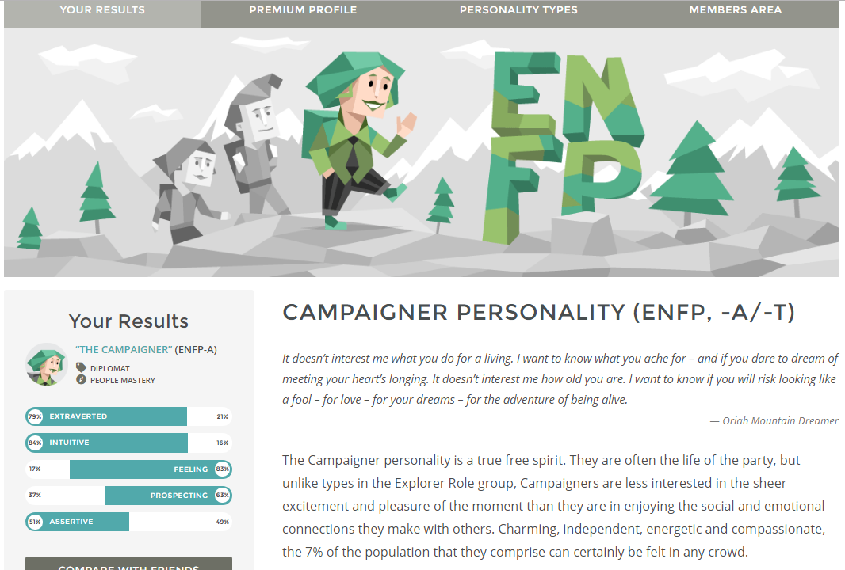

Slide 10
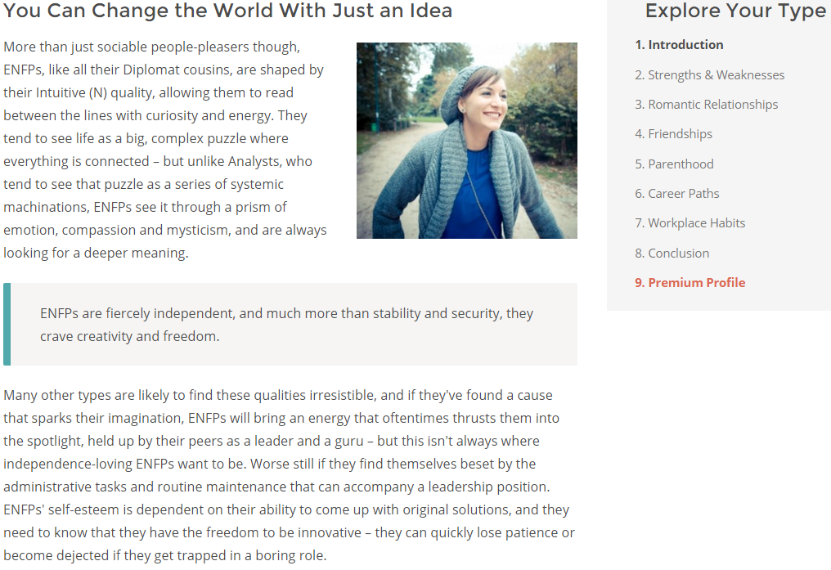

Slide 11
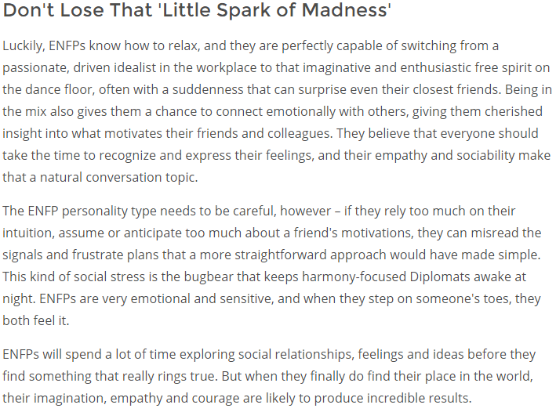

Slide 12
Jennifer's Link

