Slide 1
Pronunciation

Slide 2
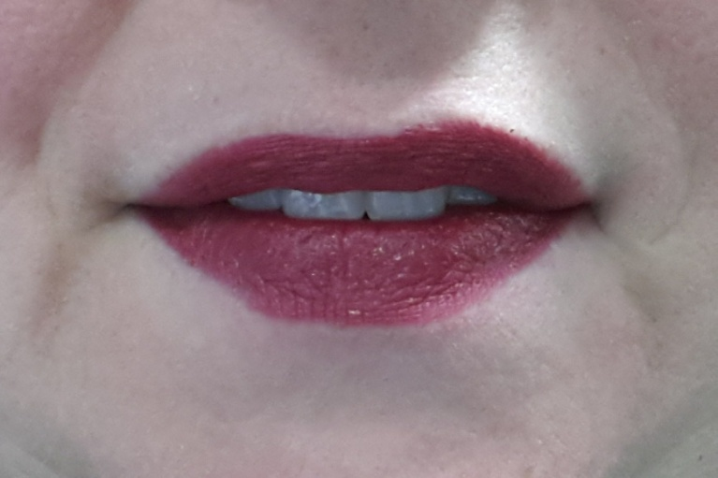
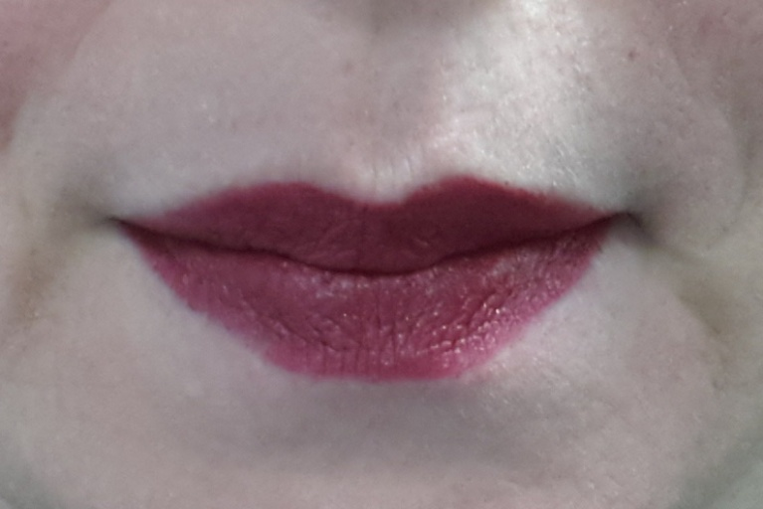
F
P
fast – past fen – pen fool – pool
fee – P fine – pine fop – pop
feel – peel fly – ply fork – pork
feet – peat foot – put face – pace

Slide 3
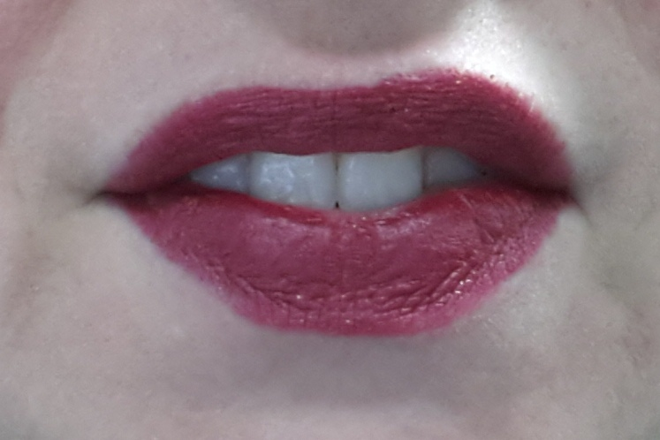
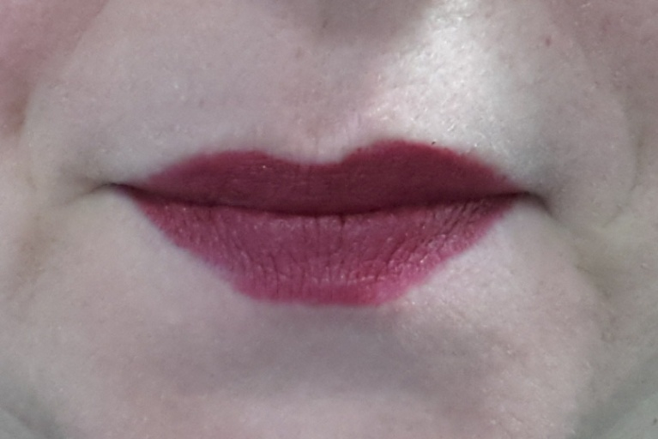
V
B
B – V ban – van best – vest
bat – vat boat – vote bale – vale
berry – very bent – vent bow – vow
best – vest bet – vet dub – dove

Slide 4
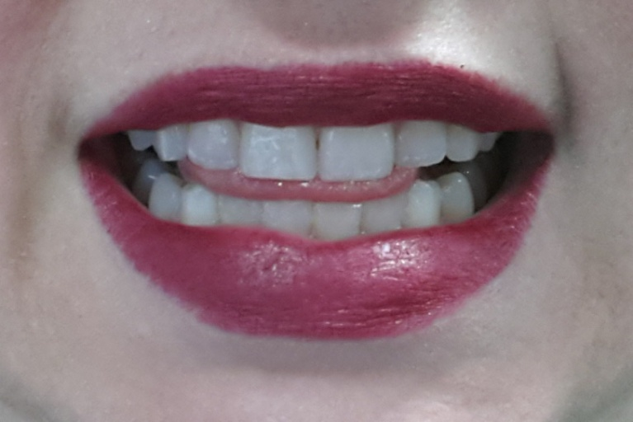
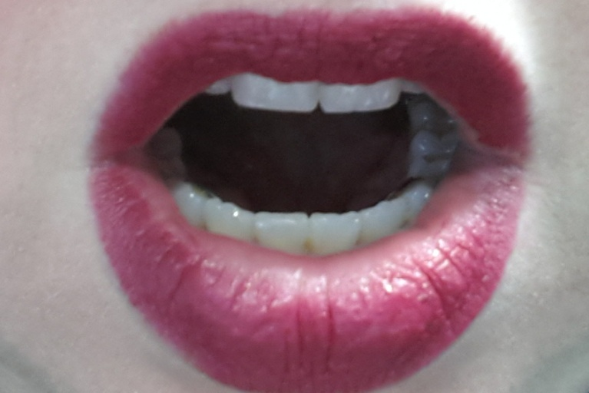
L
R
cloud - crowd loom – room lead – read
fly – fry blue – brew lane – rain
light – right glass – grass lows – rose
lice – rice lied – ride lock – rock

Slide 5
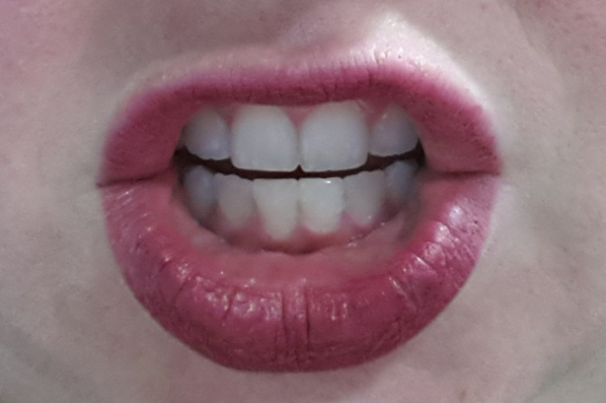
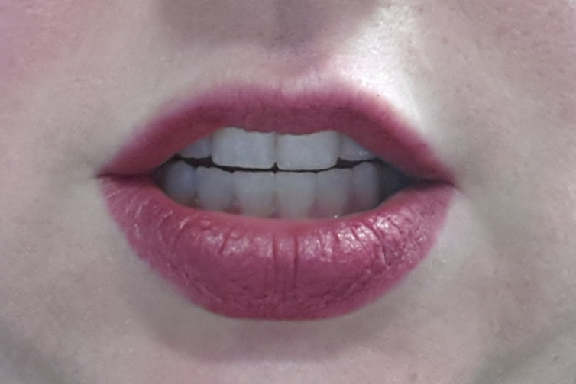
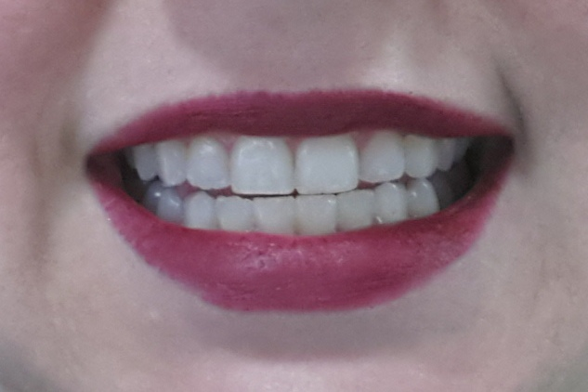
Ch
J
Z
chip – jip – zip
chew – Jew – zoo
chow – jowl – wows

Slide 6
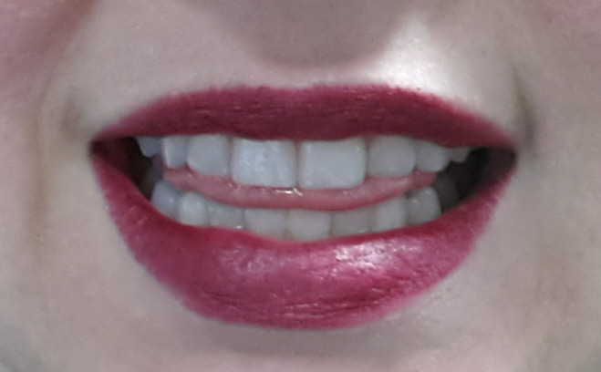
Th
S
faith – face myth – miss thing –sing
tenth – tense thick – sick math – mass
mother – father – brother

Slide 7
Tongue Twisters
Freddy Pepperoni fried potatoes for his French friends Peter and Fiona.
Victoria Bellaviks blew very blue bubbles for every five doves she viewed.
Little red rabbits love relaxing while learning really long lessons.
Jerry Chippendale zoomed and zigzagged as Julie the giraffe chased him around the zoo.
Seth at the thrift store sells soft, thick socks and leather slippers.

