Slide 1
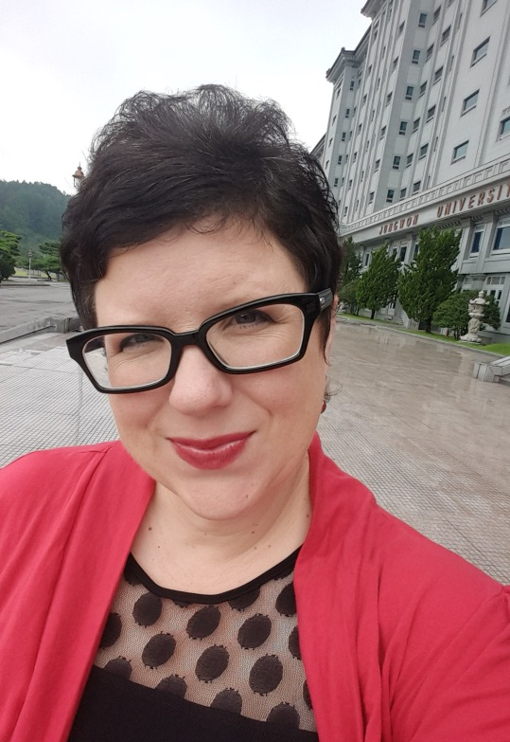
JUNGWON UNIVERSITY
English Conversation 2 (Level 4) spring/2017
Professor:
Jennifer L. Mc Ghee, MA Ed.

Office Hours by Appointment
jenni.mcghee@gmail.com
010.5728.2733

Slide 2
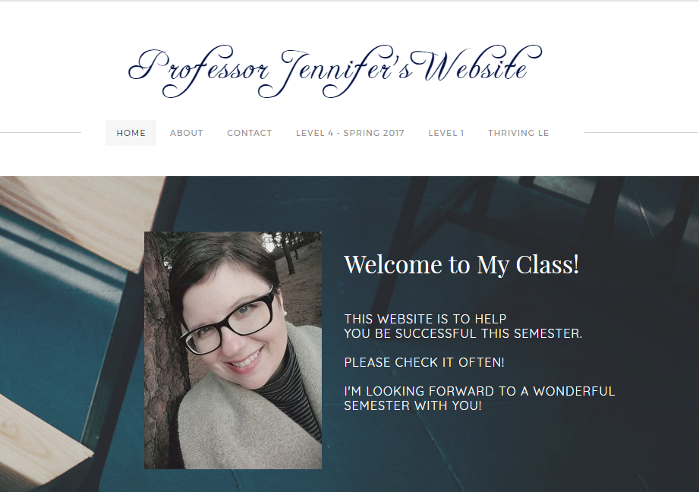
Professor Jennifer’s Website
http://professorjennifer.weebly.com

Slide 3
1. Attendance
10% of your Grade! Come to Class!
Be on Time.
Late 3 Times = 1 Class Absence
7 or more Absences = FAIL
If late, tell the professor AFTER CLASS so I can mark your attendance.
If you know you will be absent, tell the professor BEFORE class…or you cannot make up the work.

Slide 4

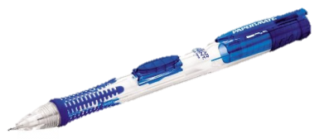




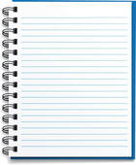
2. materials
NO REGULAR PENS PLEASE!
2 Textbooks
NO Book? = ABSENT
Pencil
Eraser
Red Pen
Notebook

Slide 5
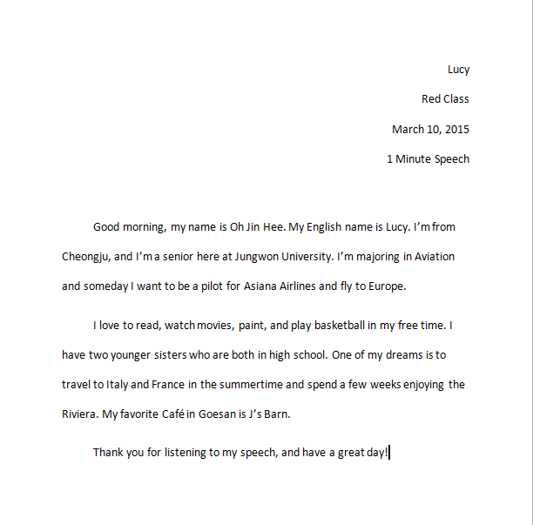
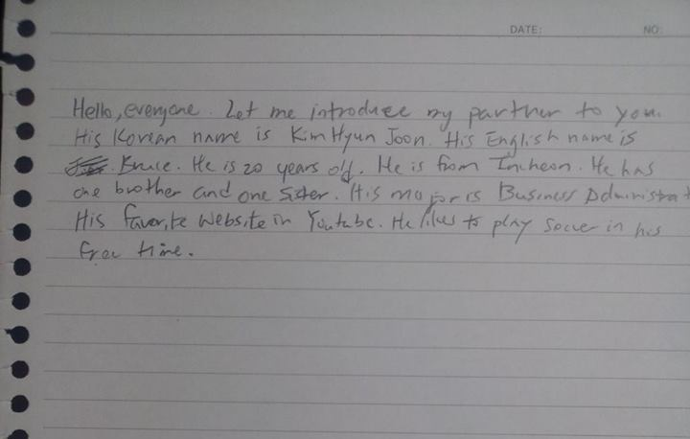
3. Homework
X
Neat
Complete
Typed
On Time
No Late Work
(without special permission)

Slide 6
4. respect
Please DO NOT TALK when the professor is talking…Thank you ☺
Please DO NOT TALK when classmates are presenting…Thank you ☺
Let’s respect each other! ☺

Slide 7
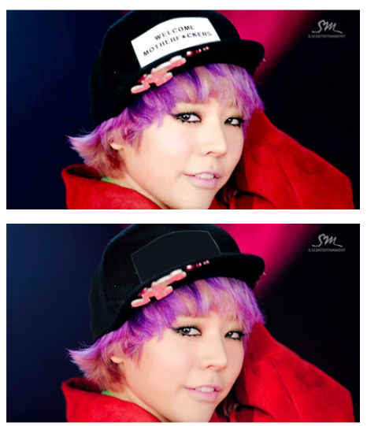
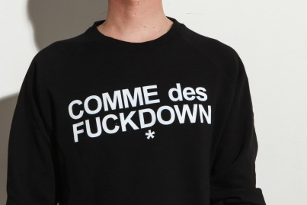
4. respect: Language
SWEAR WORDS = BAD Impression of you.
  They are NOT professional.
  They are NOT appropriate.
  They are NOT to be used in this classroom, because they are NOT respectful.
X
X
**

Slide 8
4. respect: Language
If you choose to use vulgar language in this class:
1. You will be asked to leave.
2. You will get 0% for Participation.
3. You and the Professor will have a meeting.
X
X
**

Slide 9
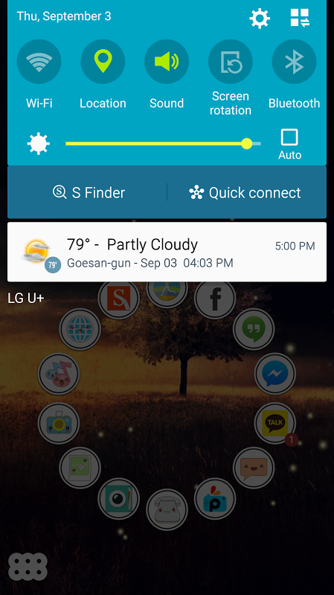


5. Cell phones
Turn them off or set them to silent.
X
X
O
X
X
O

Slide 10
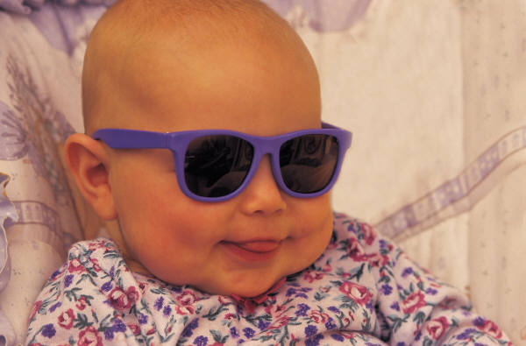
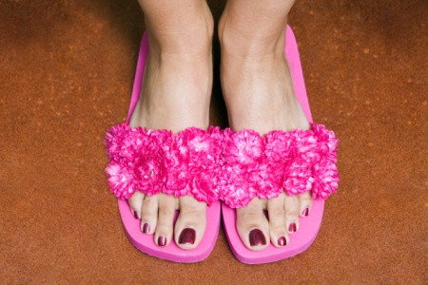
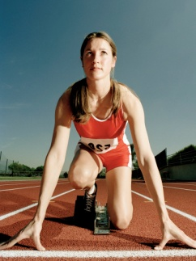
6. School Clothing Policy
No Caps, hats
No earphones
No sunglasses
No slippers
No Sleepwear
No Exercise Clothing

Slide 11
7. Participation
15 % of your grade!!!
1. Speak English Only
2. Bring completed homework on time.
3. Bring pencil, eraser, red pen, notebook, textbook to class.
4. Take notes of all important information.
5. Have a positive attitude and participate in class activities.
6. Be respectful and polite.
7. Follow directions.
8. Stay awake in class.

Slide 12
8. Grading
Assignments and Quizzes: 30%
Mid-Term Test: 20%
Final Test: 25%
Participation: 15%
Attendance: 10%
Final Grade:
Pass = 70-100% / Fail = 0-69%

Slide 13
9. Extra Resources
1.The English Café – (3F) open 2-11pm
2. FOS classes. Look online – Jungwon Website
3. Appointments with Professor Jennifer

Slide 14
Preparation is vital!!
Please study and do homework
BEFORE class! Otherwise class is useless!!!
Ask for help…and…
Enjoy this class!

Slide 15
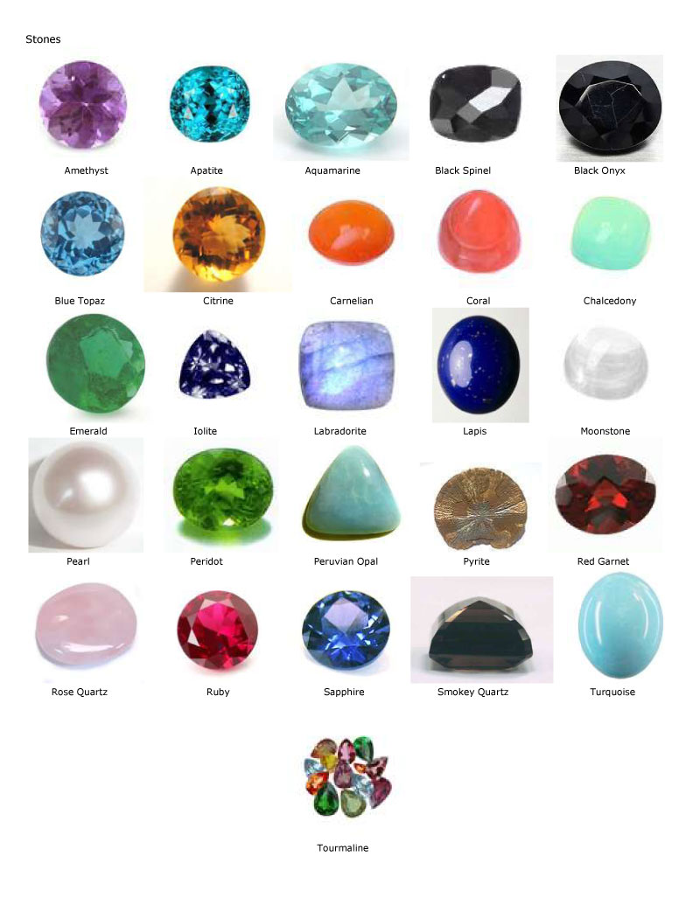

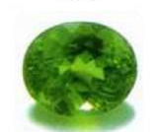
Class Gems
Level 1 (010)
M: 9 am
W: 10 am
Level 1 (008)
M: 4 pm
T: 5 pm
Level 4 (018)
M: 5 pm
T: 4 pm
Coral
Carnelian
Citrine
Level 4 (003)
T: 11 am
Th: 1 pm
Level 4 (011)
T: 2 pm
Th: 3 pm
Peridot
Aquamarine
Level 1 (015)
W: 9 am
F: 10 am
Level 1 (019)
T: 11 am
F: 1 pm
Level 1 (022)
W: 11 am
F: 3 pm
Sapphire
Amethyst
Onyx

Slide 16

Jennifer | Mon. | Tues. | Wed. | Thur. | Fri.
9 am
10 am
11 am
Lunch
1 pm
2 pm
3 pm
4 pm
5 pm
L1
1007
L1
708
L1
1007
L1
708
L4
702
L1
1007
Spring, 2017 ~ Jungwon University
L4
702
L1
1007
L4
703
L1
1007
L4
703
L1
1007
L1
1004
L4
703
L4
703
L1
1004

