Slide 1
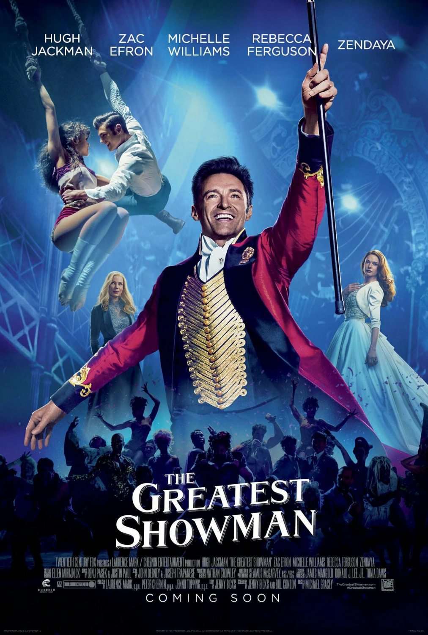

Slide 2
Discussion
What is a dream that you have?
Have you ever heard of or watched the movie “The Greatest Showman”? If so, what have your heard or what did you think of it?
What do you know about the genre of movies called “Musicals”?

Slide 3
dEFINITION
A QUICK DEFINITION FOR MUSICAL FILMS
“An internationally popular film genre, featuring music, song, and dance in varying combinations, often intertwined with a romance plot with a happy ending.
Film versions of operas and stage musicals made in the silent era were usually screened with live musical accompaniment, often as part of theatrical entertainments featuring musical acts.
Some scholars contend that it was the popularity of these shows with audiences that prompted the development of synchronized sound after the mid 1920s.” – Film Studies website
https://researchguides.dartmouth.edu/filmgenres/musicals

Slide 4
Let’s Begin!

Slide 5
cAST

Slide 6
cAST

Slide 7
cAST

Slide 10
https://This is Me with 17 artists
Keala Settle Live Performance at the Oscars
Lyrics Video

Slide 11
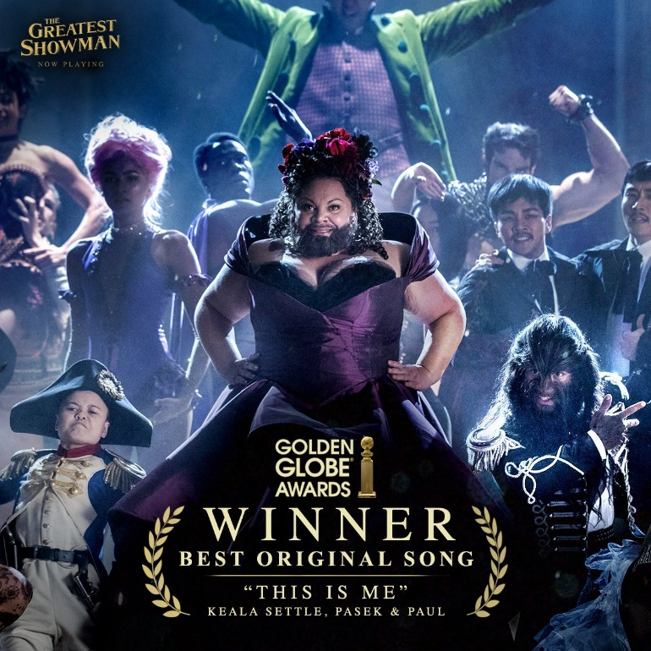
Golden Globe Winner!
“This is Me”

Slide 12
Want to Know

Slide 13
Discussion
1.What is 1 major theme you saw in the movie, and where did you see it?
2. What was your favorite song? Tell about the scene, main singers, costumes, and why is your favorite.
3. Share your favorite quote. Who says it? Why is it your favorite? Your favorite Quote
4. Who is your favorite character? Include a description and important scene he/she is in, and why he/she is your
5. What Impacted you from this movie?

