Slide 1
Level 4
Unit 10

Slide 2
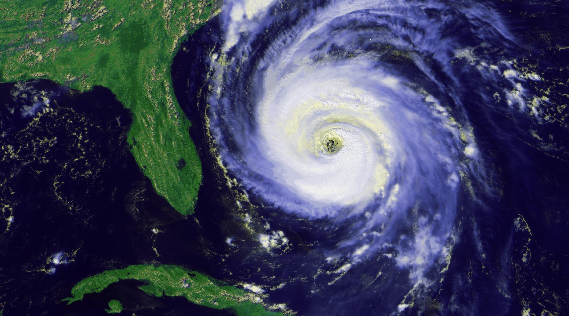
Write the vocabulary word
1.

Slide 3
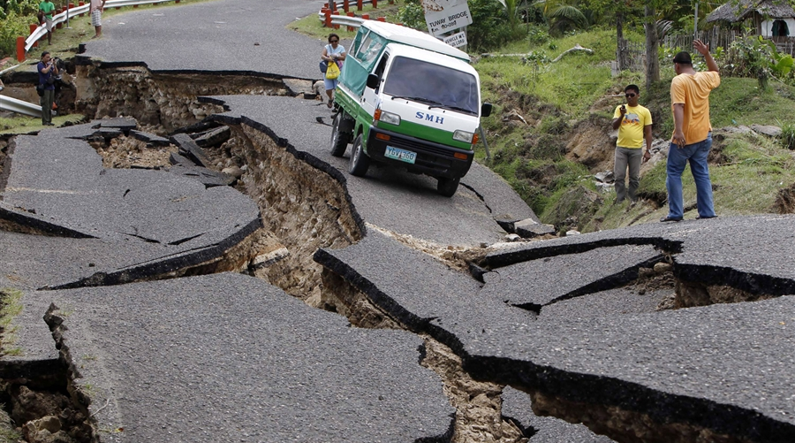
Write the vocabulary word
2.

Slide 4
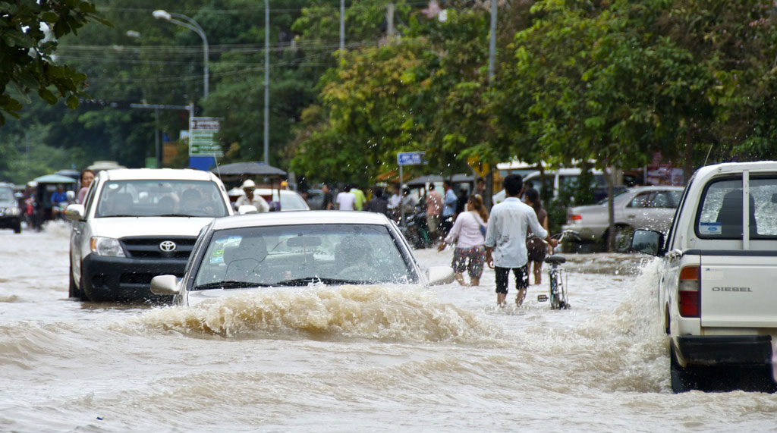
Write the vocabulary word
3.

Slide 5
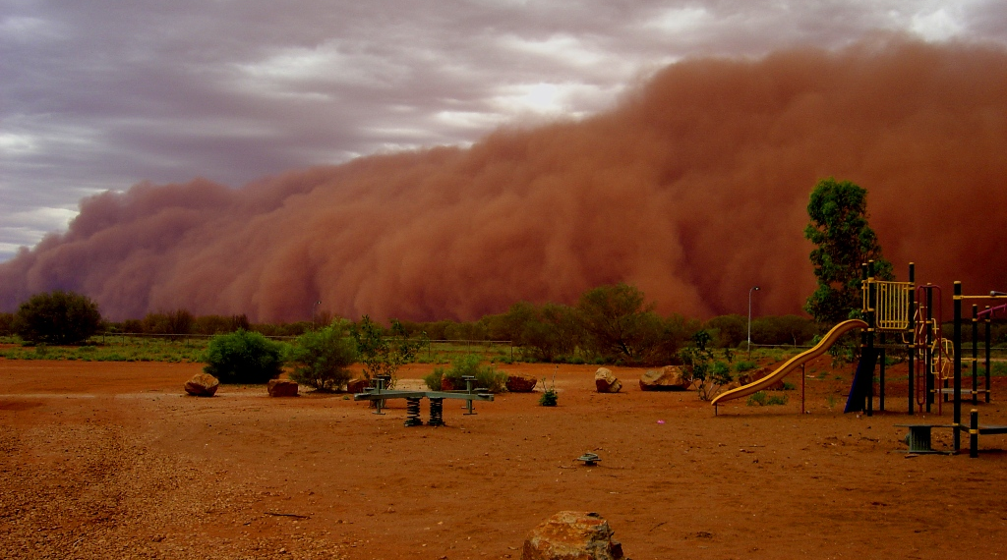
Write the vocabulary word
4.

Slide 6
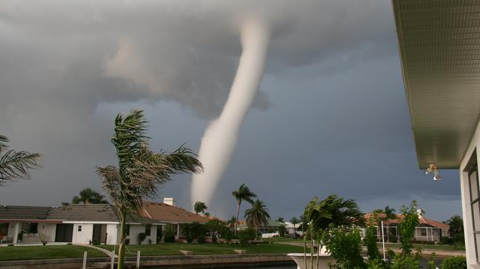
Write the vocabulary word
5.

Slide 7
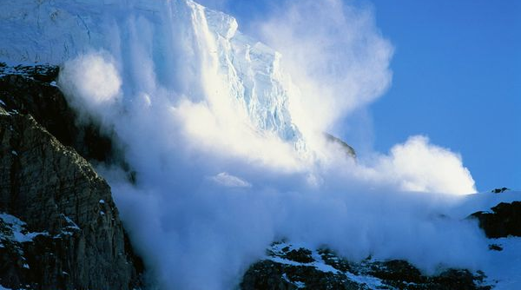
Write the vocabulary word
6.

Slide 8
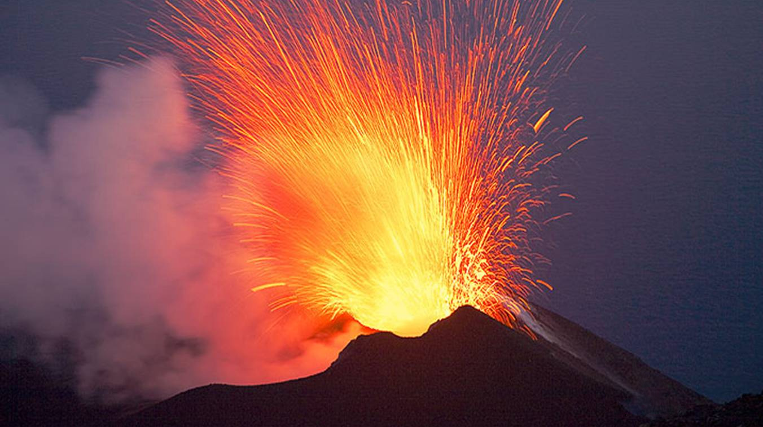
Write the vocabulary word
7.

Slide 9
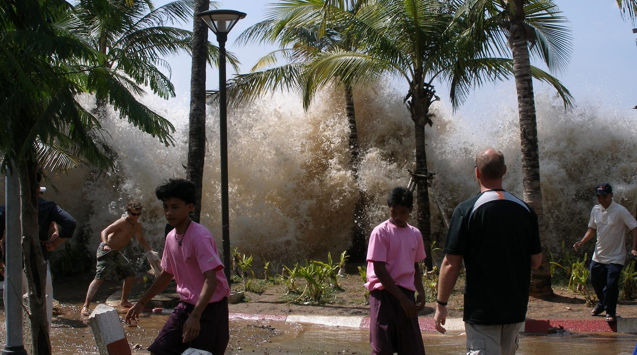
Write the vocabulary word
8.

Slide 10
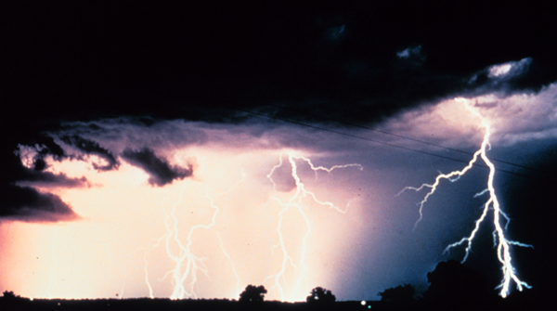
Write the vocabulary word
9.

Slide 11

Write the vocabulary word
10.

Slide 12
Unit 10: Vocabulary
Name: ________________________
1. _____________________________
2. _____________________________
3. _____________________________
4. _____________________________
5. _____________________________
6. _____________________________
7. _____________________________
8. _____________________________
9. _____________________________
10. ____________________________

Slide 13
Write the vocabulary word
1. HURRICANE (SIMILAR TO TYPHOON)

Slide 14
Write the vocabulary word
2. EARTHQUAKE

Slide 15
Write the vocabulary word
3. FLOODING

Slide 16
Write the vocabulary word
4. DUST STORM

Slide 17
Write the vocabulary word
5.TORNADO

Slide 18
Write the vocabulary word
6. AVALANCHE

Slide 19
Write the vocabulary word
7. VOLCANO

Slide 20
Write the vocabulary word
8. TSUNAMI

Slide 21
Write the vocabulary word
9.THUNDER AND LIGHTNING STORM

Slide 22
Write the vocabulary word
10. CLOUDS

