Slide 1
Level 4 : Unit 12
Grammar: If clauses with modals
Statements
Yes/NoQuestions
Wh~Questions

Slide 2
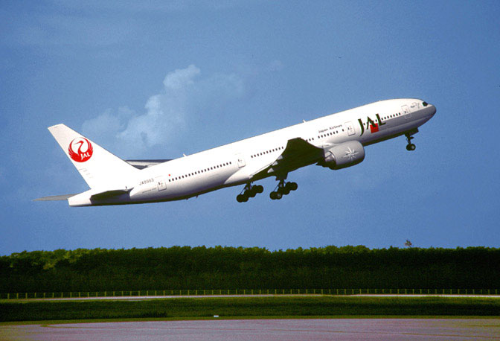
We use IF clauses for possible events in the future when one event depends on another.
If I go to Japan, I’ll visit Kyoto.
If clauses with modals: statements and questions

Slide 3
The IF clause can come before or after the main clause.
(When IF clause comes before the main clause, we use a (,) after it.)
If I go to Japan, I’ll visit Kyoto.
If clauses with modals: statements and questions

Slide 4
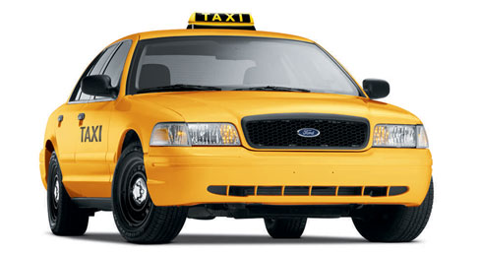
The IF clause can come before or after the main clause.
I might take a taxi home if I work late tonight.
If clauses with modals: statements and questions

Slide 5
We use the simple present in the if clause.
We use will, may, or might + the base form of a verb in the main clause
I might take a taxi home if I work late tonight.
If clauses with modals: statements and questions

Slide 6
We use the simple present in the if clause.
We use will, may, or might + the base form of a verb in the main clause
If clause (If + simple present) | Main Clause (modal + base form)
If I get a better job, | I will make more money. I won’t have much free time. I may take more trips. I may not stay in this apartment. I might move to a bigger flat. I might not tell anyone.
If clauses with modals: statements and questions

Slide 7
We use the simple present in the if clause.
We use will, may, or might + the base form of a verb in the main clause
Main Clause (modal + base form) | If clause (If + simple present)
I will make more money I won’t have much free time I may take more trips I may not stay in this apartment I might move to a bigger flat I might not tell anyone | if I get a better job.
If clauses with modals: statements and questions

Slide 8
Yes & No Questions
YES/NO questions Will/might + infinitive verb (be + verb) | If clause (If + simple present)
Will your parents be upset Might your parents be upset Won’t they be upset Might they be upset | if you move to the city? if you don’t pass your exam?
If clauses with modals: statements and questions

Slide 9
WH~Questions
WH~Questions (WH? + will/might + verb) | If clause (If + simple present)
Where will you live What will you do Who will you live with | if you move to the city? if you don’t pass your exam? if I don’t go?
If clauses with modals: statements and questions

Slide 10
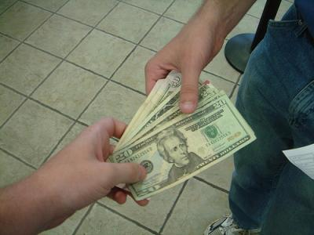
We can use affirmative or negative verbs
in one clause or both clauses.
If I don’t get a job, I’ll borrow some money.
If clauses with modals: statements and questions

Slide 11
We can use affirmative or negative verbs
in one clause or both clauses.
If I get a job, I won’t have any free time.
If clauses with modals: statements and questions

Slide 12
We can use affirmative or negative verbs
in one clause or both clauses.
If I don’t get a job, I won’t be able to pay for things.
If clauses with modals: statements and questions

