Slide 1
Smart Choice
Level 4
Unit 7 Grammar

Slide 2
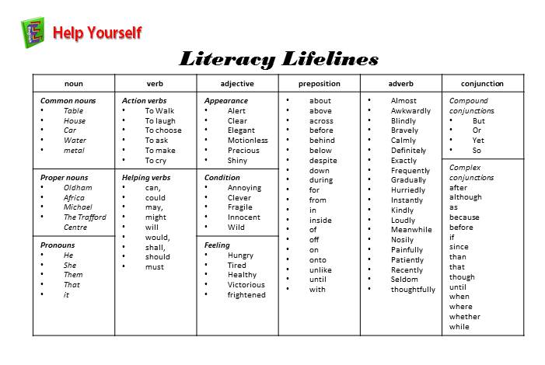

Slide 3
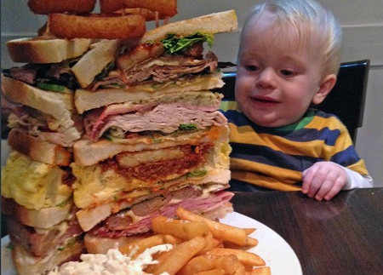
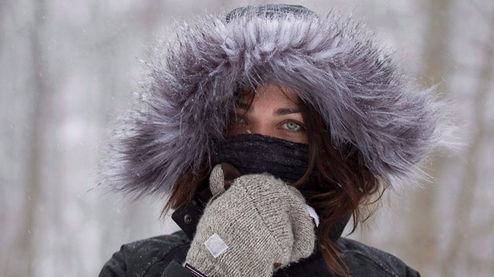
Unit 7 Grammar
Too means more than is needed or wanted.
We use too + an adjective or adverb.
It’s too cold.
(It’s colder than I want.)
I have too much food.
(It’s more food than I need.)
He eats too fast.
(He eats faster than he should.)

Slide 4

Unit 7 Grammar
We often use too with the adjectives many or much.
We use too many with countable nouns,
and too much with uncountable nouns.
Countable Nouns:
There are too many people in the store.
I have too many books to read.

Slide 5
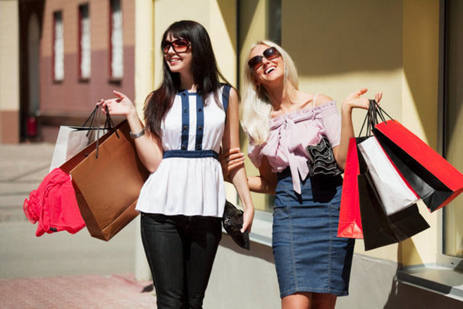
Unit 7 Grammar
We often use too with the adjectives many or much.
We use too many with countable nouns,
and too much with uncountable nouns.
Uncountable Nouns:
They spend too much money.
We have too much food.

Slide 6
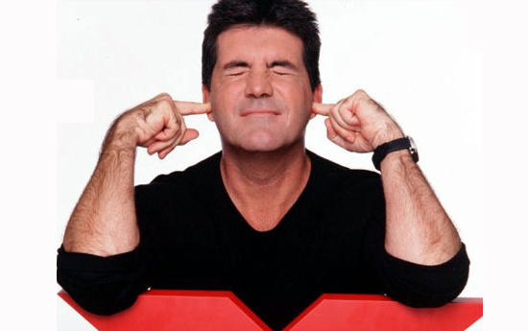
Unit 7 Grammar
Not enough is the opposite of too.
It means we need or want more of something.
We use not enough in 2 ways.
1. Not + adjective/adverb + enough
It’s not quiet enough. (I want it to be quieter.)
I can’t run fast enough. (I want to run faster.)

Slide 7
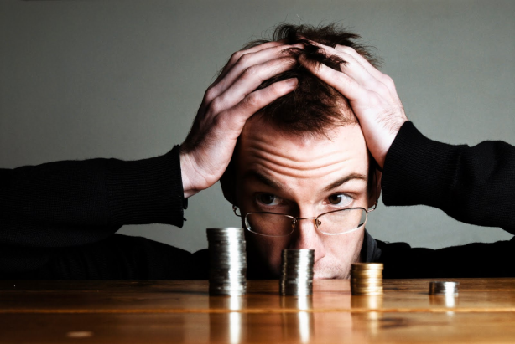
Unit 7 Grammar
Not enough is the opposite of too.
It means we need or want more of something.
We use not enough in 2 ways.
2. Not enough + noun
There isn’t enough food. (We need more food.)
I don’t have enough money. (I need more money.)

Slide 8
Unit 7 Grammar
Not enough is the opposite of too.
It means we need or want more of something.
We use not enough in 2 ways.
1. Not + adjective/adverb + enough
Subject | Verb | Not | Adj/adverb | enough
It | is | not | quiet | enough.

Slide 9
Unit 7 Grammar
Not enough is the opposite of too.
It means we need or want more of something.
We use not enough in 2 ways.
2. Not enough + noun
Subject | Verb BE/DO/HAVE | Not enough | noun
I | do | not have enough | money.
There | Is | not enough | food.

Slide 10
Unit 7 Grammar: Now Practice
Complete the sentences with too much or too many.
1.It’s impossible to have ________ jewelry.
2. You can never have _________ friends.
3. How do you feel when you eat ____________ food?
4. Is it possible to watch ___________ television?
5. Do you spend _____________ hours on the phone?
6. Are there ___________ malls in your area?
too much
too many
too much
too much
too many
too many

Slide 11
Unit 7 Grammar: Now Practice
Complete the sentences. Use too or not enough and the words in the parentheses.
1. Jason want to buy a car, but he _____________________ money. (have)
2. Ann wants to go to the movies, but she _______________ homework. (have/much)
3. Ken wanted to finish his homework, but he ____________________ time. (have)
4. Erin wanted to see the beginning of the movie, but she __________________. (be/late)
5. Linda hoped to pass the test, but she _____________________. (study/hard)
doesn’t have enough
has too much
doesn’t have enough
was too late
didn’t study hard enough

Slide 12
Unit 7 Grammar
Not enough is the opposite of too.
It means we need or want more of something.
We use not enough in 2 ways.
1. Not + adjective/adverb + enough
2. Not enough + noun
There isn’t enough food. (We need more food.)
I don’t have enough money. (I need more money.)

Slide 13
Homework ~ Unit 7
Too/not enough; too many/too much

Slide 14
Look at the pictures and complete the sentences. Use too + these words:
big | crowded | fast | heavy | loud | low
The radio is too loud .
The box is ________________.
The net is ________________.
too fast
She’s driving ________________.
The ball is ________________.
The restaurant is _______________.
too heavy
too big
too low
too crowded

Slide 15
Write too / too much / too many / or enough
You’re always at home. You don’t go out enough .
I don’t like the weather here. There’s _____________________ rain.
I can’t wait for them. I don’t have _____________________ time.
There was nowhere to sit on the beach. There were _____________________ people.
You’re always tired. I think you work _____________________ hard.
“Did you have _____________________ to eat?” “Yes, thank you.”
too much
enough
too many
too
enough

Slide 16
You drink _____________________ coffee. It’s not good for you.
You don’t eat _____________________ vegetables. You should eat more of them.
I don’t like the weather here. It’s _____________________ cold.
Our team didn’t play well. We made _____________________ mistakes.
“Would you like some ice in your tea?” “Yes, but not _____________________
too much
enough
too
too many
too much

Slide 17
Complete the sentences. Use too or enough with the words in parentheses.
I couldn’t work. I was too tired . (tired)
Can you turn the radio up, please? It isn’t loud enough . (loud)
I don’t want to walk home. It’s ________________________. (far)
Don’t buy anything in that store. It ________________________. (expensive)
You can’t put all your things in this bag. It ________________________. (big)
I couldn’t do the exercise. It ________________________. (difficult)
Your work needs to be better. It _____________________________. (good)
I can’t talk to you now. I ________________________. (busy)
I thought the movie was boring. It ________________________. (long)
too far
is too expensive
isn’t big enough
was too difficult
wasn’t good enough
am too busy
was too long

Slide 18
Homework

Slide 19
big | chairs | cups | fit | milk | money
qualified | room | time | warm | well
I can’t run very far. I’m not fit enough .
Some of us had to sit on the floor because there weren’t _______________________________.
I’d like to buy a car, but I don’t have _______________________________ right now.
Do you have _______________________________ in your coffee, or would you like some more.
Are you _______________________________? Or should I turn up the heat?
It’s only a small car. There isn’t _______________________________ for all of us.
Steve didn’t feel _______________________________ to go to work this morning.
I enjoyed my trip to Paris, but there wasn’t _______________________________ to do everything I wanted.
Do you think I’m _______________________________ to apply for the job?
Try this jacket on and see if it’s _______________________________ for you.
There weren’t _______________________________ for everybody to have coffee at the same time.
enough chairs
enough money
enough sugar
warm enough
enough room
well enough
enough time
qualified enough
big enough
enough cups

Slide 20
Are they going to get married?
  (old) No, they’re not old enough to get married .
I need to talk to you about something.
  (busy) Well, I’m afraid I’m _____________________________________ to you now.
Let’s go to the movies.
  (late) No, it’s __________________________________________ to the movies.
Why don’t we sit outside?
  (warm) It’s not __________________________________________ outside.
Would you like to be a politician?
  (shy) No, I’m __________________________________________ a politician.
Would you like to be a teacher?
  (patience) No, I don’t have __________________________________________________________________ a teacher.
Did you hear what he was saying?
  (far away) No, we were ______________________________________________________________________ what he was saying.
Can he read a newspaper in English?
  (English) No, he doesn’t know _______________________________________________________________________ a newspaper.
too busy to talk
too late to go
warm enough to sit
too shy to be
enough patience to be
too far away to hear
enough English to read

Slide 21
We couldn’t carry the boxes. They were too heavy.
  The boxes were too heavy to carry.
I can’t drink this coffee. It’s too hot.
  ___________________________________________________________________________
Nobody could move the piano. It was too heavy.
  ___________________________________________________________________________
Don’t eat these apples. They’re not ripe enough.
  ___________________________________________________________________________
I can’t explain the situation. It’s too complicated.
  ___________________________________________________________________________
We couldn’t climb over the wall. It was too high.
  ___________________________________________________________________________
Three people can’t sit on this sofa. It isn’t big enough.
  ___________________________________________________________________________
You can’t see some things without a microscope. They are too small.
  ___________________________________________________________________________
The coffee is too hot to drink.
The piano was too heavy to move.
Those apples are not ripe enough to eat
The situation is too complicated to explain.
The wall was too high to climb.
The sofa isn’t big enough to sit on.
Some things are too small to see without a microscope

