Slide 1
Smart Choice Level 4
Unit 7 Vocabulary

Slide 2
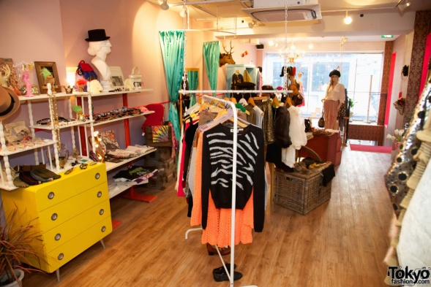
1. ____________

Slide 3
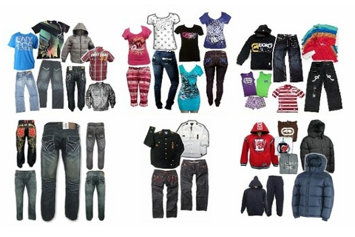
2. ____________

Slide 4
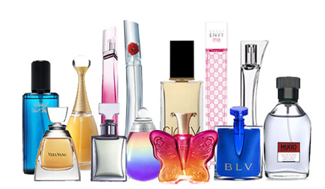
3. ____________

Slide 5
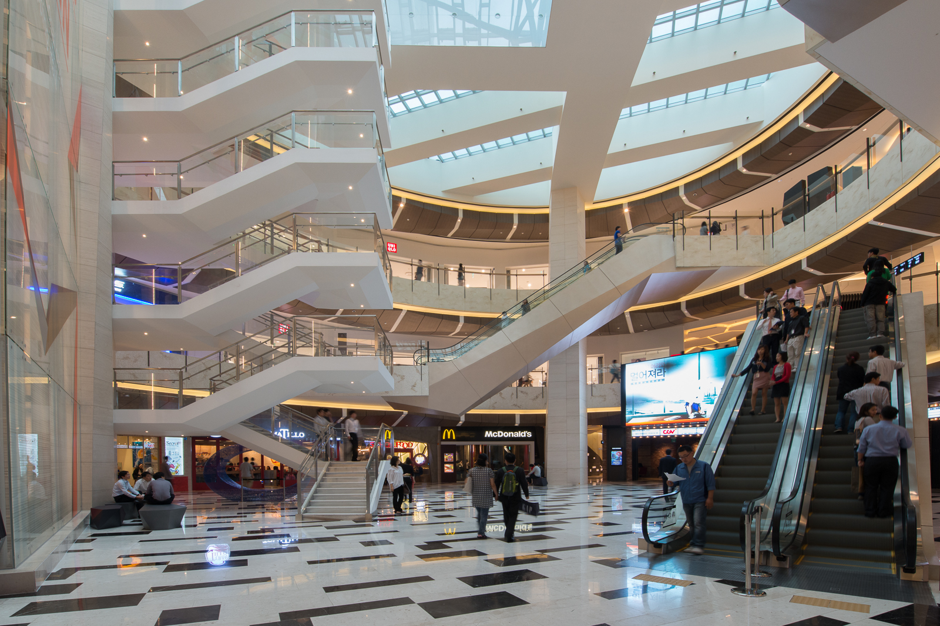
4. ____________

Slide 6
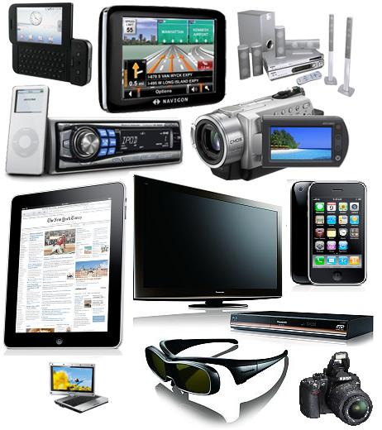
5. ______

Slide 7
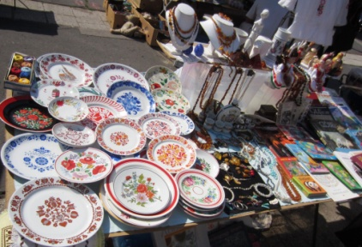
6. ____________

Slide 8
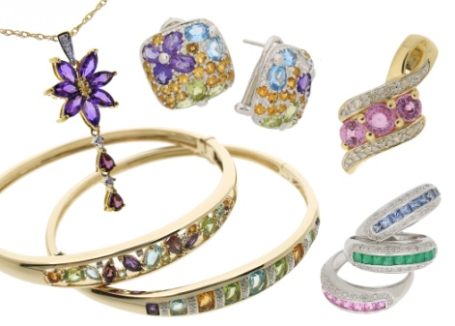
7. ____________

Slide 9
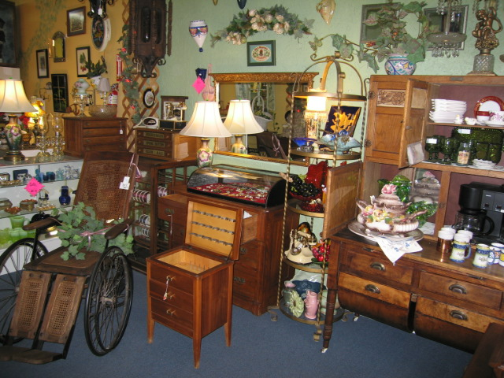
8. ____________

Slide 10
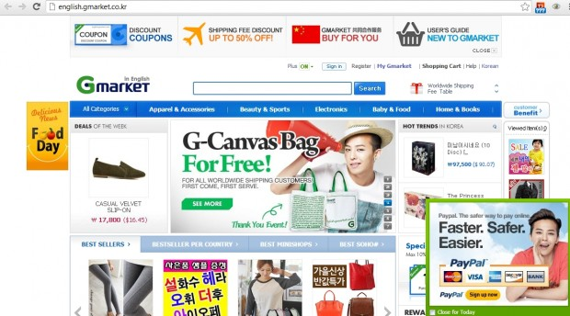
9. ____________

Slide 11
1. ____________
boutique

Slide 12
2. ____________
clothing

Slide 13
3. ____________
perfume

Slide 14
4. ____________
mall

Slide 15
5. ______
electronics

Slide 16
6. ____________
Flea market

Slide 17
7. ____________
jewelry

Slide 18
8. ____________
antiques

Slide 19
9. ____________
Online store

