Slide 1
SMART CHOICE Level 4 Unit 8
Grammar

Slide 2
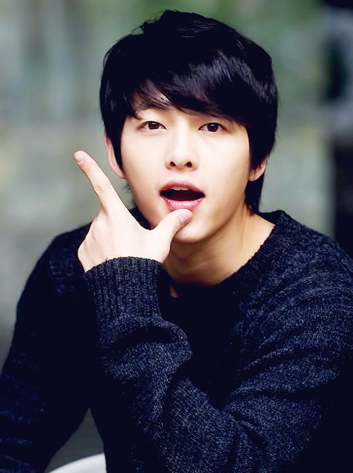
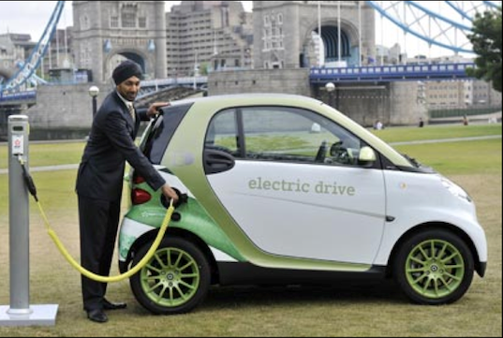
Relative clauses
We use relative clauses to identify, define, or classify a:
PERSON
THING

Slide 3
Relative clauses
PERSON
I like people who are reliable.
I like actors who are funny.
I like a friend that is honest.

Slide 4
Relative clauses
THING
I like cars which are reliable.
I like cars which are electric.
I like a car that is small.

Slide 5
Relative clauses
who
PERSON
I like people who are reliable.
I like actors who are funny.
I like a friend that is honest.
that

Slide 6
Relative clauses
which
THING
I like cars which are reliable.
I like cars which are electric.
I like a car that is small.
that

Slide 7
Relative clauses
What is the difference between a
MAIN CLAUSE and a RELATIVE CLAUSE?
MAIN CLAUSE | RELATIVE CLAUSE
I like actors | who are funny.
I like cars | which are electric.
I like a car | that is small.

Slide 8
Relative clauses
WHO, WHICH, & THAT
refer to the person or thing they identify, define, or classify.
I like people who are reliable.
I like cars which are electric.
I like a friend that is honest.

Slide 9
Relative clauses
The verb in the relative clause needs to agree in number with the noun in the main clause.
Plural
Plural
I like people who are reliable.
Plural
Plural
I like cars which are electric.
Singular
Singular
I like a friend that is honest.

Slide 10
Relative clauses
In a subject relative clause, we don’t use a personal subject pronoun after WHO, WHICH or THAT.
I like actors who are funny.
I like actors who they are funny.
I like cars which are reliable.
I like cars which they are reliable.
I like a friend that is honest.
I like a friend that he is honest.

Slide 11
Relative clauses
Now Practice!
I have a car _______ is ten years old.
There are some students in my class _____ are always late.
Do you know anyone _______ is both artistic and reliable?
Do you have any books in English ______ are easy to read?
Have you ever had a teacher _______ didn’t give homework?
Have you ever had homework ______ was fun to do?

Slide 12
Relative clauses
Now Practice!
I have a car _______ is ten years old.
There are some students in my class ______ are always late.
Do you know anyone _______ is both artistic and reliable?
Do you have any books in English ________ are easy to read?
Have you ever had a teacher _______ didn’t give homework?
Have you ever had homework ________ was fun to do?
which/that
who/that
who/that
which/that
who/that
which/that

Slide 13
Relative clauses
Now Practice!
I have a friend who (live/lives) in the US.
I have three friends who (are/is) already married.
My parents have some antiques that (are/is) very valuable.
Is there a store around here that (sell/sells) electronics?
Have you ever had a job that (were/was) very interesting?
Is there any food that (make/makes) you sick?

