Slide 1
SMART CHOICE Level 4 Unit 8
Grammar

Slide 2
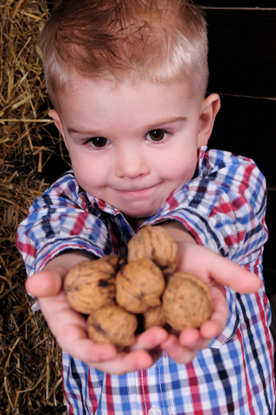
Vocabulary
generous

Slide 3
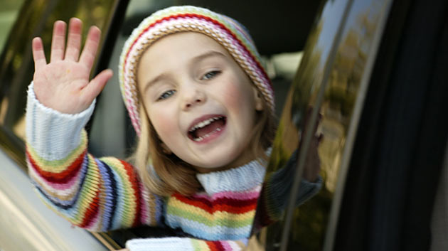
Vocabulary
outgoing

Slide 4
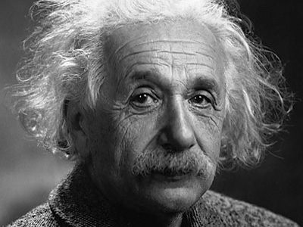
Vocabulary
intelligent

Slide 5
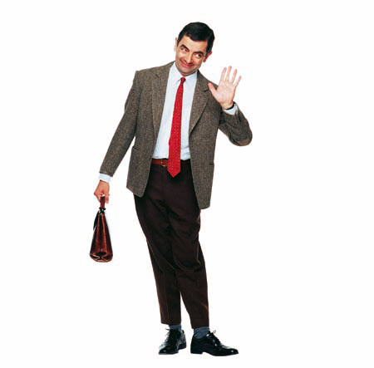
Vocabulary
funny

Slide 6
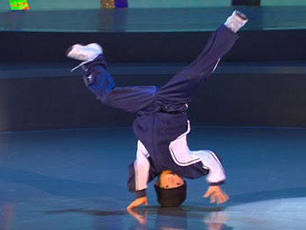
Vocabulary
talented

Slide 7
Vocabulary
bald

Slide 8
Vocabulary
beautiful

Slide 9
Vocabulary
broad shouldered

Slide 10
Vocabulary
slim
skinny

Slide 11
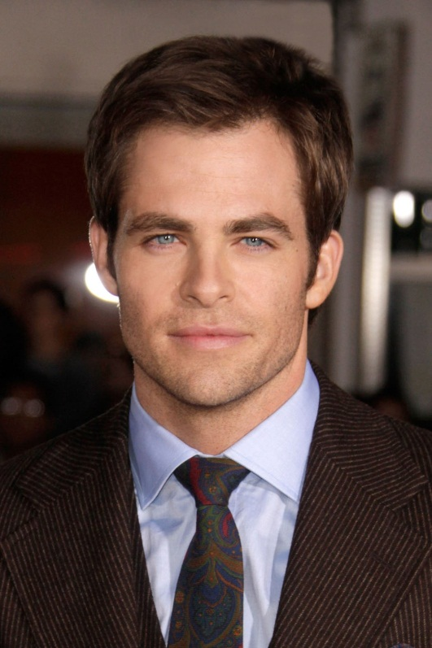
Vocabulary
handsome

Slide 12
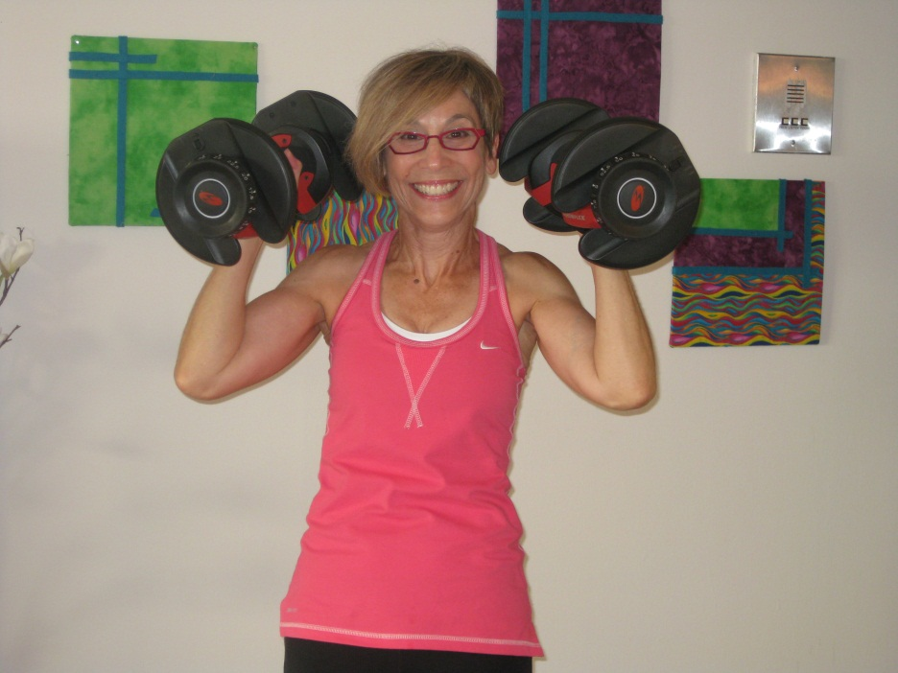
Vocabulary
muscular

Slide 13
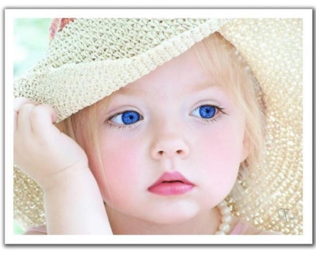
Vocabulary
pretty

Slide 14
Vocabulary
attractive

Slide 15
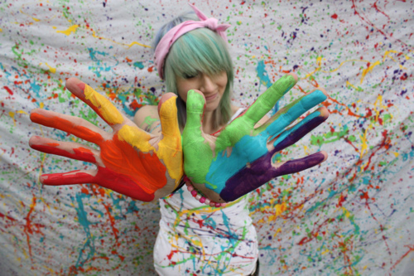
Vocabulary
artistic

Slide 16
Vocabulary
reliable

