Slide 1
SMART CHOICE LEVEL 4
GRAMMAR
UNIT 9

Slide 2
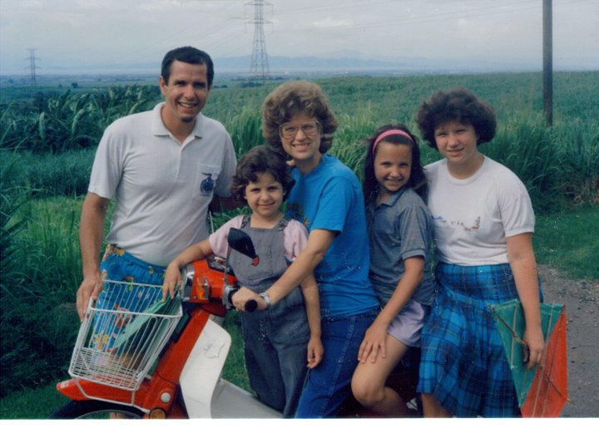
The Past Continuous
We use the Past Continuous to talk about something in progress at a specific time in the past.
In 1987 we were living in the Philippines.

Slide 3
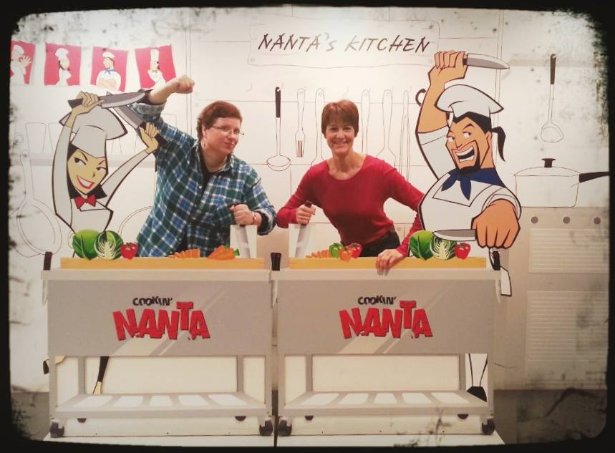
The Past Continuous
We use the Past Continuous to talk about something in progress at a specific time in the past.
What were you doing at 1:30 last Sunday?

Slide 4
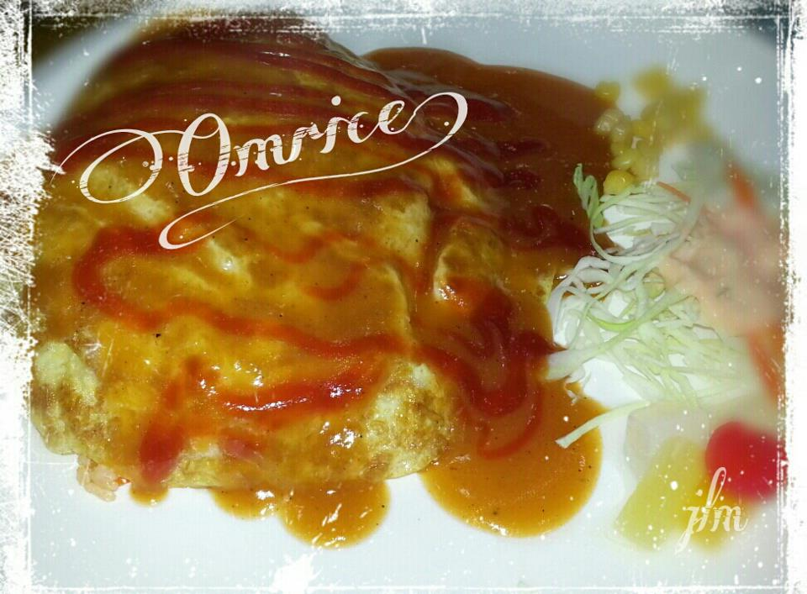
The Past Continuous
We often use the Past Continuous to talk about something in progress when another action (usually in the simple past) took place.
I was making omrice when I burned my hand.

Slide 5
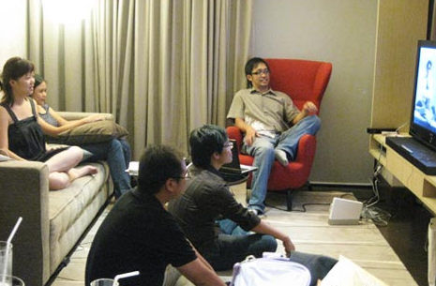
The Past Continuous
We often use the Past Continuous to talk about something in progress when another action (usually in the simple past) took place.
We were watching TV when the lights went out.

Slide 6
The Past Continuous
We use the helping verb
BE
DO
not
in Past Continuous statements and questions.

Slide 7
The Past Continuous
We also add ~ING to the verb and put it together with the past BE
In 1987 we were living in the Philippines.
I was making omrice when I burned my hand.

Slide 8
The Past Continuous
Affirmative and Negative Statements
I/He/She/It | was sleeping. was not reading. (wasn’t reading.) | You/We/They | were sleeping. were not sleeping. (weren’t sleeping.)
Wh – Questions (WHO, WHAT, WHERE, WHEN, WHY, HOW)
Where | was | I/he/she/it | sleeping?
Where | were | you/we/they | sleeping?

Slide 9
The Past Continuous
Exceptions in spelling -adding ING | Example
final e is dropped (but: ee is not changed) | come – coming (but: agree – agreeing)
after a short, stressed vowel, the final consonant is doubled | sit – sitting
l as final consonant after a vowel is doubled (in British English) | travel – travelling
final ie becomes y | lie – lying

Slide 10
The Past Continuous
while
when
Signal Words:
as long as
We were watching TV when the lights went out.
They were playing a game when the boy hurt his knee.
I was reading a book when my mom called me.

Slide 11
The Past Continuous
Word Order for WHEN and WHILE
subject | past continuous | when | subject | simple past
I | was jogging | when | I | saw my friend.
(Also possible: When I saw my friend, I was jogging.)
subject | simple past | while | subject | past continuous
I | saw my friend | while | I | was jogging.
(Also possible: While I was jogging, I saw my friend.)

