Slide 1
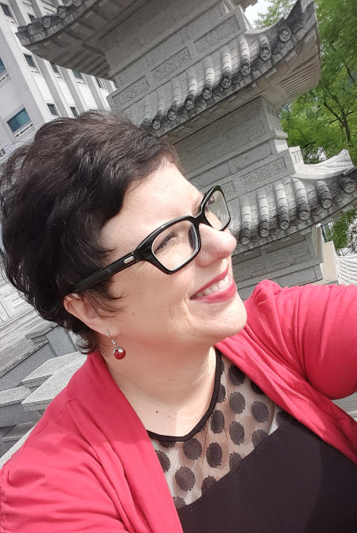
JUNGWON UNIVERSITY
English Communication (Level 1)
Professor:
Jennifer L. Mc Ghee
MA Ed

Office Hours by Appointment
jenni.mcghee@gmail.com
010.5728.2733

Slide 2
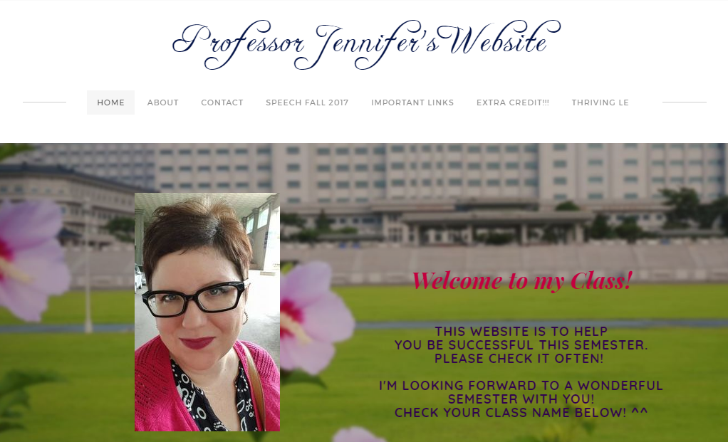
professorjennifer.weebly.com

Slide 3
1. Attendance
10% of your Grade! Come to Class!
Be on Time.
Late 3 Times = 1 Class Absence
7 or more Absences = FAIL
If late, tell the professor AFTER CLASS so I can mark your attendance.
If you know you will be absent, tell the professor BEFORE class…or you cannot make up the work.

Slide 4
1. Attendance
If you MISS a quiz or TEST for any reason, it will be an automatic 0%.
You are absent:
♦Sick ♦MT ♦ Sports Festival
You are excused (with document):
♦Military ♦Major ♦Emergency
♦Death in the family

Slide 5

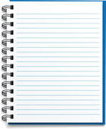



2. materials
EVERY
CLASS
Workbook/Student Book
NO Books? = ABSENT
Notebook
Pencil
Eraser
Red Pen
NO REGULAR PENS
PLEASE!

Slide 6
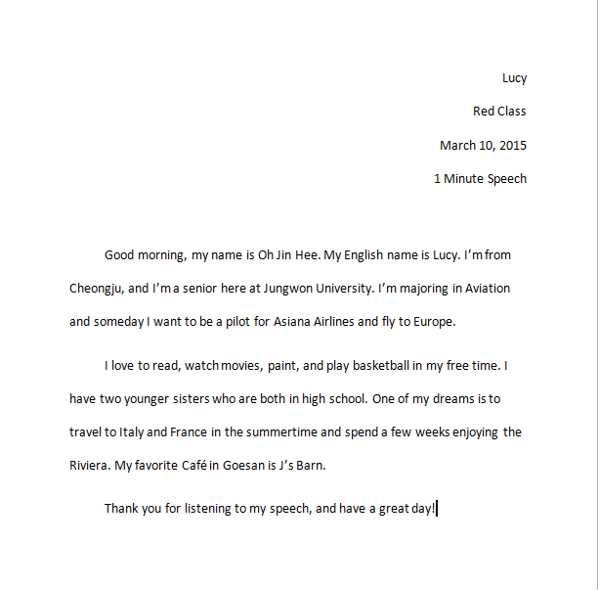
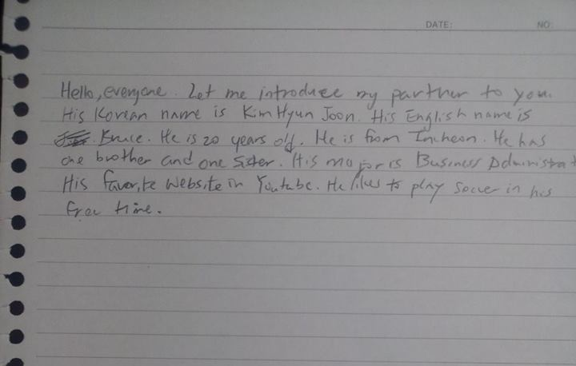
3. Homework
X
Neat
Complete
Typed
On Time
NO LATE WORK

Slide 7
4. respect
Please DO NOT TALK when the professor is talking…Thank you ☺
Please DO NOT TALK when classmates are presenting…Thank you ☺
Let’s respect each other! ☺

Slide 8
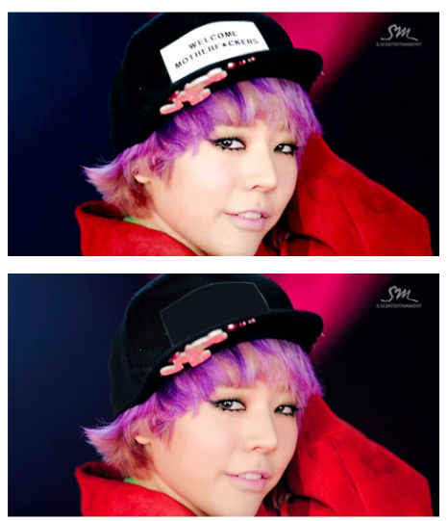

4. respect: Language
SWEAR WORDS = BAD Impression of you.
  They are NOT professional.
  They are NOT appropriate.
  They are NOT to be used in this classroom, because they are NOT respectful.
X
X
**

Slide 9
4. respect: Language
If you choose to use vulgar language in this class:
  1. You will be asked to leave.
  2. You will get 0% for Participation.
  3. You and the Professor will have a meeting.
X
X
**

Slide 10
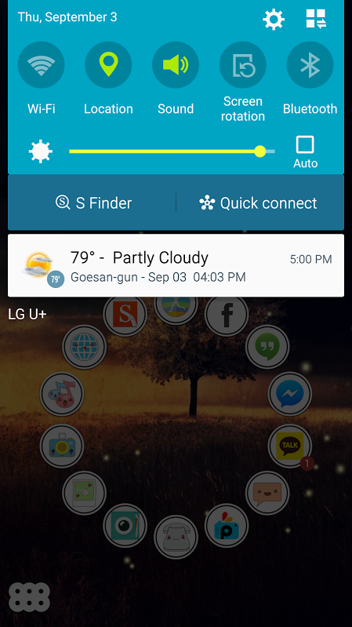


5. Cell phones
Turn them off or set them to silent.
X
X
O
X
X
O
Place them on the phone table during class.

Slide 11
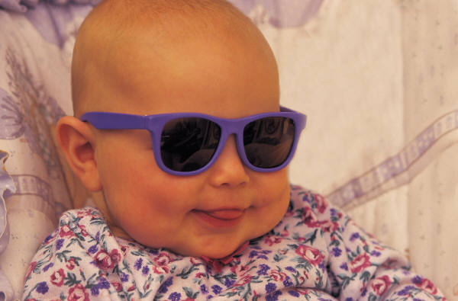
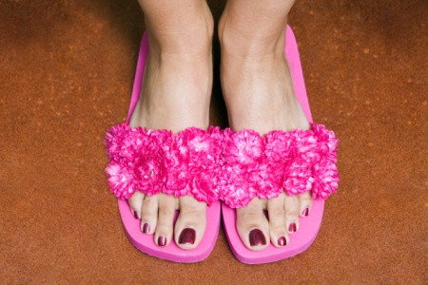
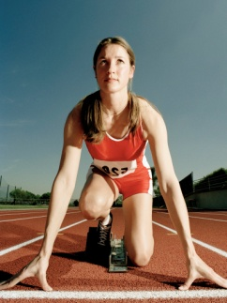
6. School Clothing Policy
No Caps, hats
No earphones
No sunglasses
No slippers
No Sleepwear
No Exercise Clothing

Slide 12
7. Participation
20 % of your grade!!!
1. Speak English Only
2. Bring completed homework on time.
3. Bring pencil, eraser, red pen, notebook, textbook to class.
4. Take notes of all important information.
5. Have a positive attitude and participate in class activities.
6. Be respectful and polite.
7. Follow directions.
8. Stay awake in class.

Slide 13
8. Grading
Assignments and Quizzes: 25%
Mid-Term Test: 20% - MUST pass with 60%
Final Test: 25% - MUST pass with 60%
Participation: 20%
Attendance: 10%
Final Grade:
Pass = 70-100% / Fail = 0-69%

Slide 14
9. Extra Resources
1.The English Café – (3F) open 12 -11pm
- Free drinks from 3pm
2. Appointments with Professor Jennifer as needed. Contact me in class or on my website.
3. Tutoring (available later this semester)

Slide 15
10. KakaoTalk Group:
1. Add me to your Kakao now:
Gypsyjennileigh
2. Send me a message:
I am ________, _________ class.
I will add you to our class Kakao Group.
This group is for ME to send you messages.
Any questions?
Send me a personal 1 to 1 message! ☺

Slide 16
11. Website
professorjennifer.weebly.com
It is your DAILY responsibility
to check the website if you have
questions or for extra material I
tell you about in class!

Slide 17
professorjennifer.weebly.com

Slide 18
Preparation is vital!!
Please study and do homework
BEFORE class! Otherwise class is useless!!!
Ask for help…and…
Enjoy this class!

