Slide 1
Using More Colorful Adjectives

Slide 2
Adjective: a word that describes a person, place, or thing.

Slide 3
Using the same adjectives over and over again makes your speaking boring.

Slide 4
Synonyms for SMALL
tiny
teeny
teensy
miniature
petite

Slide 5
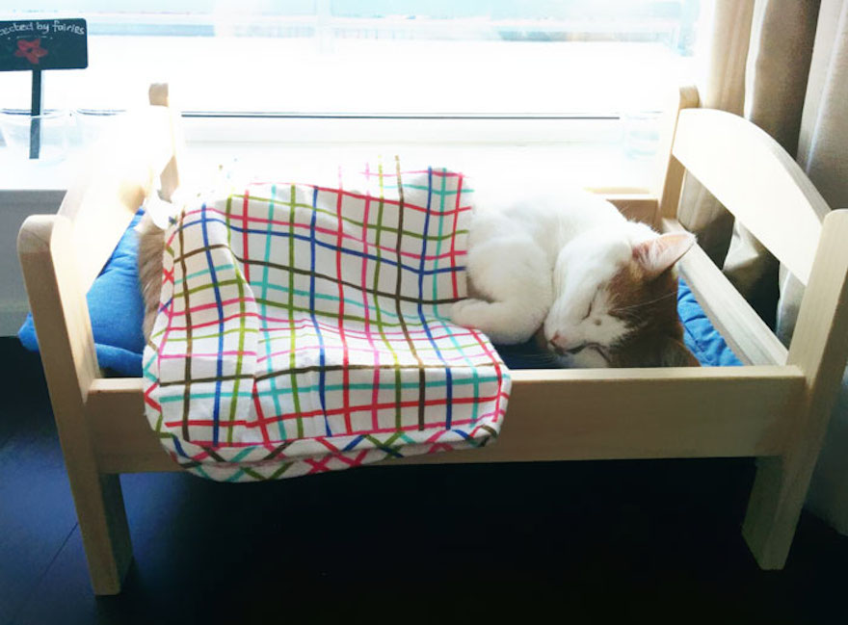
Synonyms for SMALL
a tiny bed
a teeny blanket

Slide 6
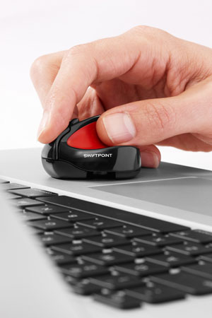
Synonyms for SMALL
a teensy mouse

Slide 7
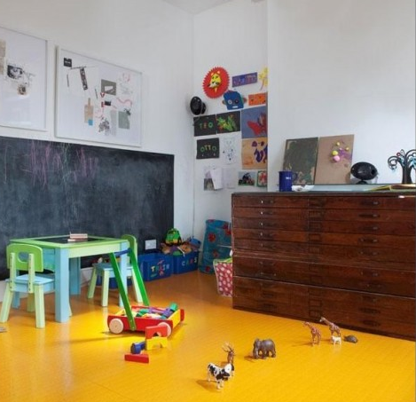
Synonyms for SMALL
miniature animals

Slide 8
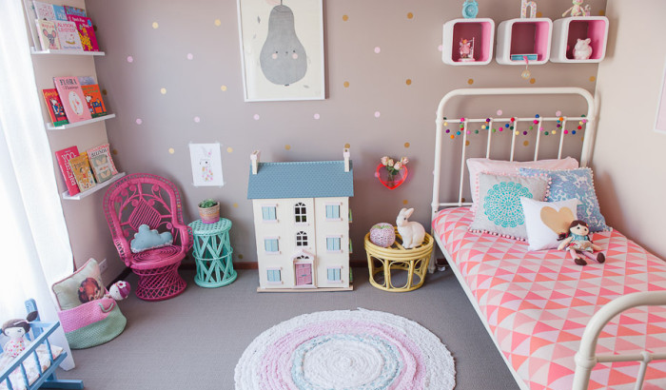
Synonyms for SMALL
a petite doll
a petite rabbit

Slide 9
Synonyms for BIG
huge
gigantic
humongous
enormous
massive

Slide 10
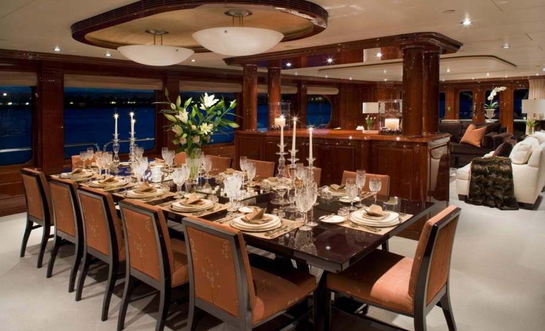
Synonyms for BIG
a huge dining table

Slide 11
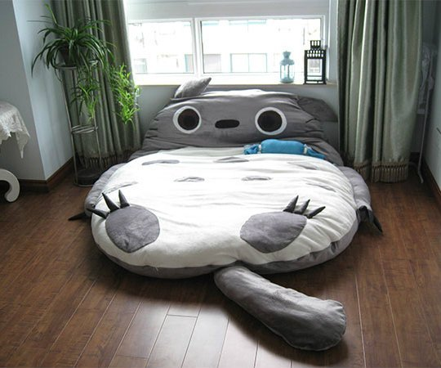
Synonyms for BIG
a gigantic cushion bed

Slide 12
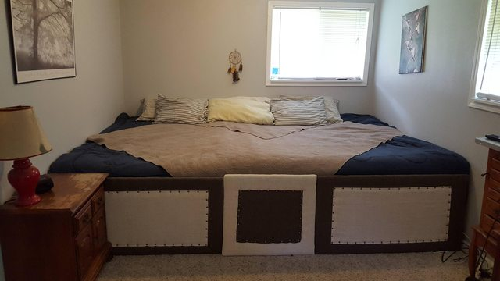
Synonyms for BIG
a humongous bed

Slide 13
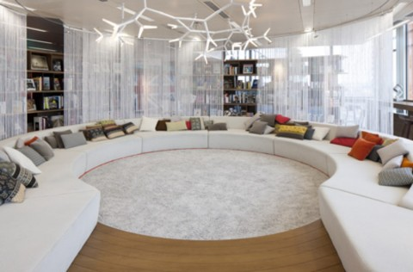
Synonyms for BIG
an enormous sofa

Slide 14
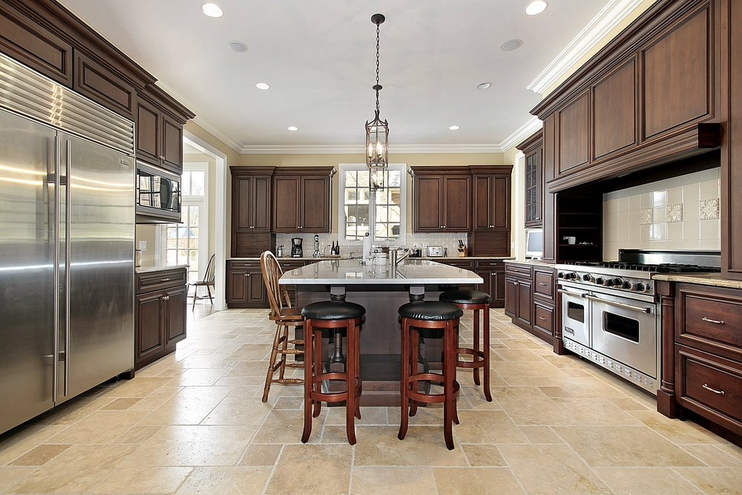
Synonyms for BIG
a massive refrigerator
a massive stove

Slide 15
Words for Texture/Appearance
rough
smooth
wooden
metal
shiny
glossy
grainy
shaggy
furry
cushioned

Slide 16
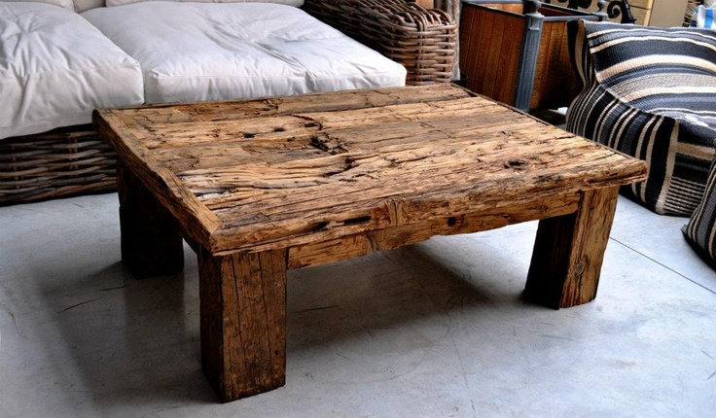
Words for Texture/Appearance
a rough wooden table

Slide 17
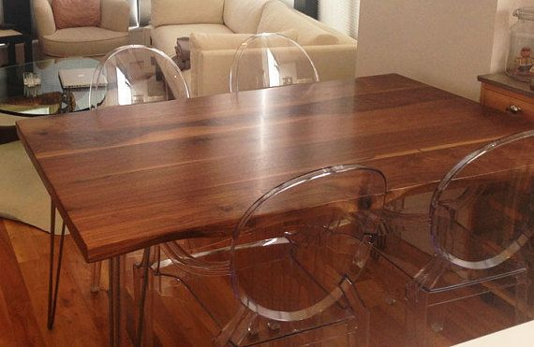
Words for Texture/Appearance
a smooth wooden table with transparent plastic chairs

Slide 18
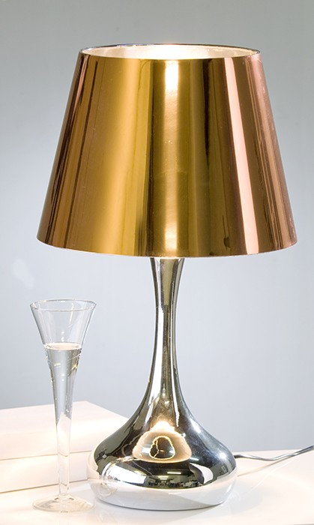
Words for Texture/Appearance
a shiny metal lamp

Slide 19
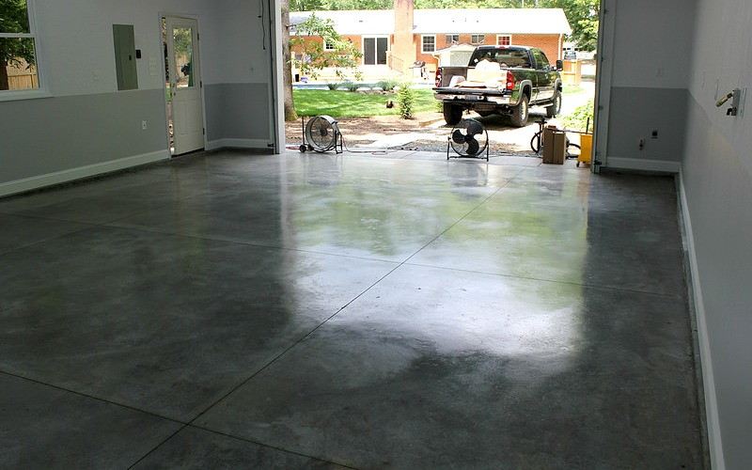
Words for Texture/Appearance
a glossy floor

Slide 20
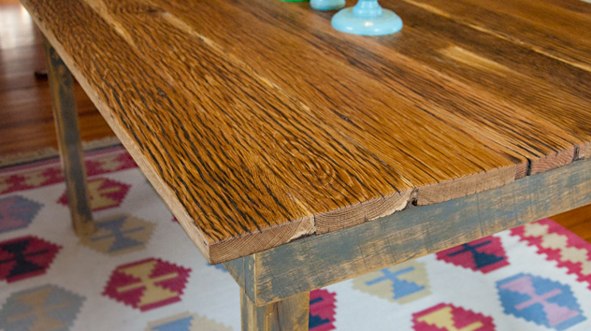
Words for Texture/Appearance
a grainy table

Slide 21
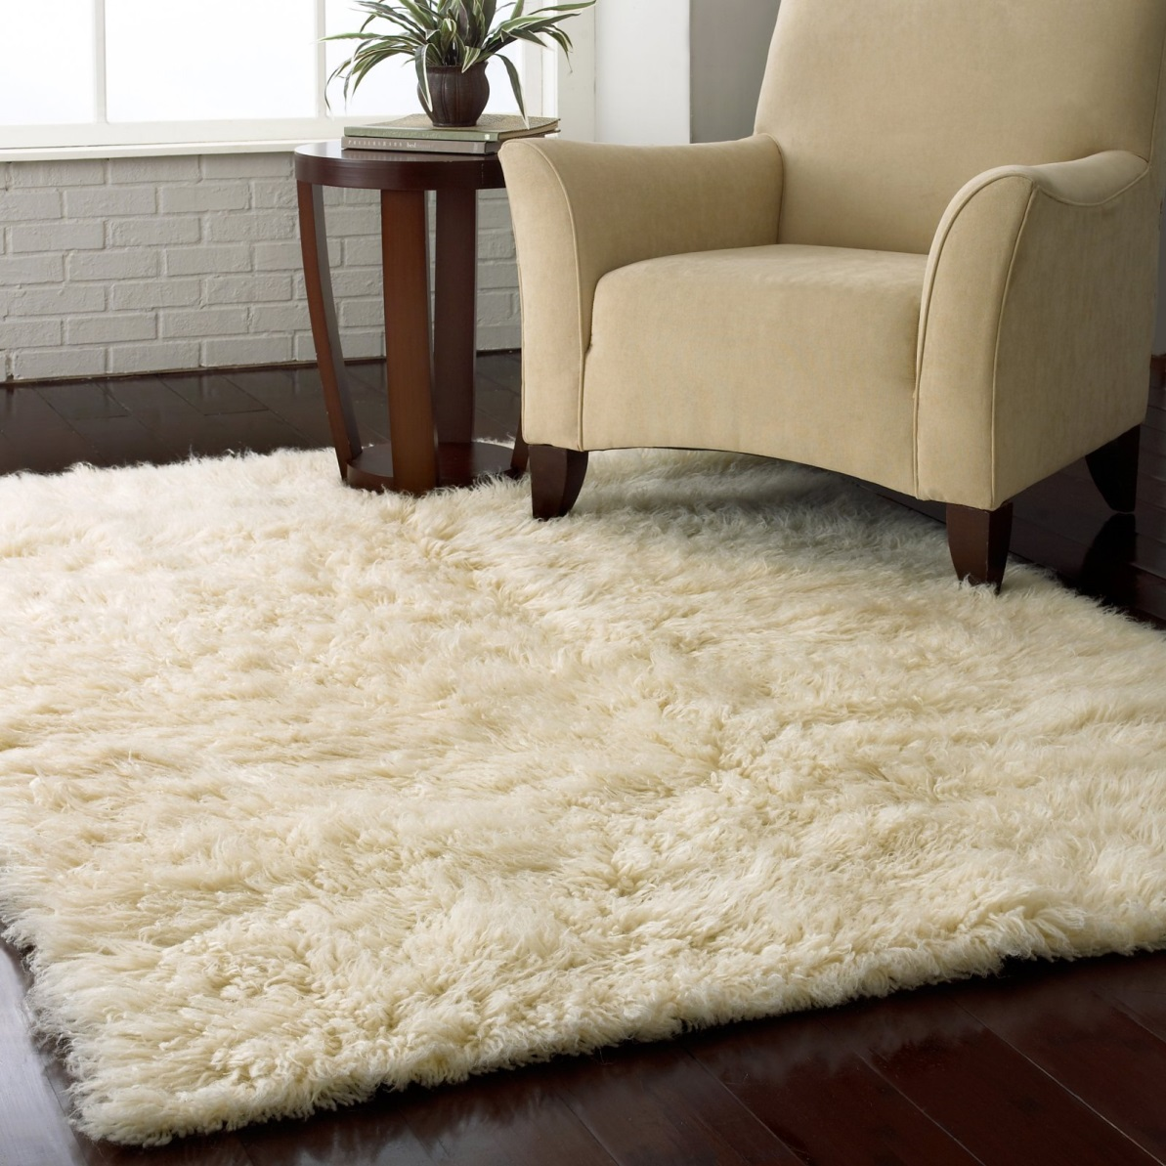
Words for Texture/Appearance
a shaggy rug

Slide 22
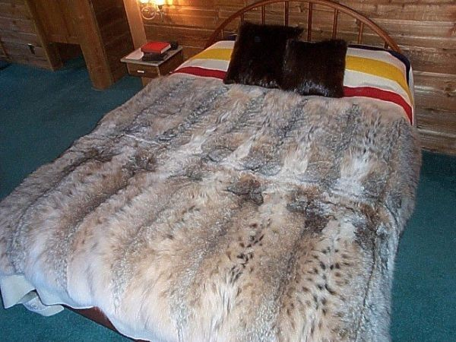
Words for Texture/Appearance
a striped sheet
furry cushions
a furry blanket

Slide 23
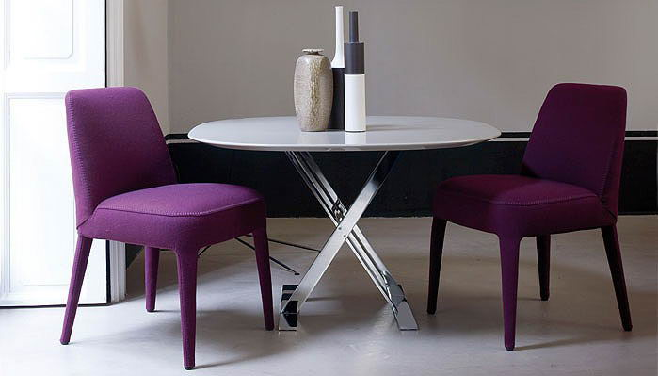
Words for Texture/Appearance
cushioned chairs

Slide 24
Order of Adjectives
1. Opinion (good, bad, strange, lovely)
2. Measurement (big, small, tiny, huge)
3. Shape (curved, straight, round, square)
4. Condition (wet, dry, clean, sad, happy)
5. Age (old, young, new, ancient)
6. Color (red, yellowish, transparent, blue)
7. Pattern (checked, striped, plaid, flowered)
8. Origin (American, British, eastern, western)
9. Material (wooden, plastic, steel, cloth)
10. Purpose (sleeping, shopping, work, gardening)

Slide 25
Add colors to make your descriptions better. The more details you give, the better picture the listener will have.

Slide 26
Write 5 things that are in your home. Use 3 adjectives. You may use adjectives we didn’t learn if you know others. * Don’t forget to use the correct order of adjectives.

Slide 27
Professor Jennifer’s Home
an old square black oven
a heavy white marble table
two large white cushioned chairs
a tiny rectangular rock-hard bed
a beautiful smooth black piano

