Slide 1
What might you do if…?

Slide 2
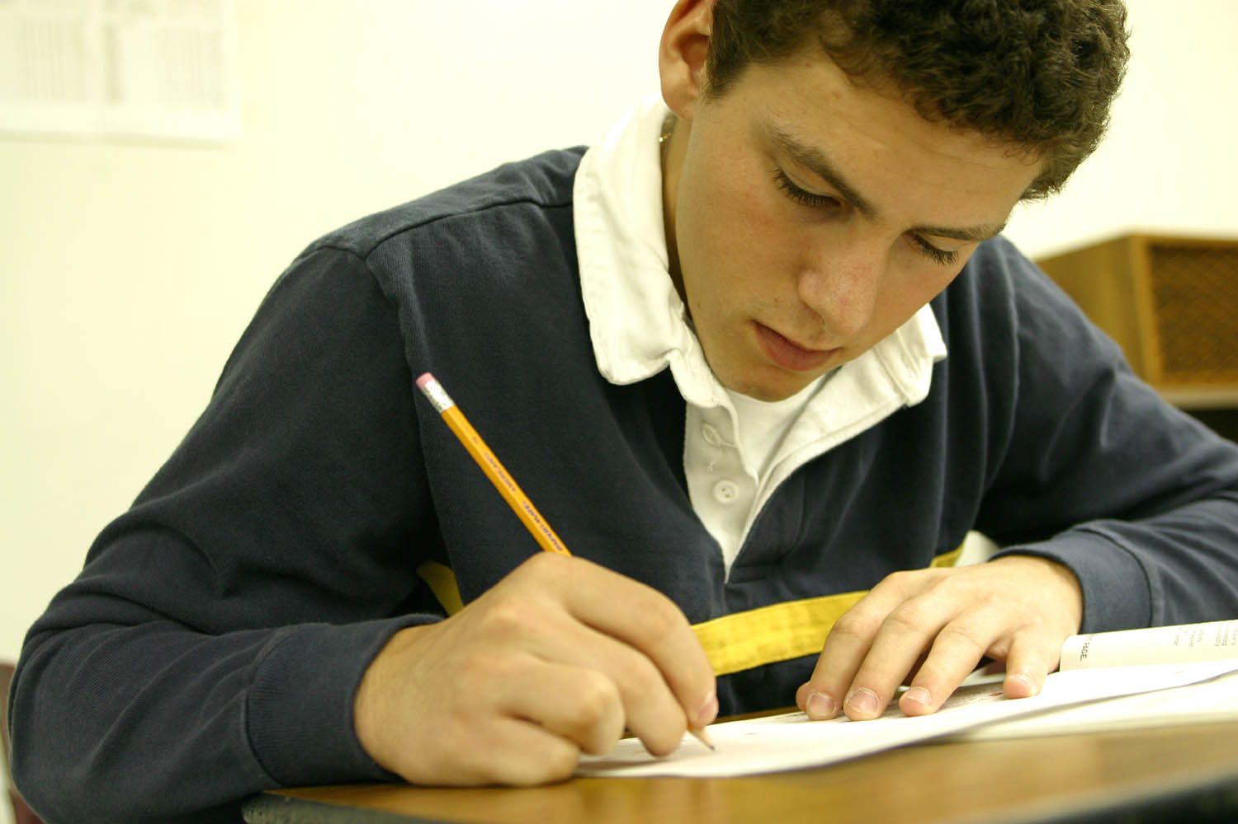
He might celebrate if he passes the test.

Slide 3
He might get drunk if he doesn’t pass the test.

Slide 4
He might not get a scholarship if he fails the test.

Slide 5
She might scrape her leg if she falls down.

Slide 6
If it’s delicious, he might win her heart.

Slide 7
If she doesn’t sleep soon, she might not wake up in time for work.

Slide 8
If he doesn’t drive carefully, he might crash.

Slide 9
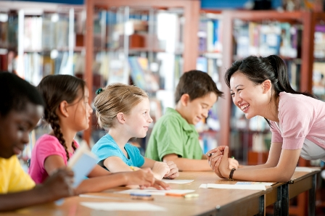
The teacher might give the students some candy if they study hard.

Slide 10
The next 5 pictures are for the Unit 12 Quiz. Look at them and think about them before the quiz.

Slide 11
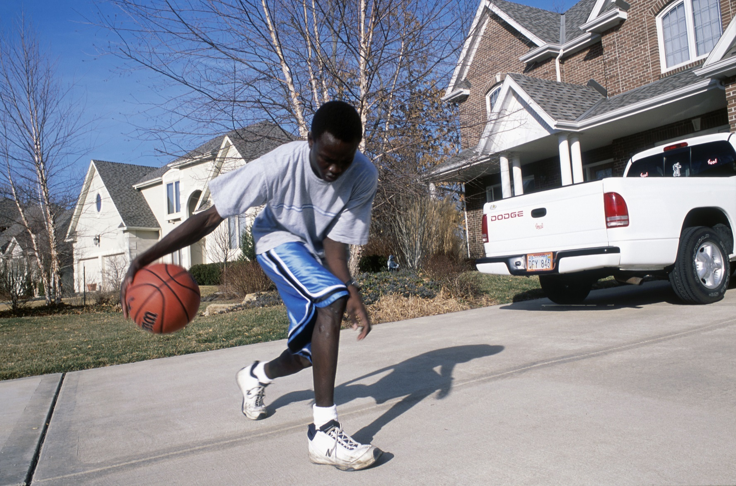

Slide 12
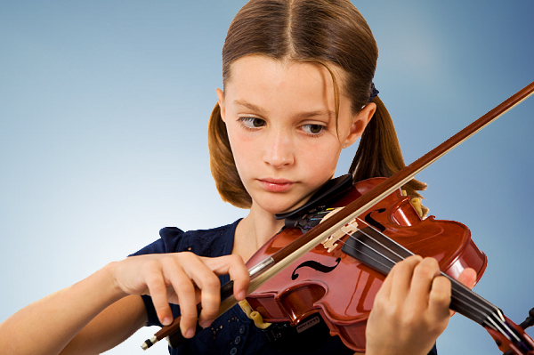

Slide 13
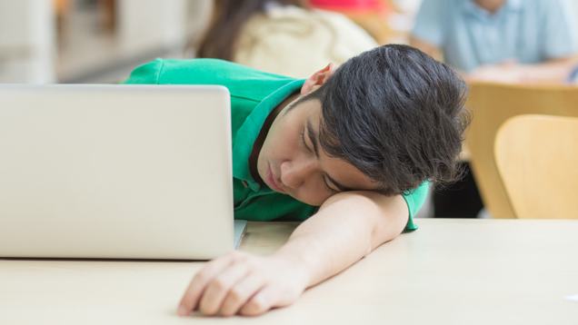

Slide 16
- Your Turn -

Slide 17
Answer each question using will or might. Use both a main clause and an IF clause.

Slide 18
What will you do if you pass Level 4?
What might you do if North and South Korea unite?
What might you eat if you go to Lotteria?

Slide 19
What won’t you do if it rains this weekend?
How might you feel if you move to another country?

Slide 20
The next 5 questions are for the Unit 12 Quiz. Read them and think about them before the quiz.

Slide 21
Where will you go if you go to Europe?
What might you do if you go to Everland?
What won’t you do if you go to the Blue House?

Slide 22
Who might you see if you visit Hollywood?
How many kids might you have if you get married?

